Slide 1
Language Models and Brain Alignment: Brain Encoding and Decoding
Subba Reddy Oota^{1,2,3}, Raju S. Bapi⁴
¹Inria Bordeaux, France; ²MPI for Software Systems, Germany; ³TU Berlin, Germany,
⁴IIIT Hyderabad, India;
Subba.reddy.oota@tu-berlin.de, raju.bapi@iiit.ac.in
CODS COMAD 2024: DL for Brain Encoding and Decoding

Slide 2
Agenda
Neuro-AI alignment: Introduction [1 hour 30 min]
Introduction to Brain encoding and decoding [30 min]
Types of Brain Recordings [15 min]
Types of Stimulus Representations [15 min]
Methodology [30 min]
Coffee break [30 min]
Language and Brain: Deep Learning for Brain Encoding and Decoding [1 hour 30 min]
Linguistic Brain Encoding [60 min]
Encoding schema
Pretrained language models and brain alignment
Challenges in using DL for cognitive science
Linguistic Brain Decoding [15 min]
Multimodal Brain Encoding [15 min]
CODS COMAD 2024: DL for Brain Encoding and Decoding

Slide 3
Agenda
Neuro-AI alignment: Introduction [1 hour 30 min]
Introduction to Brain encoding and decoding [30 min]
Types of Brain Recordings [15 min]
Types of Stimulus Representations [15 min]
Methodology [30 min]
Coffee break [30 min]
Language and Brain: Deep Learning for Brain Encoding and Decoding [1 hour 30 min]
Linguistic Brain Encoding [60 min]
Encoding schema
Pretrained language models and brain alignment
Task-based language models and brain alignment
Disentangling Syntax and Semantics
Linguistic Brain Decoding [15 min]
Multimodal Brain Encoding [15 min]
CODS COMAD 2024: DL for Brain Encoding and Decoding

Slide 4
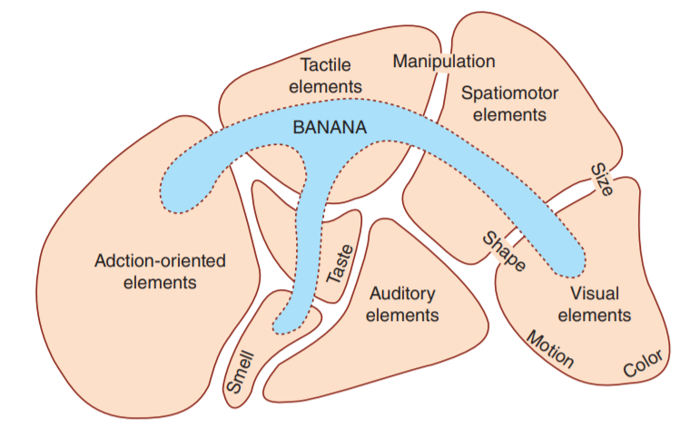
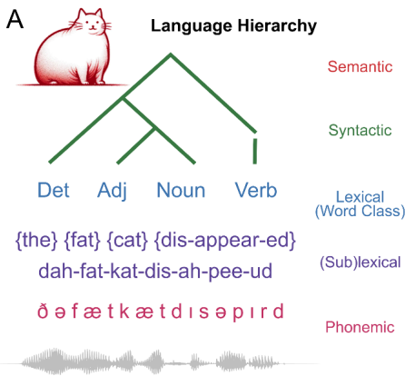
Mechanistic understanding of language processing in the brain: four big questions
What
When
Where
How
[Fedorenko et al. 2010, 2014]
Gwilliams et al. 2024
Notes:
Fundamental questions about what information is processed where, when, and how in the brain

Slide 5
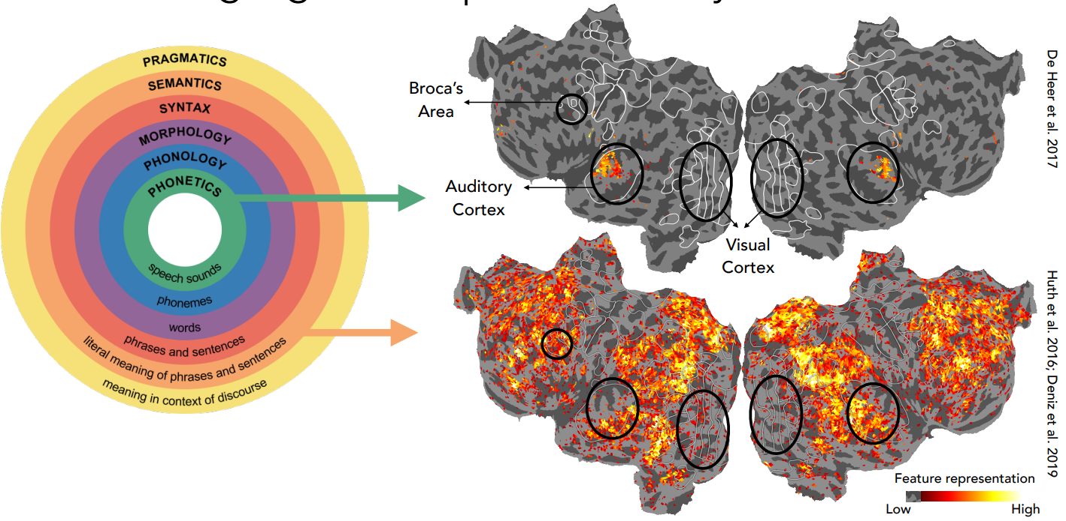
Natural language is composed of many different features
Source: Slide from Fatma Deniz’s talk at NEAT-24 workshop
What features of the language stimulus drive the response in each brain area?

Slide 6
Typical studies of language processing with controlled experiments
How the human brain computes and encodes syntactic structures?
Syntax: how do words structurally combine to form sentences and meaning?
Controlled experiments
Structured complex sentence
Word lists
I believe that you should accept the proposal of your new associate
thing very tree where of watching copy tensed they states heart plus
Pallier et al. 2011
CODS COMAD 2024: DL for Brain Encoding and Decoding
Notes:
controlled experiments that design artificial stimuli to separate the brain activation
such as comparing structured complex sentences or phrases with word lists
many valuable findings and have identified several brain regions, including the left temporal lobe and the left frontal lobe, that are involved in syntactic structure building
However, as designing artificial stimuli can only separate situations with or without structurebuilding

Slide 7
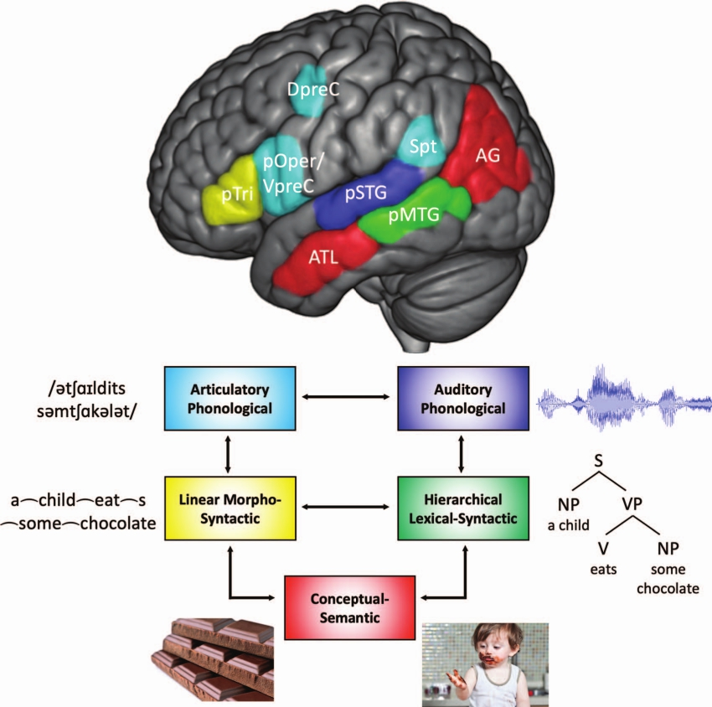
Language organization in the brain
Controlled experiments are task-based and not ecological
Brain process language at different features
Hierarchical syntactic information occurs in the cortical zone situated between auditory-phonological and semantic zones.
Matchin & Hickok et al. 2022
CODS COMAD 2024: DL for Brain Encoding and Decoding

Slide 8
Designing a functional MRI experiment: watching movies
Source: Video from Gallant Lab
CODS COMAD 2024: DL for Brain Encoding and Decoding

Slide 9
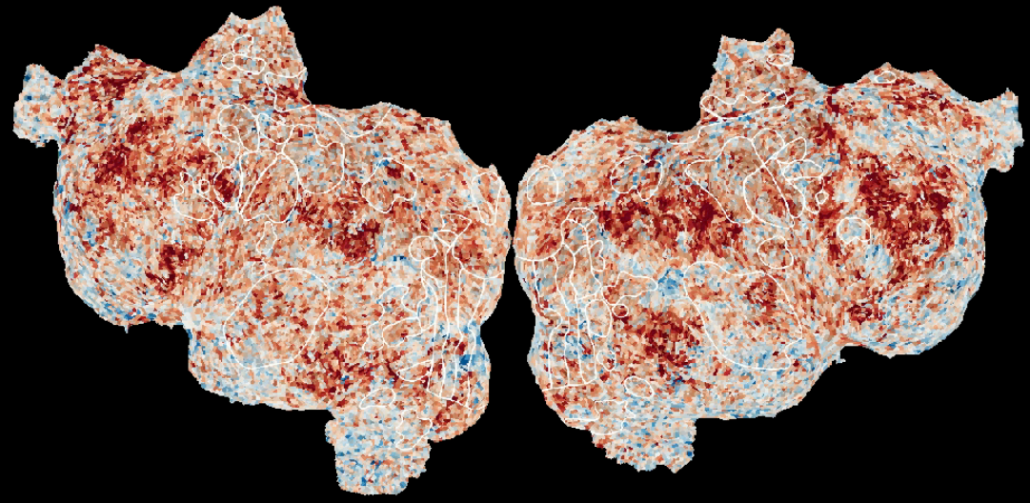
What are we talking about when we talk about “mapping stimulus to the human brain”
Do representations differ when you read a book in different languages?
Do concept representations differ across modalities?
How do we perceive the words?
Where in the brain is word meaning represented?
Do representations differ when you read or listen to a book?
How does the brain combine multiple words across different timescales ?
What is the shared and unique information explained by each modality?
Do representations differ when we learn new languages?
(words —> sentences —> paragraphs)
CODS COMAD 2024: DL for Brain Encoding and Decoding

Slide 10
Deep learning models enable data-driven encoding models for naturalistic stimuli
DeepMind’s New AI Taught Itself to Be the World’s Greatest Go Player
Singularity Hub
Meet GPT-3. It Has Learned to Code (and Blog and Argue)
The New York Times

Slide 11
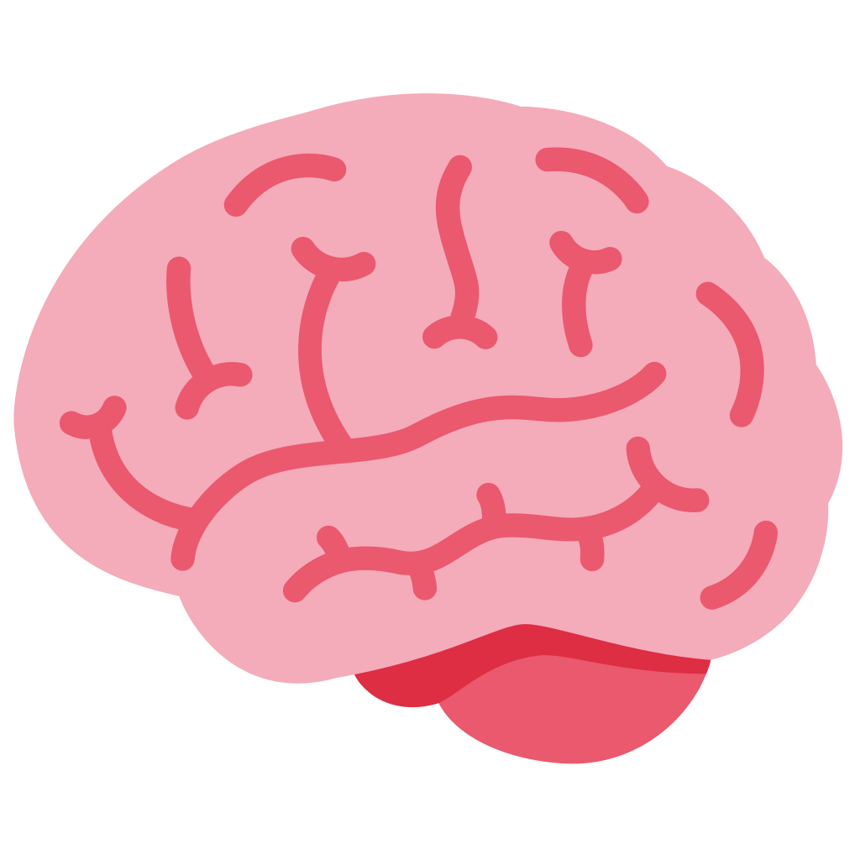
Increasingly available open source ecological stimuli datasets
With advancement of ecological stimuli datasets and open source language models, recent studies looked at interesting open questions?
?
?
Is the “how” of the NLP system process language comprehension the same as “how” of the brain process language comprehension?
How is information aggregated by the brain during language comprehension?
Deniz et al. 2019
Nastase et al. 2021
Li et al. 2022
Lebel et al. 2022
Zhang et al. 2021
Notes:
ecological stimuli -> reading books, listening to stories, watching a movie
The properties of the stimulus that affect brain activity are increasing, so simple representations of the stimuli capture less variance of the brain activity
Meanwhile we have huge progress in deep learning in the last 10 years that gives us AI models that can do many tasks. Of course they are not perfect, and are sometimes flawed, but there is the question of whether we can use their internal representations of the world as rich stimulus representations that perhaps capture some of the properties that are also relevant for the processing in the brain.
Here comes to encoding model

Slide 12
How closely do LLM capabilities relate to those of the human brain?
?
Another language processing system
LLM
?
1: methods to estimate alignment
2: neuroscience background
3: works on alignment between LLMs and brains, and reasons for alignment
4: works on reasons for alignment, and on improving alignment
Questions very much encouraged!!
CODS COMAD 2024: DL for Brain Encoding and Decoding

Slide 13
Agenda
Neuro-AI alignment: Introduction [1 hour 30 min]
Introduction to Brain encoding and decoding [30 min]
Types of Brain Recordings [15 min]
Types of Stimulus Representations [15 min]
Methodology [30 min]
Coffee break [30 min]
Language and Brain: Deep Learning for Brain Encoding and Decoding [1 hour 30 min]
Linguistic Brain Encoding [60 min]
Encoding schema
Pretrained language models and brain alignment
Challenges in using DL for cognitive science
Linguistic Brain Decoding [15 min]
Multimodal Brain Encoding [15 min]
CODS COMAD 2024: DL for Brain Encoding and Decoding

Slide 14
Deep neural networks and brain alignment: brain encoding and decoding
Multimodal ecological stimulus
Deep learning system
A priori locations in DL system and brain
Data-driven encoding model
how are they related?
fMRI
Wehbe et al. 2014,
Jain and Huth 2018,
Gauthier and Levy 2019
Toneva and Wehbe 2019,
Caucheteux et al. 2020,
Toneva et al. 2020
Jain et al. 2020,
Schrimpf et al. 2021,
Goldstein et al. 2022
...
CODS COMAD 2024: DL for Brain Encoding and Decoding

Slide 15
General encoding pipeline to evaluate brain-LM alignment
language model (LM)
a priori locations in NLP system and brain
“Harry never thought
he would ...”
Learn function
𝑥 alignment
~5000 words
fMRI
Test how well predicts unseen brain recordings
Brain alignment of a LM ⇒ how similar its representations are to a human brain’s
Wehbe et al. 2014,
Jain and Huth 2018,
Gauthier and Levy 2019
Toneva and Wehbe 2019,
Caucheteux et al. 2020,
Toneva et al. 2020
Jain et al. 2020,
Schrimpf et al. 2021,
Goldstein et al. 2022
...
CODS COMAD 2024: DL for Brain Encoding and Decoding

Slide 16
LLMs, estimating alignment, evaluation
language model
a priori locations in NLP system and brain
“Harry never thought
he would ...”
Learn function
𝑥 alignment
~5000 words
fMRI
Test how well predicts unseen brain recordings
CODS COMAD 2024: DL for Brain Encoding and Decoding

Slide 17
Part 1: LLMs + extracting representations
language model
a priori locations in NLP system and brain
“Harry never thought
he would ...”
Learn function
𝑥 alignment
~5000 words
fMRI
Test how well predicts unseen brain recordings
CODS COMAD 2024: DL for Brain Encoding and Decoding

Slide 18
LLMs, estimating alignment, evaluation
language model
a priori locations in NLP system and brain
“Harry never thought
he would ...”
Learn function
𝑥 alignment
~5000 words
fMRI
Test how well predicts unseen brain recordings
CODS COMAD 2024: DL for Brain Encoding and Decoding

Slide 19
Estimating brain-LM alignment + evaluation
language model
a priori locations in NLP system and brain
“Harry never thought
he would ...”
Learn function
𝑥 alignment
~5000 words
fMRI
Test how well predicts unseen brain recordings
CODS COMAD 2024: DL for Brain Encoding and Decoding

Slide 20
Agenda
Neuro-AI alignment: Introduction [1 hour 30 min]
Introduction to Brain encoding and decoding [30 min]
Types of Brain Recordings [15 min]
Types of Stimulus Representations [15 min]
Methodology [30 min]
Coffee break [30 min]
Language and Brain: Deep Learning for Brain Encoding and Decoding [1 hour 30 min]
Linguistic Brain Encoding [60 min]
Encoding schema
Pretrained language models and brain alignment
Challenges in using DL for cognitive science
Linguistic Brain Decoding [15 min]
Multimodal Brain Encoding [15 min]
CODS COMAD 2024: DL for Brain Encoding and Decoding

Slide 21
Pretrained language models and brain alignment
Comparison of semantic feature spaces from PLMs with traditional word embeddings
CODS COMAD 2024: DL for Brain Encoding and Decoding

Slide 22
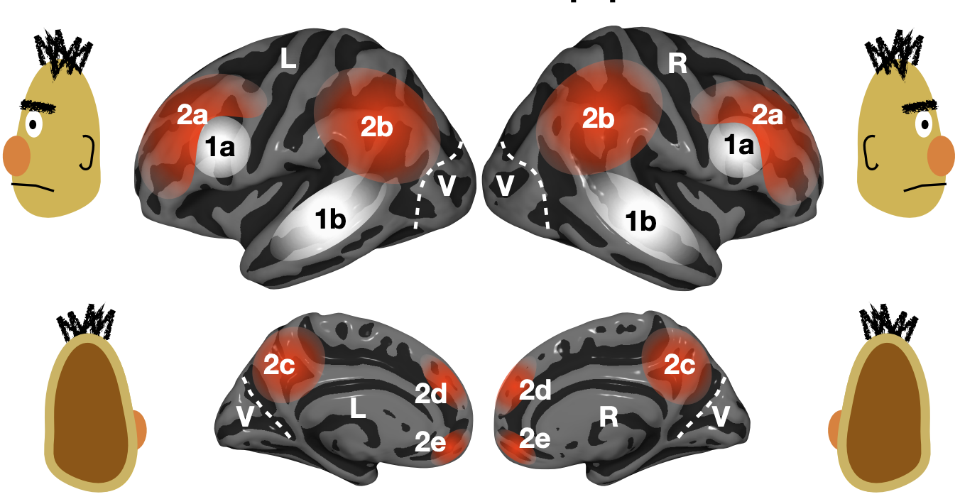
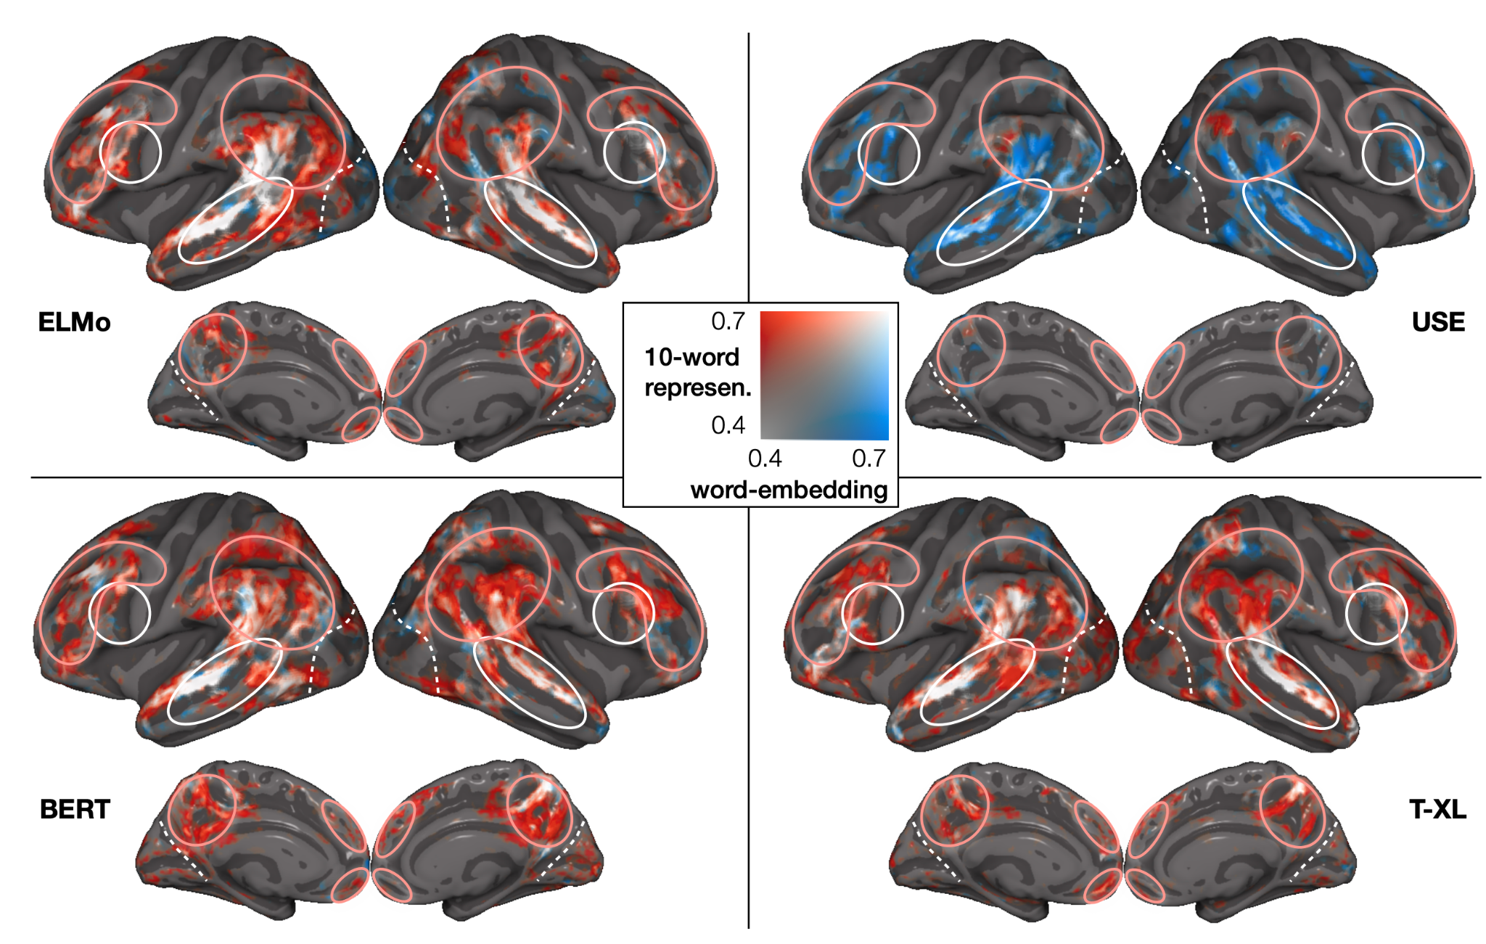
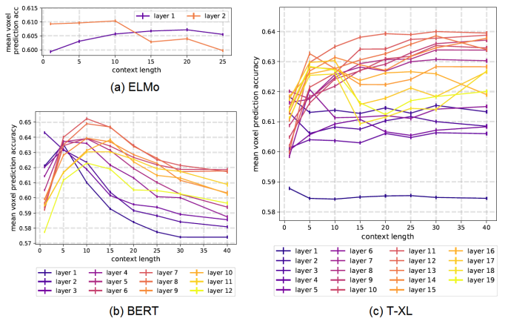
Language: work utilizing DL progress
Stimuli: one chapter of Harry Potter
Stimulus representation: derived from pretrained NLP systems
Brain recording & modality: fMRI, reading
across several types of large NLP systems, best alignment with fMRI in middle layers
Toneva, M., & Wehbe, L. (2019). Interpreting and improving natural-language processing (in machines) with natural language-processing (in the brain). Advances in Neural Information Processing Systems, 32.

Slide 23
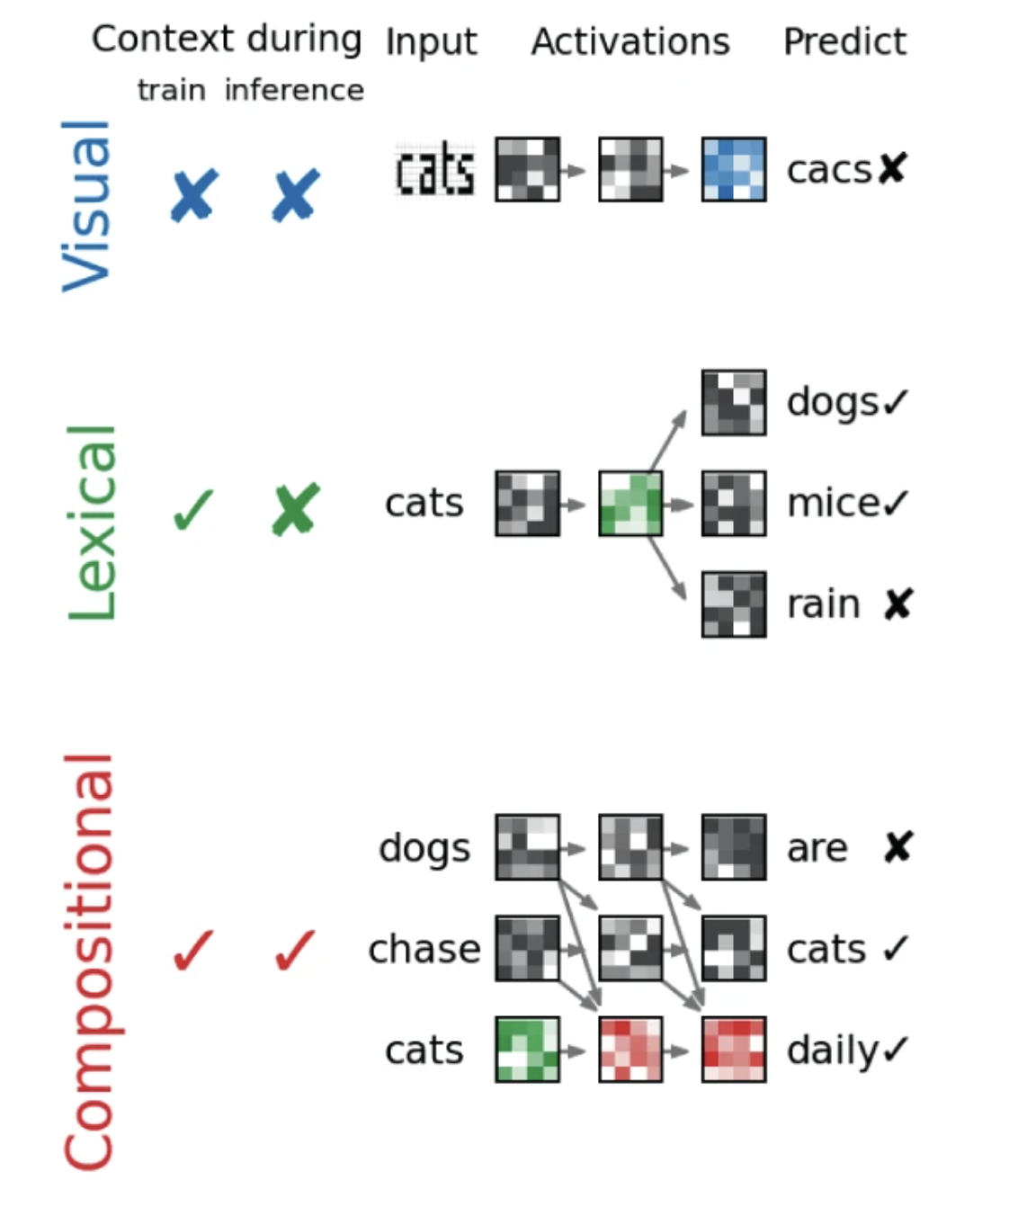
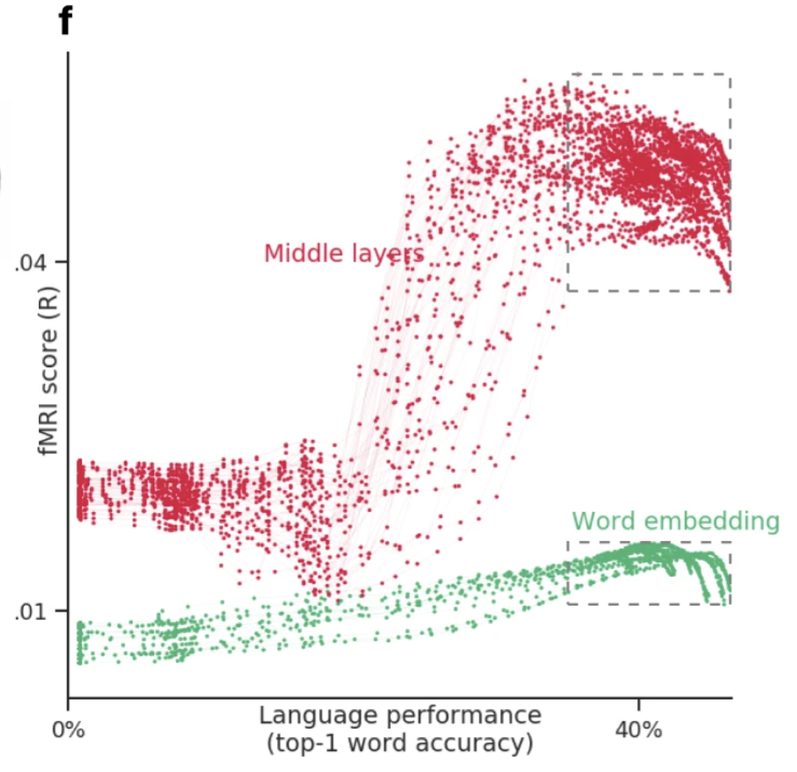
Language: work utilizing DL progress
best alignment with fMRI & MEG in middle layers
better performance at predicting next word -> better prediction of fMRI & MEg
Stimuli: sentences
Stimulus representation: derived from pretrained NLP systems
Brain recording & modality: MEG & fMRI, reading
Caucheteux, Charlotte, and Jean-Rémi King. "Brains and algorithms partially converge in natural language processing." Communications biology 5, no. 1 (2022): 1-10.

Slide 24
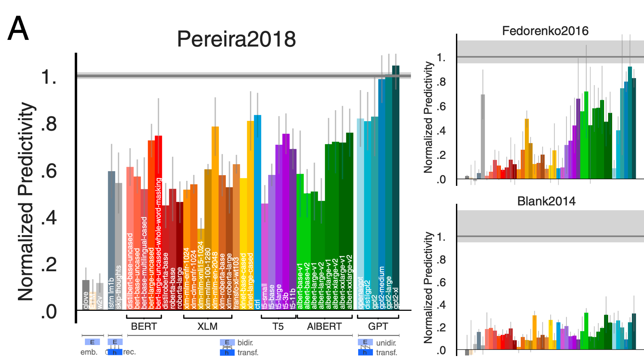
Language: work utilizing DL progress
Stimuli: sentences, passages, short story
Stimulus representation: derived from pretrained NLP systems (BERT, GPT-2, T5 , and XLM)
Brain recording & modality: fMRI & ECoG, reading & listening
some NLP systems can predict fMRI and ECoG up to 100% of estimated noise ceiling
Schrimpf, Martin, Idan Asher Blank, Greta Tuckute, Carina Kauf, Eghbal A. Hosseini, Nancy Kanwisher, Joshua B. Tenenbaum, and Evelina Fedorenko. "The neural architecture of language: Integrative modeling converges on predictive processing." Proceedings of the National Academy of Sciences 118, no. 45 (2021): e2105646118.
Notes:
The datasets varied in the imagingmodality (fMRI/ECoG), the nature of the materials (uncon-nected sentences/passages/stories), the grain of linguistic unitsto which responses were recorded (sentences/words/2-s-longstory fragments), and presentation modality (reading/listening).
We find that the most powerful models predict neural and behavioral responses across different datasets up to noise levels. Models that perform better at predicting the next word in a sequence also better predict brain measurements
Next-word-prediction task performance is predictive of reading times
Brain scores correlate with behavioral scores

Slide 25
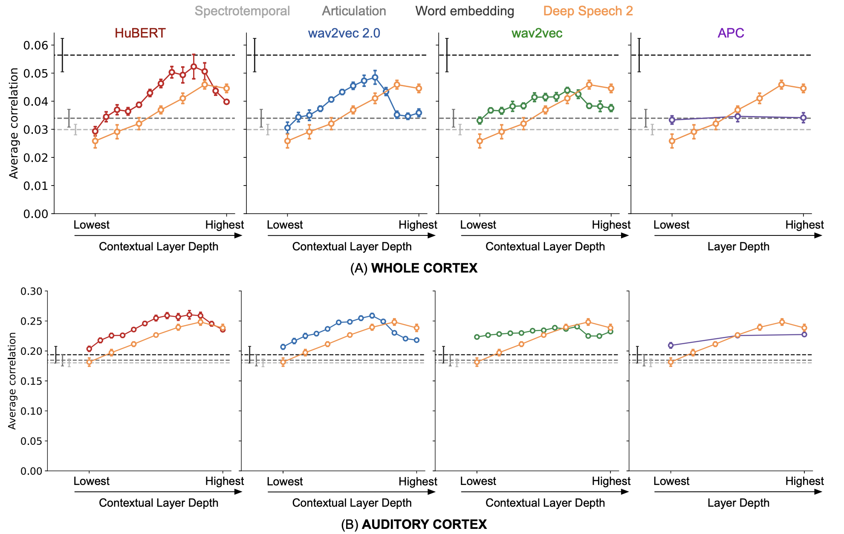
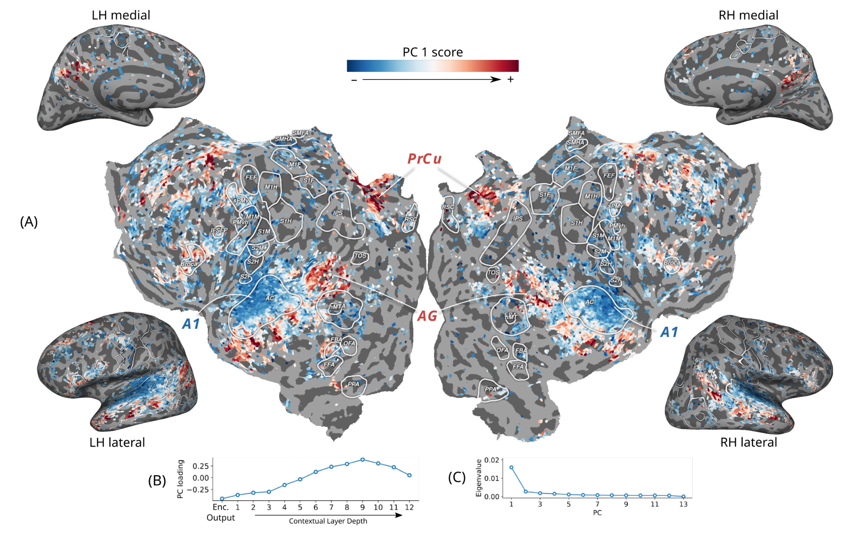
Audio: work utilizing DL progress
Stimuli: Moth Radio Hour
Stimulus representation: derived from pretrained self-supervised speech models
Brain recording & modality: fMRI, listening
Middle layers of self-supervised speech models predict auditory cortex the best
Vaidya, Aditya R., Shailee Jain, and Alexander G. Huth. "Self-supervised models of audio effectively explain human cortical responses to speech." ICML (2022).

Slide 26
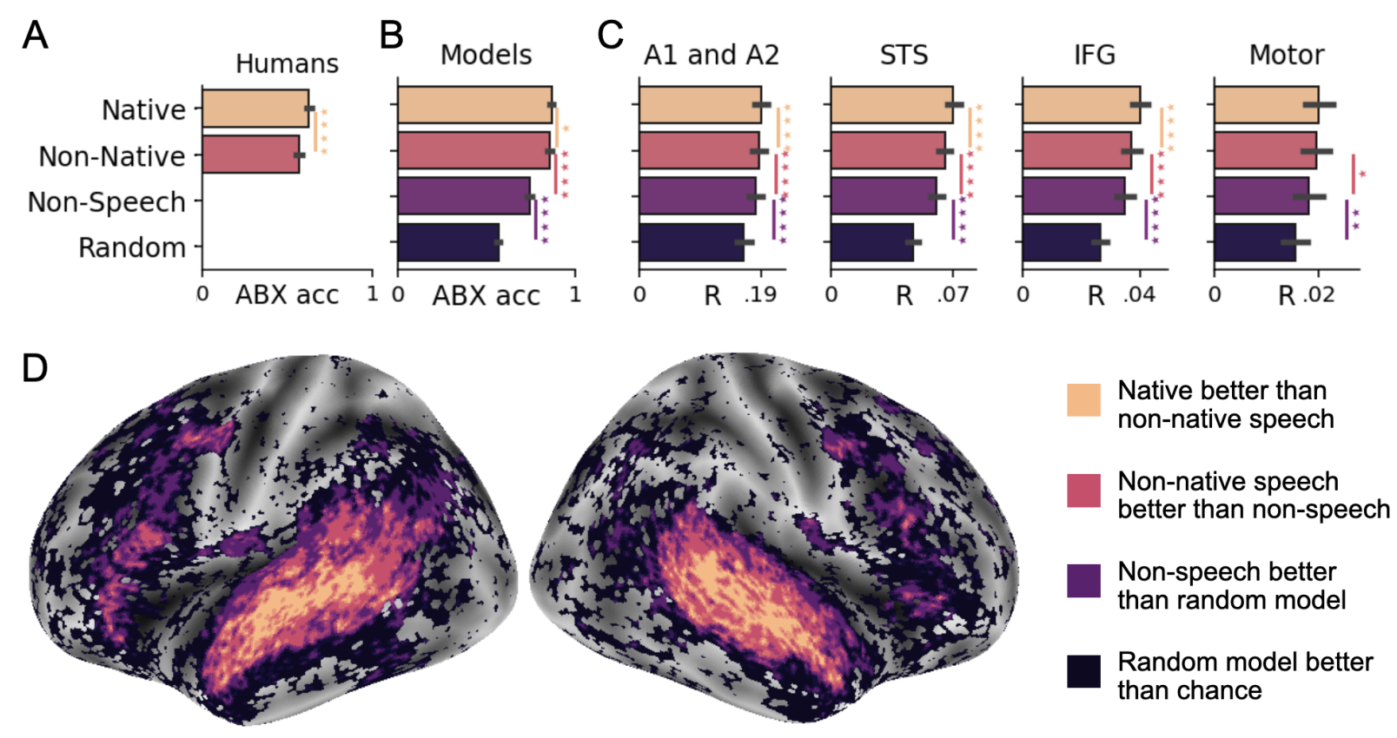
Audio: work utilizing DL progress
Stimuli: audio books
Stimulus representation: derived from pretrained self-supervised speech model
Brain recording & modality: fMRI, listening in 3 languages (Eng, Fr, Mandarin)
Self-supervised speech models reveal specialization for native sounds in the STS and MTG;
IFG and AG show more general specialization for speech rather than native-language
Millet, Juliette, Charlotte Caucheteux, Pierre Orhan, Yves Boubenec, Alexandre Gramfort, Ewan Dunbar, Christophe Pallier, and Jean-Remi King. "Toward a realistic model of speech processing in the brain with self-supervised learning." arXiv preprint arXiv:2206.01685 (2022).

Slide 27
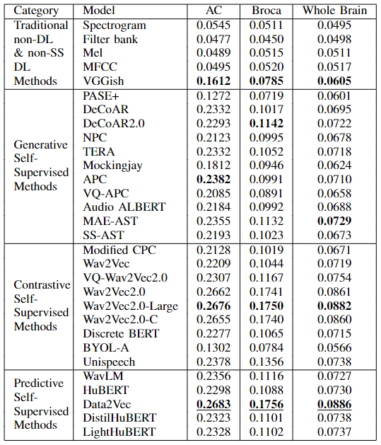
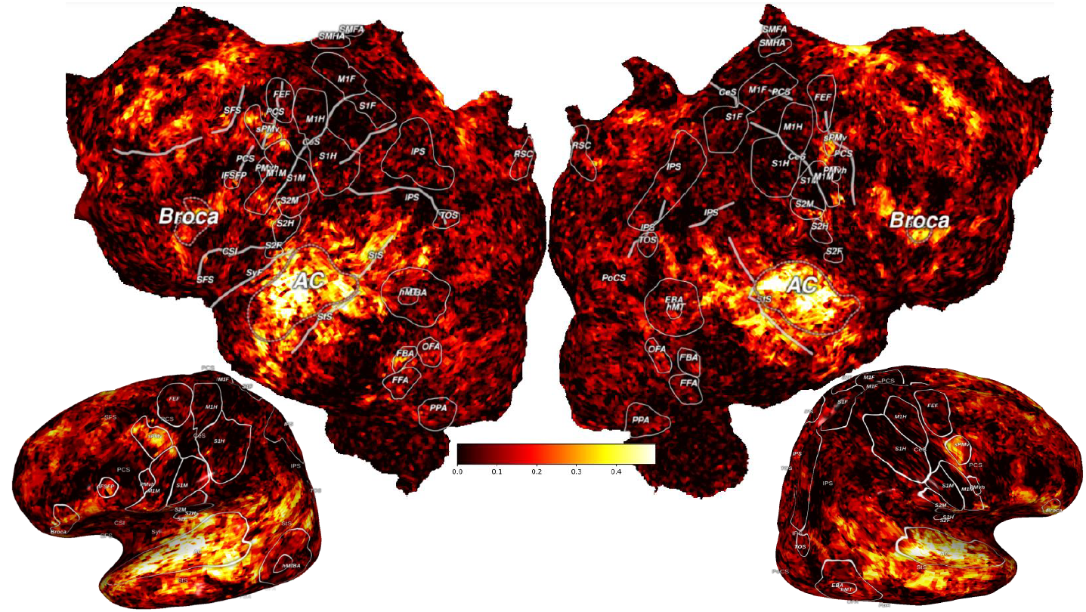
Audio: work utilizing DL progress
Contrastive and predictive models encode the information better than the generative and the traditional low-level acoustic baselines, and VGGish models.
Stimuli: Moth-Radio-Hour
Stimulus representation: derived from 5 basic + 25 pretrained self-supervised speech models
Brain recording & modality: fMRI
Data2Vec
Subba Reddy Oota, Khushbu Pahwa, Mounika Marreddy, Manish Gupta, and Bapi S. Raju. "Neural architecture of speech" ICASSP-2023
Notes:
Does the model show commonalities merely with general auditory processing in the brain, or does it capture speech-specific processing? If so, does it show commonalities with brain representations that are specific to the native language of the participants, or merely to general speech processing? We first evaluate the specialization of humans’ perception to their native language using an ABX behavioral task (Section 2.4). Specifically, we compare 386 French and English participants on their ability to distinguish native and non-native phones. As expected Bohn [2017], Kuhl et al. [2005], participants were better at discriminating native sounds than non-native ones (across phone pairs: p < 10−18, Figure 4-A). Second, applying the same test to our self-supervised French and English models shows that, like humans, models best discriminate sounds from their ‘native’ language (i.e., the French model better distinguishes French stimuli than English ones, across phone pairs, and vice versa: p < 0.05). Finally, the random and acoustic models obtain the worst ABX accuracy. These results confirm that 600 h of self-supervised learning suffices for Wav2Vec 2.0 to learn language-specific representations (Figure 4-B).
Wav2Vec 2.0 and the brain learn language specific representations. Next, we compare the Neural Predictivity scores of random, non-speech, non-native and native models (Figure 4-C D). First, our results show that the non-speech model attains higher R scores than the random model (on average across voxels, ∆R = 0.006, p=10−31) confirming the importance of learning to generate brain-like representations. Second, non-native models attain higher R scores than the non-speech model (∆R = 0.002, p = 10−9 ), confirming that Wav2Vec 2.0 learns speech-specific representations of sounds when trained on speech. Finally, the native model attains higher R scores than non-native models (∆R = 0.002, p = 10−15). The specialization for native sounds shared between models and the brain appears to be mainly localized around the superior temporal sulcus and the middle temporal gyrus (Figure 4-D), whereas higher-level regions like IFG and the angular gyrus only show more general specializations (i.e., speech rather than native-language sounds).

Slide 28
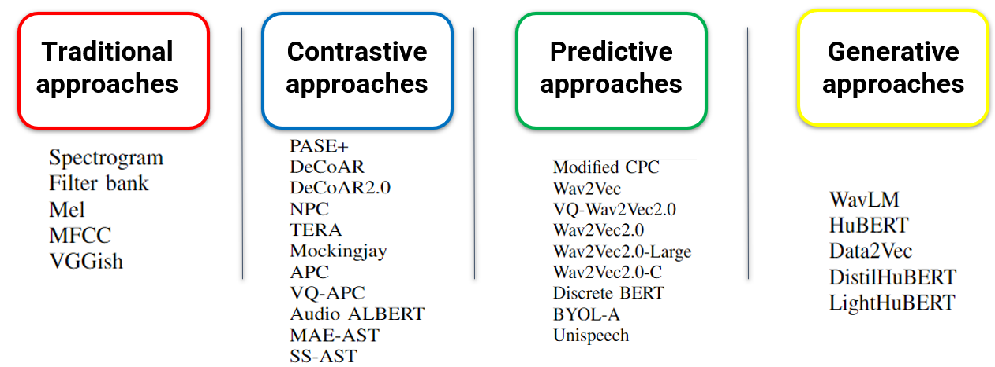
Neural Architecture of Speech
Stimuli: Moth Radio Hour
Stimulus representation: 25 SSL speech models and 5 low-level speech descriptors
Brain recording & modality: fMRI, Listening
Subba Reddy Oota; Khushbu Pahwa; Mounika Marreddy; Manish Gupta; Bapi S. Raju. "Neural Architecture of Speech." ICASSP 2023.
Notes:
In this study, we propose novel multi-dimensional features that encode information about the syntactic structure of sentences.
First, we find that our syntactic structure-based features explain additional variance in the brain activity of various parts of the language system, even after controlling for complexity metrics that capture processing load.
At the same time, we see that regions well-predicted by syntactic features are distributed in the language system and are not distinguishable from those processing semantics.

Slide 29
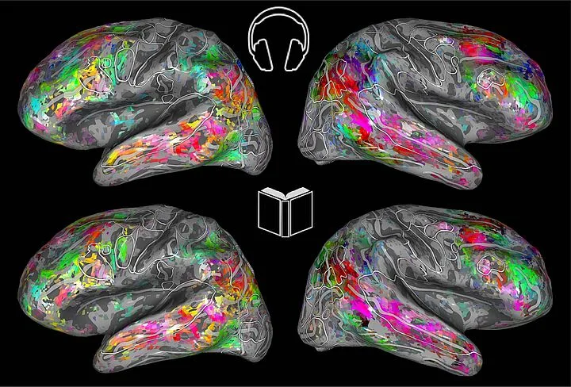
Aspects of NLP models and Brain datasets
Stimuli: Narrative Stories
Stimulus representation: pretrained NLP model and speech models
Brain recording & modality: fMRI, Reading, Listening
Questions: Is the choice of stimulus modality (reading vs. listening) important for the study of brain alignment?
Are all naturalistic fMRI datasets equally good for brain encoding?
How does the type of model (text vs. speech and encoder vs. decoder) affect the resulting alignment?
Text models predict fMRI recordings significantly better than speech models
Oota, Subba Reddy, Gupta, Manish and Toneva, Mariya. "Joint processing of linguistic properties in brains and language models." 2022 arXiv.
Notes:
In this study, we propose novel multi-dimensional features that encode information about the syntactic structure of sentences.
First, we find that our syntactic structure-based features explain additional variance in the brain activity of various parts of the language system, even after controlling for complexity metrics that capture processing load.
At the same time, we see that regions well-predicted by syntactic features are distributed in the language system and are not distinguishable from those processing semantics.

Slide 30
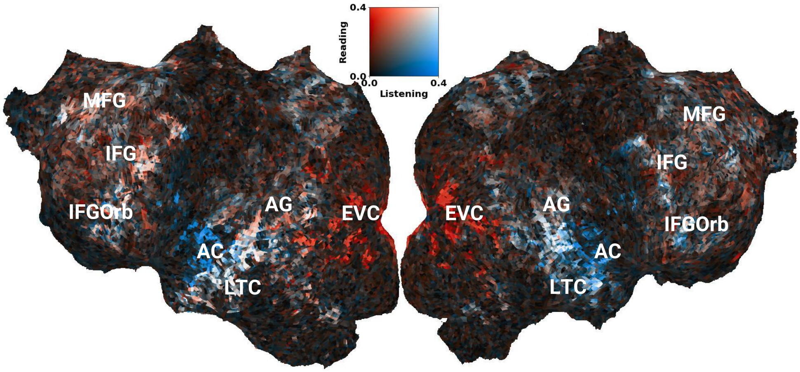
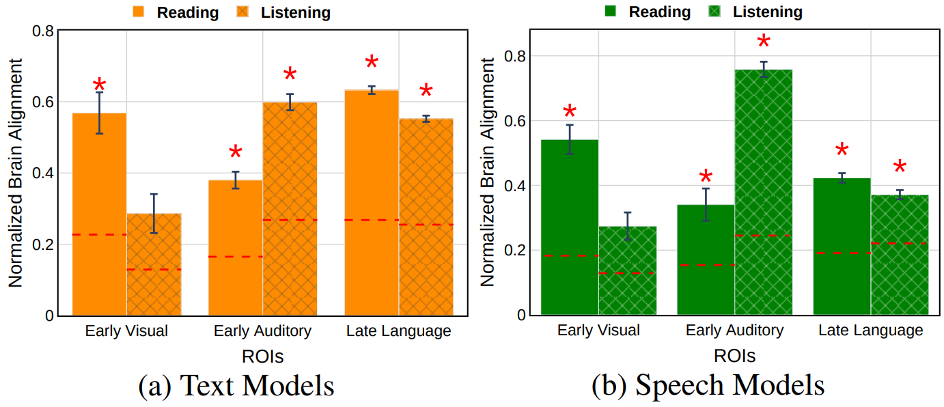
Text- vs. Speech-based language models : brain alignment
Stimuli: Subset-Moth-Radio-Hour
Stimulus representation: pretrained NLP models and speech models
Brain recording & modality: fMRI, Reading, Listening
Late language regions: Both types of models show high brain alignment with late language regions, but speech models trails behind text models
Highly predict early visual and auditory areas.
Subba Reddy Oota, Emin Çelik, Fatma Deniz, Mariya Toneva. Speech language models lack important brain-relevant semantics. ACL 2024.
Notes:
In this study, we propose novel multi-dimensional features that encode information about the syntactic structure of sentences.
First, we find that our syntactic structure-based features explain additional variance in the brain activity of various parts of the language system, even after controlling for complexity metrics that capture processing load.
At the same time, we see that regions well-predicted by syntactic features are distributed in the language system and are not distinguishable from those processing semantics.

Slide 31
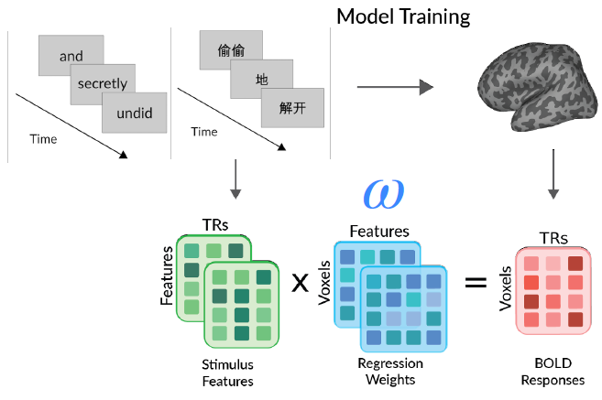
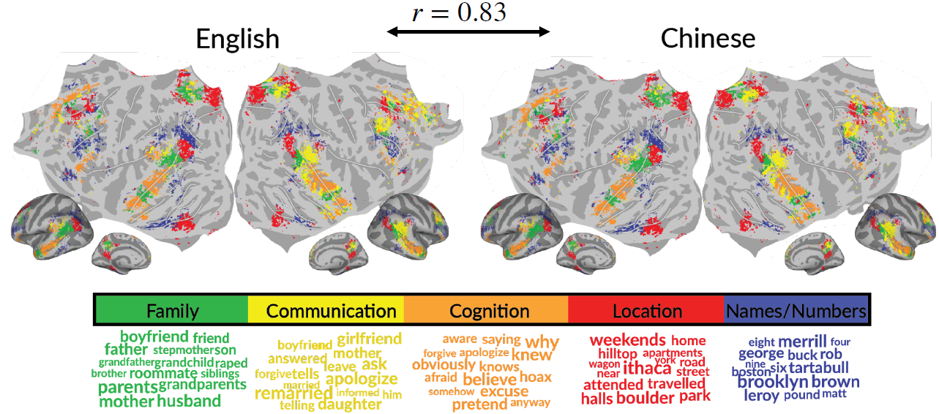
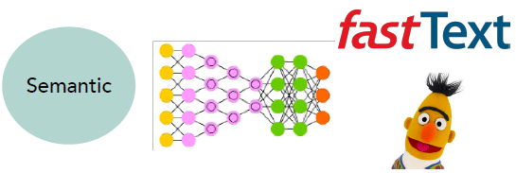
English- vs. Chinese: Bilingual language processing
Stimuli: Bilingual-Moth-Radio-Hour (Chinese and English)
Stimulus representation: facebook FastText model
Brain recording & modality: fMRI, Reading
Semantic representations are largely shared across languages
Catherine Chen, Xue L. Gong, Christine Tseng, Daniel L. Klein, Jack L. Gallant, Fatma Deniz. "Bilingual Language Processing Relies on Shared Semantic Representations that are Modulated by Each Language" 2024 arXiv.
Notes:
In this study, we propose novel multi-dimensional features that encode information about the syntactic structure of sentences.
First, we find that our syntactic structure-based features explain additional variance in the brain activity of various parts of the language system, even after controlling for complexity metrics that capture processing load.
At the same time, we see that regions well-predicted by syntactic features are distributed in the language system and are not distinguishable from those processing semantics.

Slide 32
Conclusions for neuro-AI research field
Use 🧠 to evaluate how well representations from 🔤 (static vs. recurrent vs. pretrained) can predict representations of the 🧠 during language comprehension
Speech models (🔊) useful for modeling early listening (🎧): investigate speech models to learn more about AC
Text models (🔤) useful for modeling language processing in both 🎧 and 📖
Semantic representations are independent of the modality (📖 or 🎧) and distributed across language regions
Across several types of pretrained language models, best alignment with fMRI/MEG in middle layers
Text models (🔤) predict fMRI recordings significantly better than speech models (🔊)
Semantic representation within individuals are mostly shared across Chinese and English
CODS COMAD 2024: DL for Brain Encoding and Decoding
Notes:
Overall, our work has several implications for neuro-AI
Speech models ARE useful

Slide 33
Agenda
Neuro-AI alignment: Introduction [1 hour 30 min]
Introduction to Brain encoding and decoding [30 min]
Types of Brain Recordings [15 min]
Types of Stimulus Representations [15 min]
Methodology [30 min]
Coffee break [30 min]
Language and Brain: Deep Learning for Brain Encoding and Decoding [1 hour 30 min]
Linguistic Brain Encoding [60 min]
Encoding schema
Pretrained language models and brain alignment
Challenges in using DL for cognitive science
Linguistic Brain Decoding [15 min]
Multimodal Brain Encoding [15 min]
CODS COMAD 2024: DL for Brain Encoding and Decoding

Slide 34
Challenges in using DL for cognitive science
Not designed to specifically model brain processing
NLP systems: Designed to predict upcoming words
Harry never thought ???
Harry never thought he ???
Harry never thought he would ???
...

Slide 35
Challenges in using DL for cognitive science
Not designed to specifically model brain processing
Training DL models using brain recordings
Task-based modeling

Slide 36
Challenges in using DL for cognitive science
Not designed to specifically model brain processing
Training DL models using brain recordings
Task-based modeling
Can be difficult to interpret due to multiple sources of information
part-of-speech
+
semantic role
?
+
dependence on other words
+
...

Slide 37
Challenges in using DL for cognitive science
Not designed to specifically model brain processing
Training DL models using brain recordings
Task-based modeling
Can be difficult to interpret due to multiple sources of information
Disentangling contributions of different info sources to brain predictions

Slide 38
Agenda
Neuro-AI alignment: Introduction [1 hour 30 min]
Introduction to Brain encoding and decoding [30 min]
Types of Brain Recordings [15 min]
Types of Stimulus Representations [15 min]
Methodology [30 min]
Coffee break [30 min]
Language and Brain: Deep Learning for Brain Encoding and Decoding [1 hour 30 min]
Linguistic Brain Encoding [60 min]
Encoding schema
Pretrained language models and brain alignment
Challenges in using DL for cognitive science
Training DL models using brain recordings
Task-based language models and brain alignment
Disentangling Syntax and Semantics
Linguistic Brain Decoding [15 min]
Multimodal Brain Encoding [15 min]
CODS COMAD 2024: DL for Brain Encoding and Decoding

Slide 39
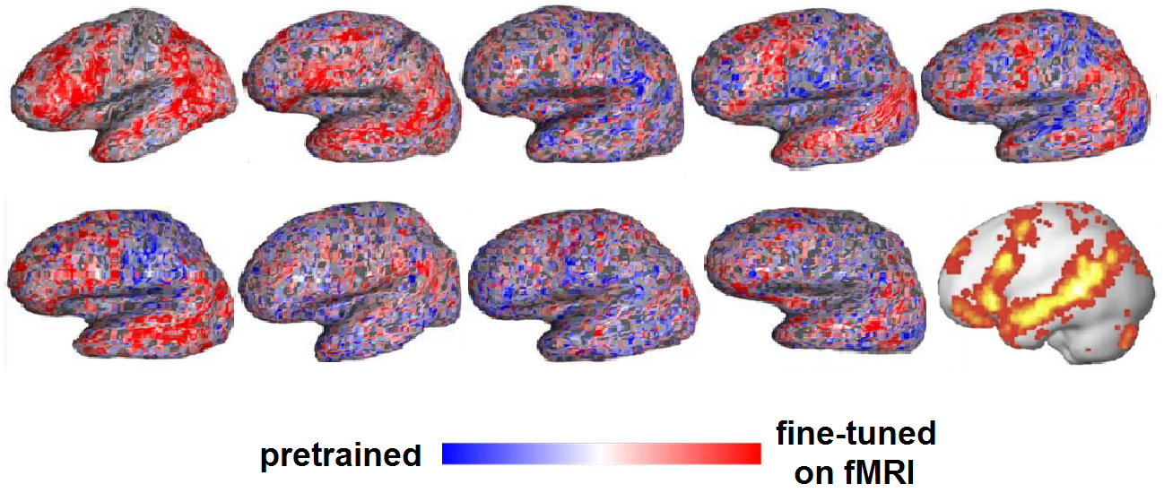
Training DL models using brain recordings
Stimuli: one chapter of Harry Potter
Stimulus representation: brain-optimized NLP model
Brain recording & modality: fMRI & MEG, reading
Chapter of a book
NLP system
A priori locations in NLP system and brain
error propagation
Brain-optimized NLP model predicts unseen fMRI recordings better, especially in canonical language regions
𝑥 alignment
fMRI
Schwartz, Dan, Mariya Toneva, and Leila Wehbe. "Inducing brain-relevant bias in natural language processing models." Advances in neural information processing systems 32 (2019).
Notes:
we presented an approach that directly introduced brain-relevant language bias in an NLP model by explicitly training an NLP model to predict language-induced brain recordings. To achieve this, we fine-tuned all parameters of a state-of-the-art NLP model, which was already pre-trained in a self-supervised fashion on a large amount of text, to predict two different types of brain imaging measurements---fMRI and Magnetoencephalography (MEG)---of people reading the same chapter of a popular book. We included two different imaging modalities to discourage the encoded bias' dependence on a specific imaging modality. In fact, we showed that for some participants, when a model is trained to predict MEG data, the resulting changes to the language-encoding that the model uses benefit subsequent training on fMRI data compared to starting with a language model trained only on text. This suggests that the changes to the language representations induced by the MEG data are not entirely imaging modality-specific, and that indeed the model is learning the relationship between language and brain activity as opposed to the relationship between language and a brain activity recording modality. We showed that the resulting model leads to improved prediction of previously unseen brain recordings, specifically in regions that are known to support language processing. This study demonstrates the feasibility of directly biasing language models to learn relationships between text and brain activity.

Slide 40
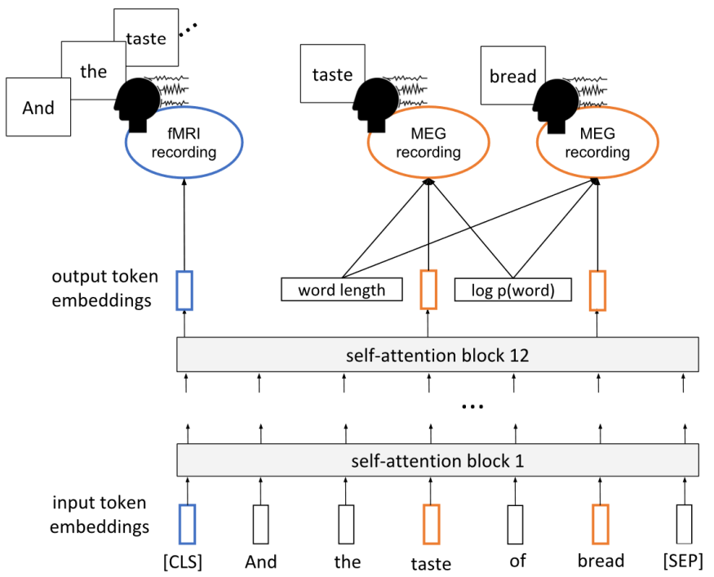
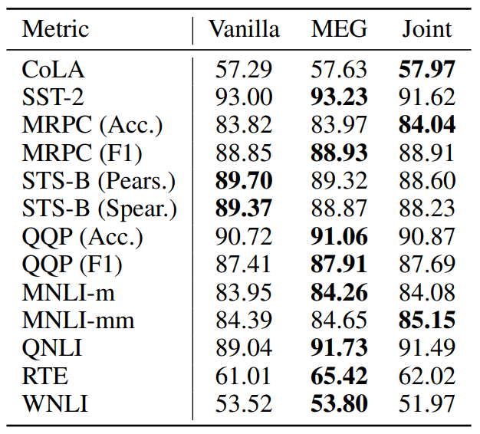
Inducing Brain Relevant Bias
Schwartz, Dan, Mariya Toneva, and Leila Wehbe. "Inducing brain-relevant bias in natural language processing models." Advances in neural information processing systems 32 (2019).

Slide 41
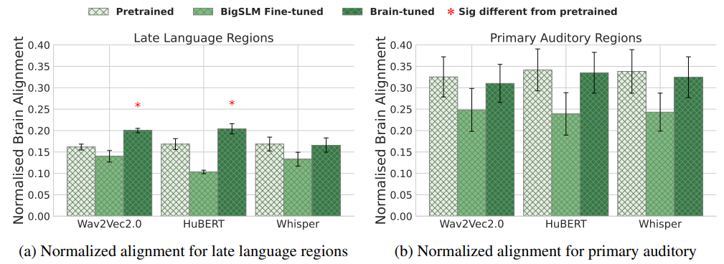
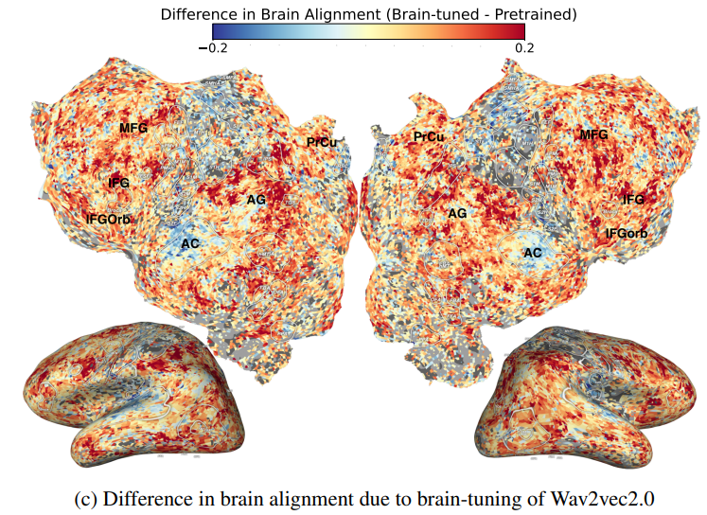
Training Speech models using brain recordings
Stimuli: Moth-Radio-Hour
Stimulus representation: brain-optimized speech model
Brain recording & modality: fMRI, listening
Brain-tuning may improve the brain-relevant semantics in at least some speech language models
Omer Moussa, Dietrich Klakow, Mariya Toneva. "Improving semantic understanding in speech language models via brain-tuning" Arxiv 2024.
Notes:
we presented an approach that directly introduced brain-relevant language bias in an NLP model by explicitly training an NLP model to predict language-induced brain recordings. To achieve this, we fine-tuned all parameters of a state-of-the-art NLP model, which was already pre-trained in a self-supervised fashion on a large amount of text, to predict two different types of brain imaging measurements---fMRI and Magnetoencephalography (MEG)---of people reading the same chapter of a popular book. We included two different imaging modalities to discourage the encoded bias' dependence on a specific imaging modality. In fact, we showed that for some participants, when a model is trained to predict MEG data, the resulting changes to the language-encoding that the model uses benefit subsequent training on fMRI data compared to starting with a language model trained only on text. This suggests that the changes to the language representations induced by the MEG data are not entirely imaging modality-specific, and that indeed the model is learning the relationship between language and brain activity as opposed to the relationship between language and a brain activity recording modality. We showed that the resulting model leads to improved prediction of previously unseen brain recordings, specifically in regions that are known to support language processing. This study demonstrates the feasibility of directly biasing language models to learn relationships between text and brain activity.

Slide 42
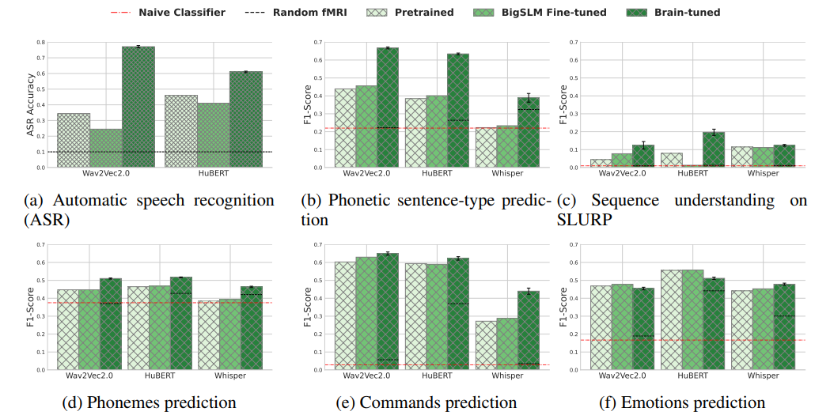
Downstream performance
Brain-tuned models show consistent improvement over the baselines, with biggest gains in more semantic tasks (ASR and phonetic sentence-type prediction)
Omer Moussa, Dietrich Klakow, Mariya Toneva. "Improving semantic understanding in speech language models via brain-tuning" Arxiv 2024.
CODS COMAD 2024: DL for Brain Encoding and Decoding

Slide 43
Agenda
Neuro-AI alignment: Introduction [1 hour 30 min]
Introduction to Brain encoding and decoding [30 min]
Types of Brain Recordings [15 min]
Types of Stimulus Representations [15 min]
Methodology [30 min]
Coffee break [30 min]
Language and Brain: Deep Learning for Brain Encoding and Decoding [1 hour 30 min]
Linguistic Brain Encoding [60 min]
Encoding schema
Pretrained language models and brain alignment
Challenges in using DL for cognitive science
Training DL models using brain recordings
Task-based language models and brain alignment
Disentangling Syntax and Semantics
Linguistic Brain Decoding [15 min]
Multimodal Brain Encoding [15 min]
CODS COMAD 2024: DL for Brain Encoding and Decoding

Slide 44
Can task-specific language models better predict fMRI brain activity?
Tasks
Paraphrase
Summrisation
Question Answering
Sentiment Analysis
NER
Word Sense Disambiguation
Natural Language Inference
Semantic Role Labeling
Coreference Resolution
Shallow Syntax
Pretrained BERT
Syntactic
Devlin et al. 2019, Bowon et al. 2020
CODS COMAD 2024: DL for Brain Encoding and Decoding
Notes:
In this study, we investigate the correlation between brain activation and feature representa- tions learned by different task-specific networks, and ask which tasks lead to improvements in brain-encoding performance.
Our selection of these tasks was based on the following design principles:
(1) We wanted to select a set of tasks covering diverse cognitive-linguistic skills.
(2) We wanted to select tasks that are a part of popular NLP benchmarks like GLUE
The emerging evidence from fMRI studies both syntax and semantics is distributed in the brain Thus, in this work, we explore syntactic and semantic tasks separately. Of the above mentioned tasks, NER and SS are syntactic, while the others involve semantic reasoning.

Slide 45
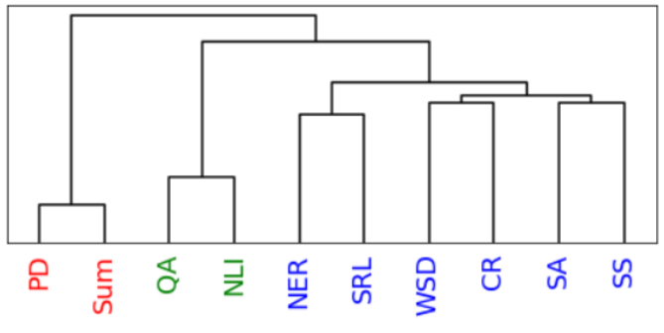
Tasks affect processing: NLP
Stimuli: passages and narratives
Stimulus representation: task-optimized NLP models for a range of tasks
Brain recording & modality: fMRI, reading & listening of different stimuli
Reading fMRI best explained by coref. resolution, NER, shallow syntax parsing
Listening fMRI best explained by paraphrasing, summarization, NLI
Oota, Subba Reddy, Jashn Arora, Veeral Agarwal, Mounika Marreddy, Manish Gupta, and Bapi Raju Surampudi. "Neural Language Taskonomy: Which NLP Tasks are the most Predictive of fMRI Brain Activity?." NAACL (2022).
Notes:
Features from coreference resolution, NER, and shallow syntax parsing explain greater variance for the reading activity. On the other hand, for the listening activity, tasks such as paraphrase generation, summarization, and natural language inference show better encoding performance
And obv different experiments with different stimuli
Need better all tasks annotated on the same initial dataset

Slide 46
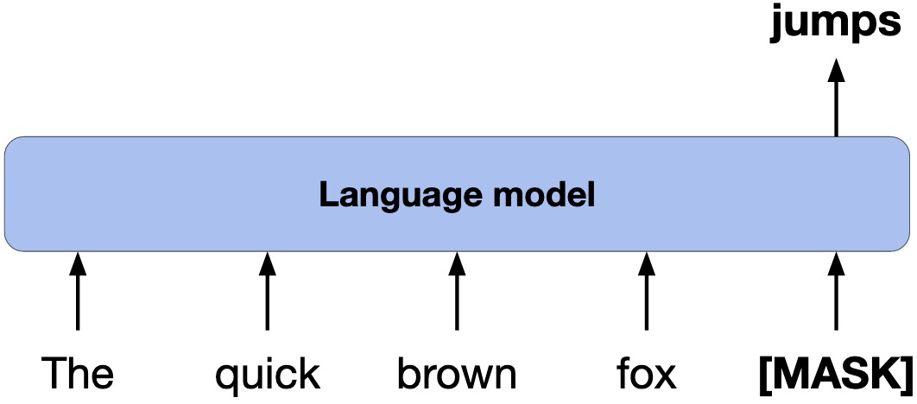
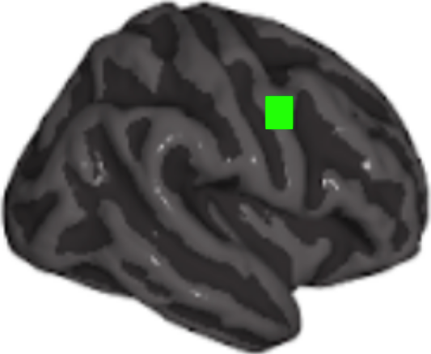
How to build better Language models?
Model trained with language modeling
input
input
Model trained to summarize narratives
book chapter
activations
activations
Use model’s internal layer activations to predict brain activity on held-out data
Compare against actual brain recordings
(brain alignment)
CODS COMAD 2024: DL for Brain Encoding and Decoding
Notes:
We use the models’ internal layer activations to predict brain activity on unseen data.
[CLICK] Finally, we compare the brain activity predictions against the actual brain recordings. This comparison serves as the amount of brain alignment.

Slide 47
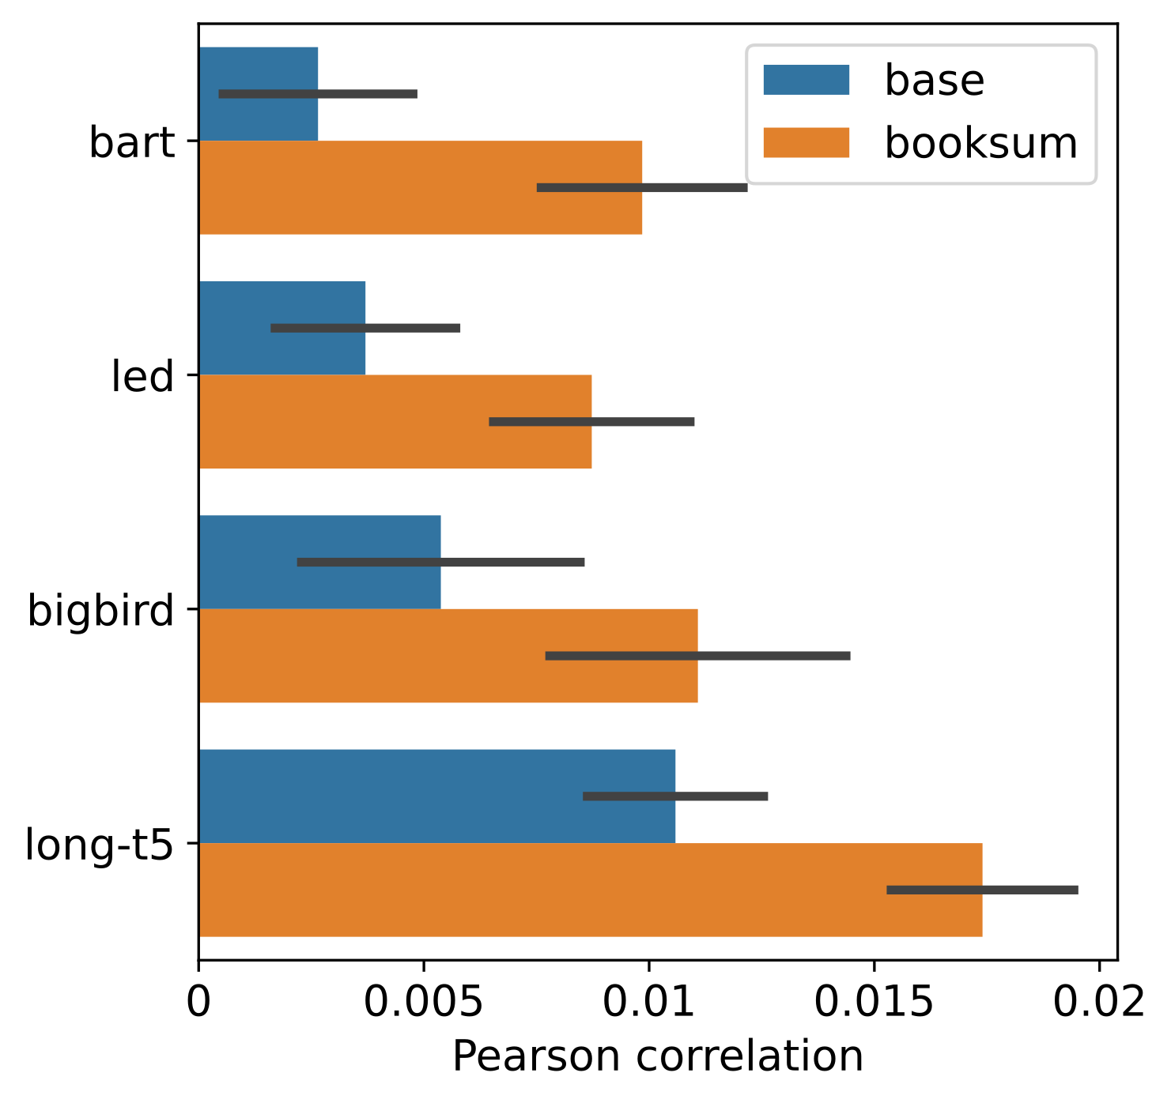
Result: Summarize narratives → Greater brain alignment 🧠
brain alignment (Pearson correlation)
Training language models to summarize narratives improves brain alignment
this is the title of our paper!
CODS COMAD 2024: DL for Brain Encoding and Decoding
Notes:
In our first result figure, we will show that models trained to summarize narratives indeed have greater brain alignment.
the x-axis represents the amount of brain alignment.
The y-axis compares the 4 pairs of Language models.
Blue bars represent the base models, and orange bars represent the booksum models.
Note that the Pearson correlation values on the x-axis are relatively low in magnitude because they include a large number of brain areas that may not be significantly involved in brain alignment or language processing. Also, these results are an average of many different layers and input sequence lengths that we tested for each language model.
From our results, we see that booksum LMs have greater brain alignment than base LMs.
[CLICK]
Therefore, training language models to summarize narratives improves brain alignment.

Slide 48
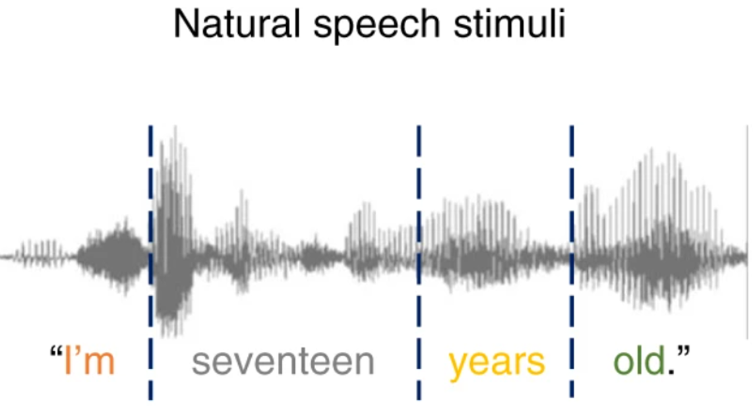
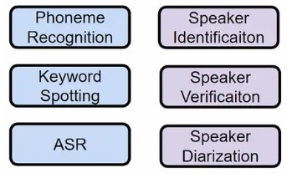
Tasks affect processing: Speech
Pretrained speech model
input
input
Model fine-tuned to downstream speech tasks
Wav2Vec 2.0-base
activations
activations
Use model’s internal layer activations to predict brain activity on held-out data
Compare against actual brain recordings
(brain alignment)
Notes:
In this work, we pass a book chapter as input into models trained with language modeling
[CLICK] as well as a models trained to summarize narratives.
[CLICK] We extract each model’s intermediate activations at every layer, and this serves as their representations.

Slide 49
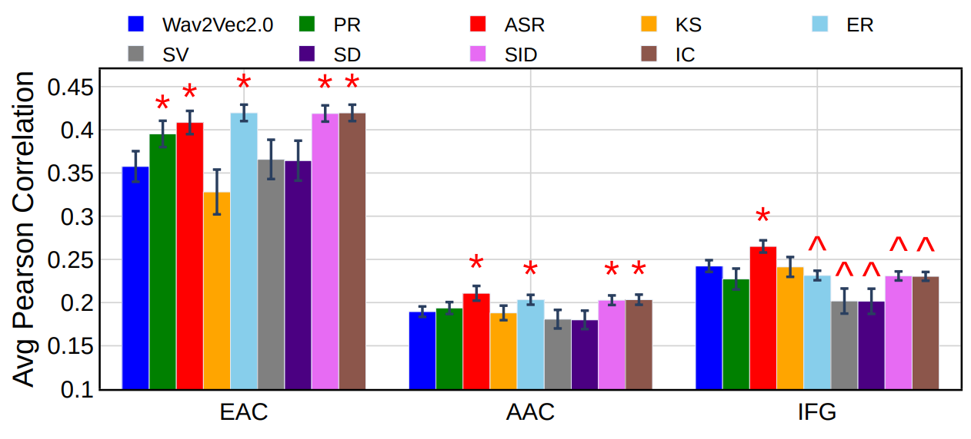
Region level alignments
All speech tasks are better aligned with EAC compared to AAC and IFG regions.
Finetuning on ER, SID and IC leads to the best alignment for the early auditory cortex
Finetuning on ASR provides the best encoding for the auditory associative cortex and language regions.
Oota, Subba Reddy, Veeral Agarwal, Mounika Marreddy, Manish Gupta, and Bapi Raju Surampudi. "Speech Taskonomy: Which Speech Tasks are the most Predictive of fMRI Brain Activity?" INTERSPEECH (2023).

Slide 50
Agenda
Neuro-AI alignment: Introduction [1 hour 30 min]
Introduction to Brain encoding and decoding [30 min]
Types of Brain Recordings [15 min]
Types of Stimulus Representations [15 min]
Methodology [30 min]
Coffee break [30 min]
Language and Brain: Deep Learning for Brain Encoding and Decoding [1 hour 30 min]
Linguistic Brain Encoding [60 min]
Encoding schema
Pretrained language models and brain alignment
Challenges in using DL for cognitive science
Training DL models using brain recordings
Task-based language models and brain alignment
Disentangling Syntax and Semantics
Linguistic Brain Decoding [15 min]
Multimodal Brain Encoding [15 min]
CODS COMAD 2024: DL for Brain Encoding and Decoding

Slide 51
Disentangling contributions of different info sources to brain predictions
“Mary finished the apple”
Isolating supra-word meaning is a type of intervention
supra-word meaning may contain concept of:
eating
apple core
…
supra-word
meaning
Toneva, Mariya, Tom M. Mitchell, and Leila Wehbe. "Combining computational controls with natural text reveals new aspects of meaning composition." BioRxiv (2020).

Slide 52
Disentangling contributions of different info sources to brain predictions
Stimuli: one chapter of Harry Potter
Stimulus representation: disentangled embeddings from pretrained NLP models
Brain recording & modality: fMRI & MEG, reading
full context
supra-word
Bilateral PTL and ATL process supra-word meaning
Word-level information important for prediction of most language regions
Toneva, Mariya, Tom M. Mitchell, and Leila Wehbe. "Combining computational controls with natural text reveals new aspects of meaning composition." BioRxiv (2020).
Notes:
True for different NLP models
True for different stimuli: watching movie vs reading a book

Slide 53
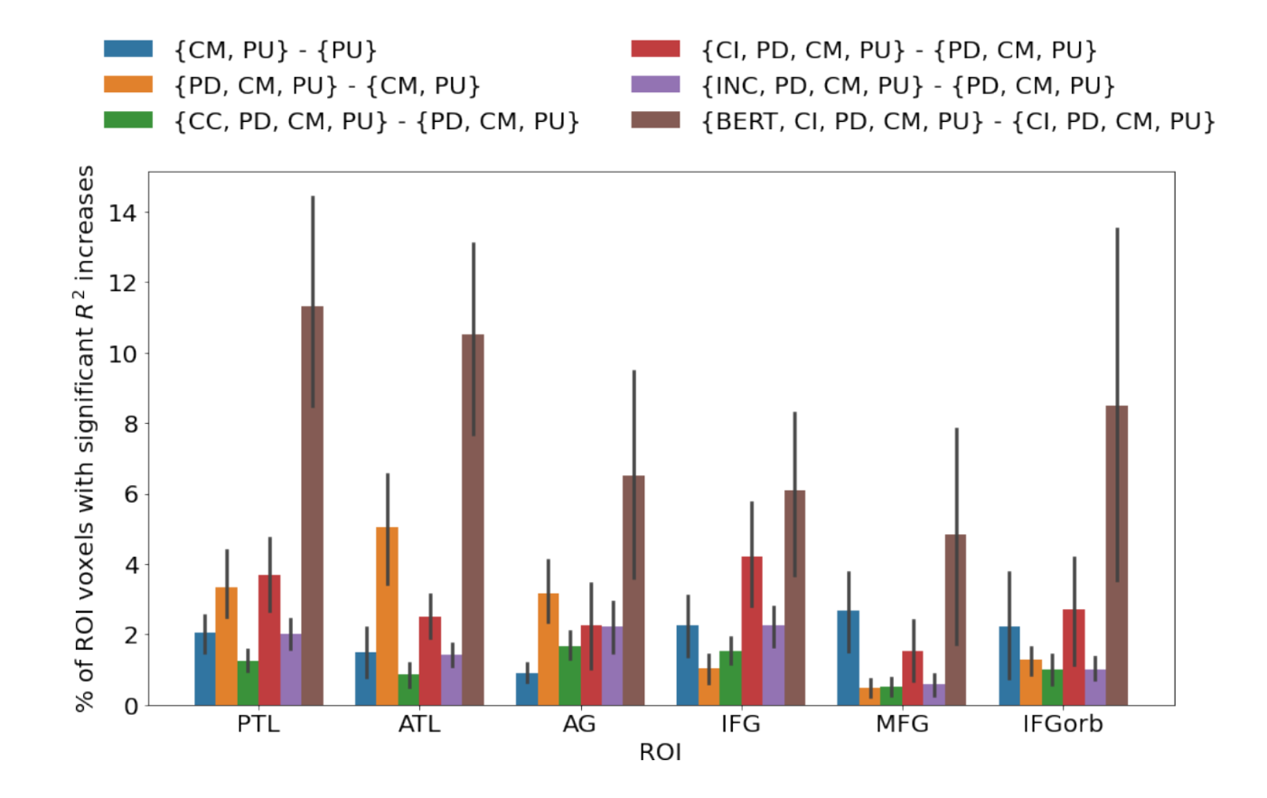
Disentangling contributions of different info sources to brain predictions
Stimuli: one chapter of Harry Potter
Stimulus representation: syntactic tree representations & pretrained NLP model
Brain recording & modality: fMRI, reading
Syntactic structure-based features explain additional variance in language regions over complexity metrics
Regions predicted by syntactic and semantic are difficult to distinguish
Reddy, Aniketh Janardhan, and Leila Wehbe. "Can fMRI reveal the representation of syntactic structure in the brain?." Advances in Neural Information Processing Systems 34 (2021): 9843-9856.
Notes:
In this study, we propose novel multi-dimensional features that encode information about the syntactic structure of sentences.
First, we find that our syntactic structure-based features explain additional variance in the brain activity of various parts of the language system, even after controlling for complexity metrics that capture processing load.
At the same time, we see that regions well-predicted by syntactic features are distributed in the language system and are not distinguishable from those processing semantics.

Slide 54
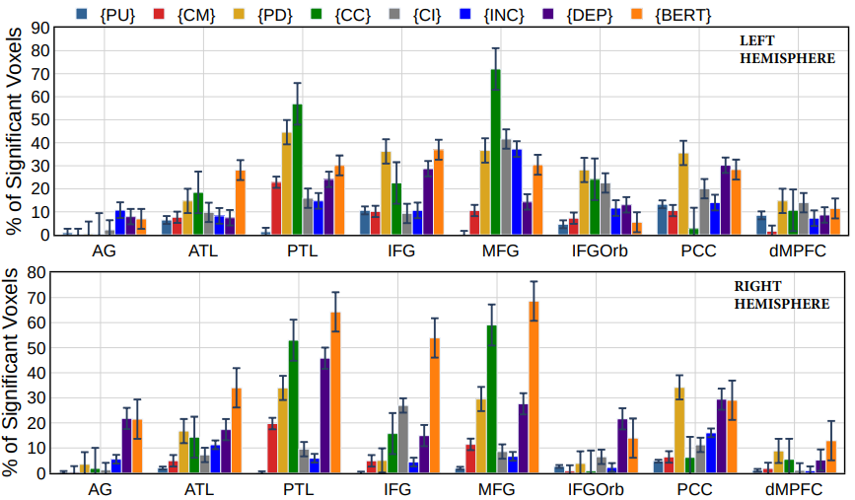
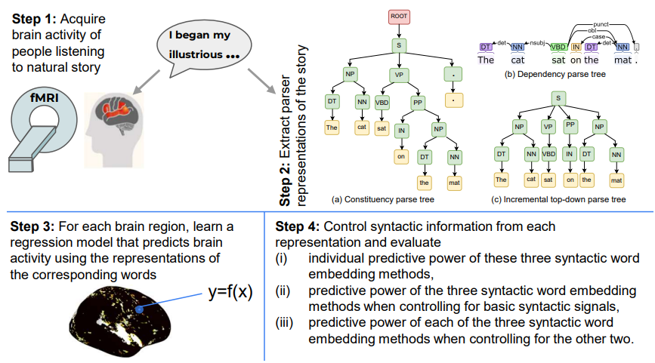
Disentangling contributions of different info sources to brain predictions
Stimuli: Narratives
Stimulus representation: syntactic tree representations & pretrained NLP model
Brain recording & modality: fMRI, listening
Constituency tree structure is better in temporal cortex and MFG, while Dependency structure is better in AG and PCC,
Regions predicted by syntactic and semantic are difficult to distinguish
Oota, Subba Reddy et al. 2022 "How distinct are Syntactic and Semantic Representations in the Brain During Sentence Comprehension?" ACL 2023
Notes:
In this study, we propose novel multi-dimensional features that encode information about the syntactic structure of sentences.
First, we find that our syntactic structure-based features explain additional variance in the brain activity of various parts of the language system, even after controlling for complexity metrics that capture processing load.
At the same time, we see that regions well-predicted by syntactic features are distributed in the language system and are not distinguishable from those processing semantics.

Slide 55
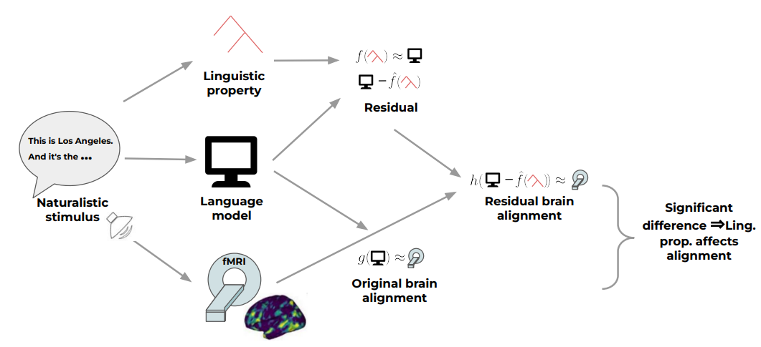
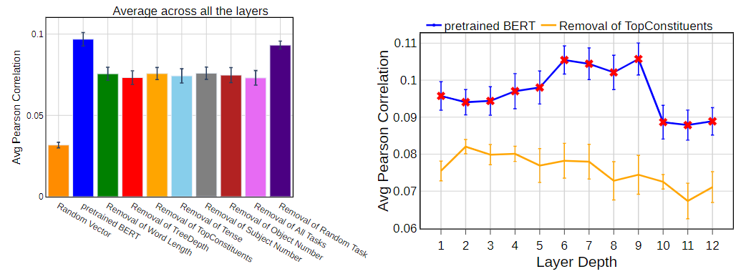
Joint processing of linguistic properties in brains and language models
Stimuli: Narrative Stories
Stimulus representation: pretrained NLP model and removal of linguistic properties
Brain recording & modality: fMRI, Listening
Questions: What linguistic properties underlie brain alignment, across all layers but also specifically in middle layers?
Top constituents and Tree Depth contribute the most to the alignment trend across layers
Oota, Subba Reddy, Gupta, Manish and Toneva, Mariya. "Joint processing of linguistic properties in brains and language models." NeurIPS 2023.
Notes:
In this study, we propose novel multi-dimensional features that encode information about the syntactic structure of sentences.
First, we find that our syntactic structure-based features explain additional variance in the brain activity of various parts of the language system, even after controlling for complexity metrics that capture processing load.
At the same time, we see that regions well-predicted by syntactic features are distributed in the language system and are not distinguishable from those processing semantics.

Slide 56
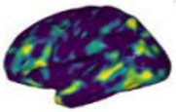
What are the reasons for this observed brain alignment?
Investigate via a perturbation approach
Linguistic property
Residual =
Residual encoding performance
Significant difference ⇒ Ling. prop. affects alignment
This is Los Angeles. And it's the …
Original encoding performance
Language model
Naturalistic stimulus
fMRI
Oota, Subba Reddy, Gupta, Manish and Toneva, Mariya. "Joint processing of linguistic properties in brains and language models." NeurIPS 2023.
CODS COMAD 2024: DL for Brain Encoding and Decoding

Slide 57
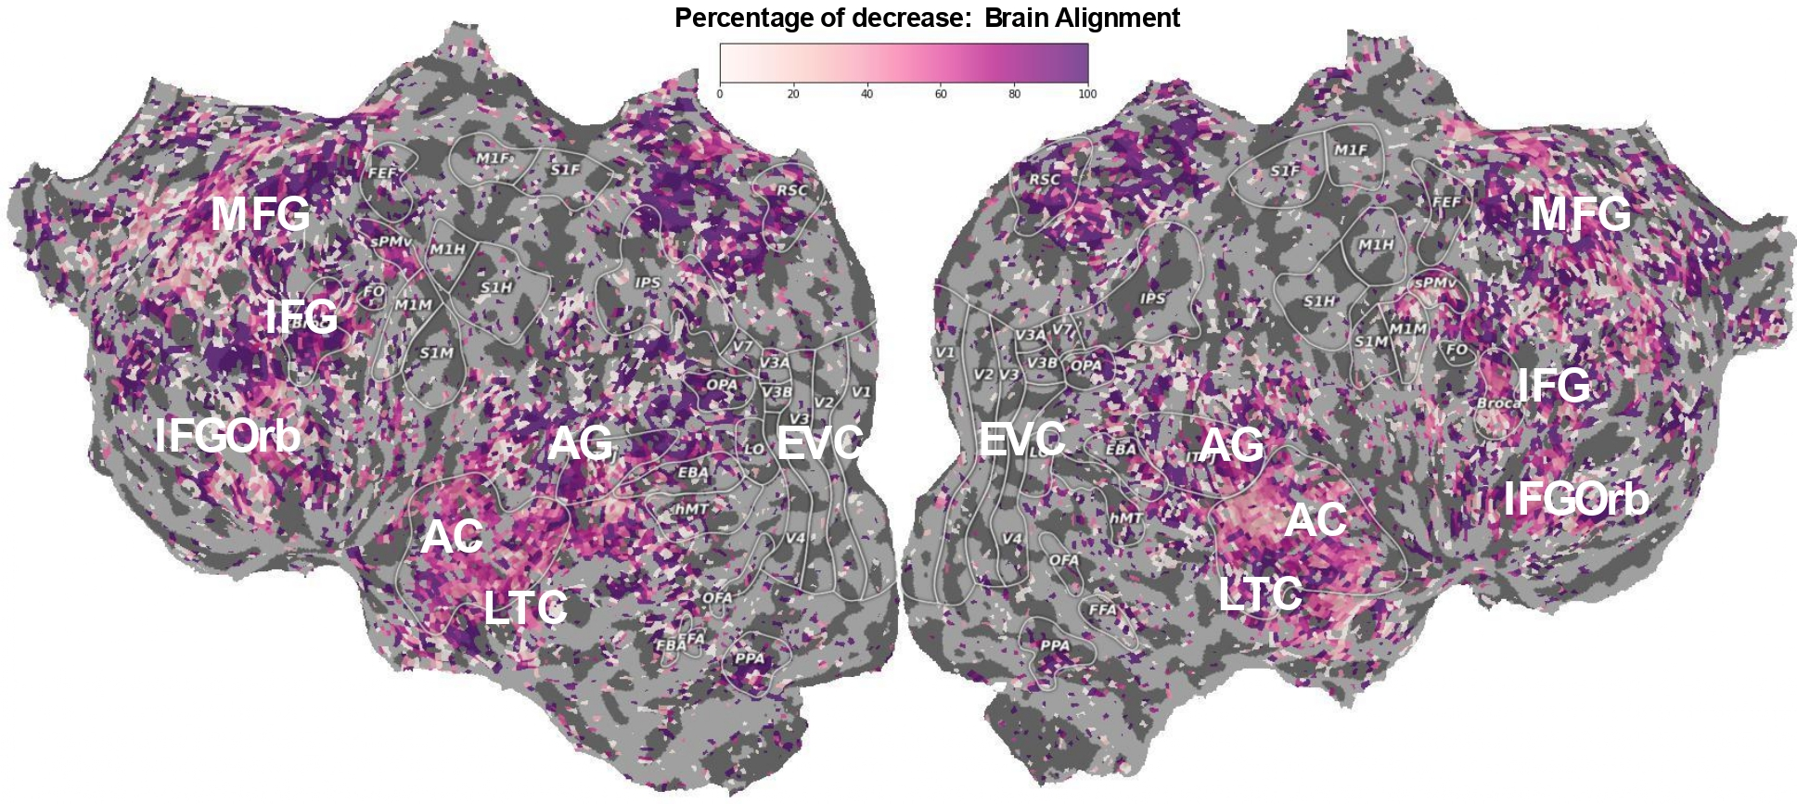
Speech language models lack important brain relevant semantics
Stimuli: Narrative Stories
Stimulus representation: pretrained NLP model and speech models
Brain recording & modality: fMRI, Reading, Listening
Questions: Why do text-based language models predict early auditory cortices to an impressive degree?
What types of information do language models truly predict in the Brain?
How does the type of model (text vs. speech) affect the resulting alignment?
Text models:
high alignment in late language regions is not due to low-level features
Speech models:
alignment in late language regions entirely due to low-level stimulus features
Subba Reddy Oota, Emin Çelik, Fatma Deniz, Mariya Toneva. "Speech language models lack important brain-relevant semantics." ACL 2024.
Notes:
In this study, we propose novel multi-dimensional features that encode information about the syntactic structure of sentences.
First, we find that our syntactic structure-based features explain additional variance in the brain activity of various parts of the language system, even after controlling for complexity metrics that capture processing load.
At the same time, we see that regions well-predicted by syntactic features are distributed in the language system and are not distinguishable from those processing semantics.

Slide 58
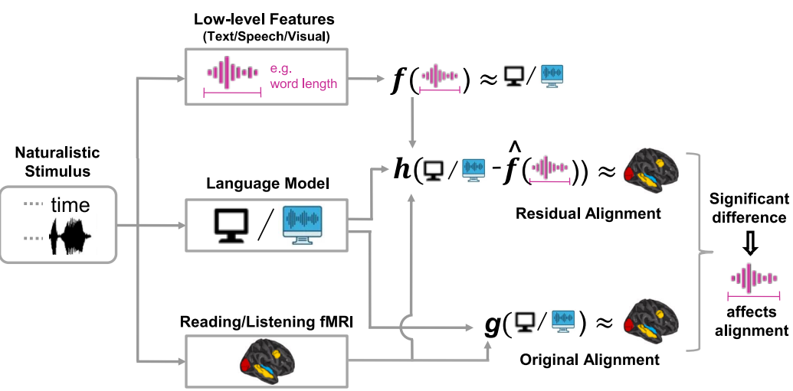
What types of information lead to high brain alignment?
Investigate via a perturbation approach
Subba Reddy Oota, Emin Çelik, Fatma Deniz, Mariya Toneva. "Speech language models lack important brain-relevant semantics." ACL 2024.
CODS COMAD 2024: DL for Brain Encoding and Decoding
Notes:
We investigated this question via a perturbation approach

Slide 59
Conclusions for neuro-AI research field
Text models (🔤) : alignment with early auditory cortex (AC) during listening and early visual cortex (VC) during reading is due to low-level textual features
Speech models (🔊) : high alignment with early auditory cortex (AC) is only partially explained by low-level speech features.
Language regions predicted by syntactic and semantic representations are difficult to distinguish
Syntactic properties contribute the most to the alignment trend across middle layers of language model.
Past word context is crucial in obtaining significant brain predictivity results.
Booksum models’ representations of Characters, Emotions and Motions are more aligned to the brain than the base models’ representations.
Brain-tuned models show consistent improvement over the baselines, with biggest gains in more semantic tasks.
CODS COMAD 2024: DL for Brain Encoding and Decoding
Notes:
Overall, our work has several implications for neuro-AI
Speech models ARE useful

Slide 60
Agenda
Neuro-AI alignment: Introduction [1 hour 30 min]
Introduction to Brain encoding and decoding [30 min]
Types of Brain Recordings [15 min]
Types of Stimulus Representations [15 min]
Methodology [30 min]
Coffee break [30 min]
Language and Brain: Deep Learning for Brain Encoding and Decoding [1 hour 30 min]
Linguistic Brain Encoding [60 min]
Encoding schema
Pretrained language models and brain alignment
Challenges in using DL for cognitive science
Training DL models using brain recordings
Task-based language models and brain alignment
Disentangling Syntax and Semantics
Linguistic Brain Decoding [15 min]
Multimodal Brain Encoding [15 min]
CODS COMAD 2024: DL for Brain Encoding and Decoding

Slide 61
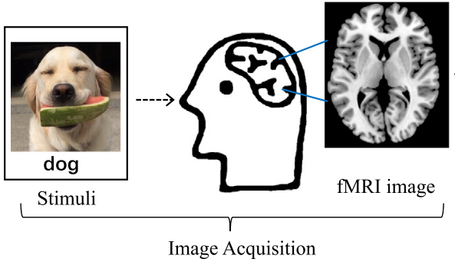
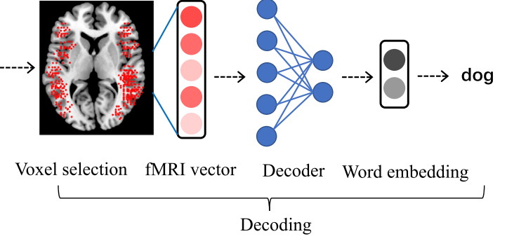
What is Brain Decoding?
Can we reconstruct the stimulus, given the brain response?
Can you read the mind with fMRI?
Or at least tell what the person saw?
Visual Task
Language Task
Smith et al., 2011, Wang et al. 2019
CODS COMAD 2024: DL for Brain Encoding and Decoding

Slide 62
Linguistic Decoding
Alexandre Défossez, Charlotte Caucheteux, Jérémy Rapin, Ori Kabeli & Jean-Rémi King. "Decoding speech perception from non-invasive brain recordings" Nature Machine Intelligence 2023.
Timo I. Denk, Yu Takagi, Takuya Matsuyama, Andrea Agostinelli, Tomoya Nakai, Christian Frank, Shinji Nishimoto. "Brain2Music: Reconstructing Music from Human Brain Activity" Arxiv 2024.
CODS COMAD 2024: DL for Brain Encoding and Decoding

Slide 63
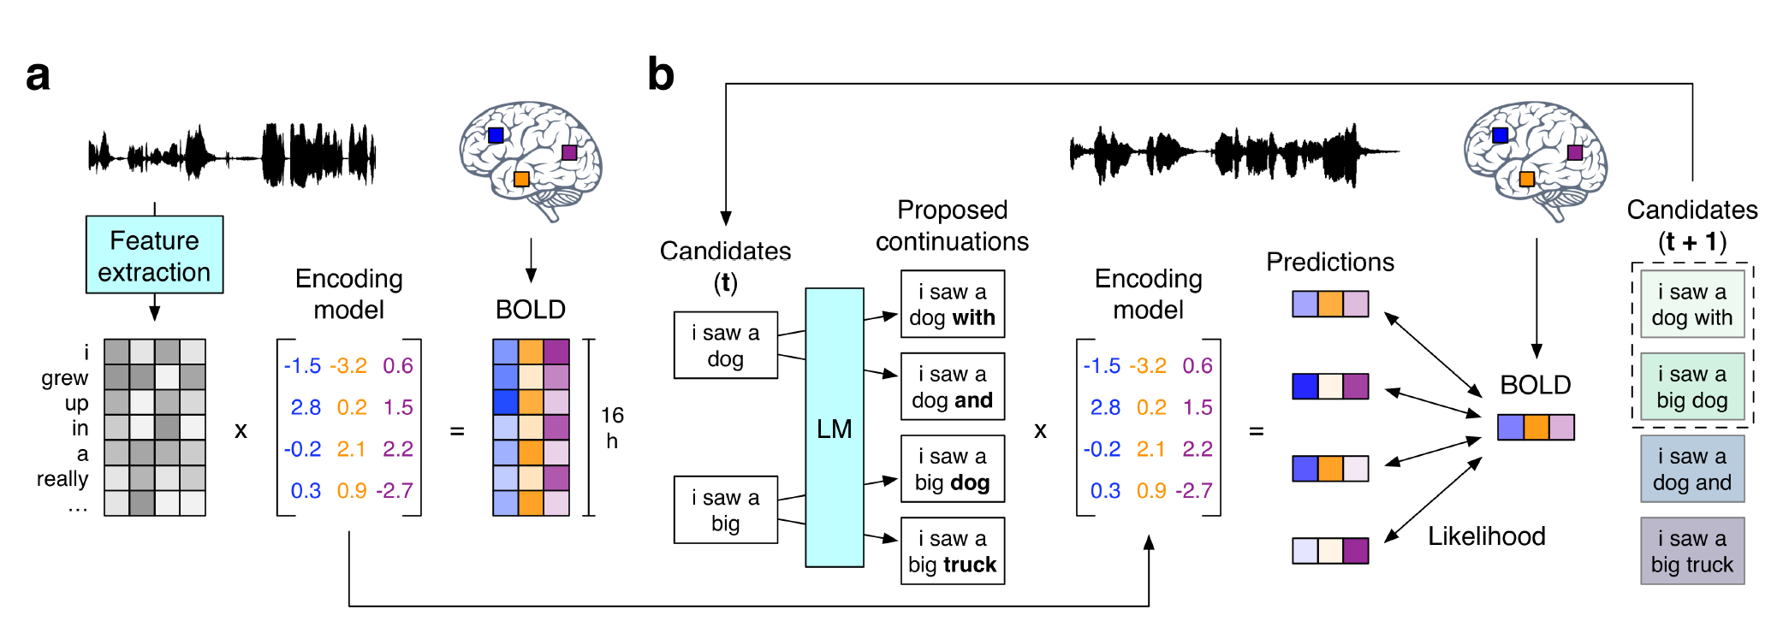
Continuous Language Decoder
Stimuli: Moth-Radio-Hour, Short-movie-clips
Stimulus representation: GPT2 language model
Brain recording & modality: fMRI, listening
Jerry Tang, Amanda LeBel, Shailee Jain & Alexander G. Huth "Semantic reconstruction of continuous language from non-invasive brain recordings" Nature Neuroscience 2023.
CODS COMAD 2024: DL for Brain Encoding and Decoding

Slide 64
Continuous Language Decoder
Jerry Tang, Amanda LeBel, Shailee Jain & Alexander G. Huth "Semantic reconstruction of continuous language from non-invasive brain recordings" Nature Neuroscience 2023.
CODS COMAD 2024: DL for Brain Encoding and Decoding

Slide 65
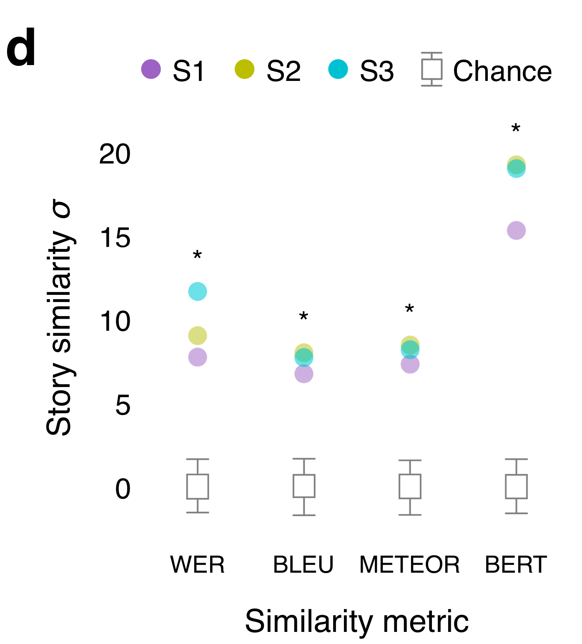
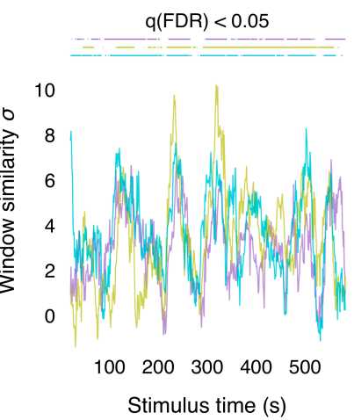
Continuous Language Decoder
Jerry Tang, Amanda LeBel, Shailee Jain & Alexander G. Huth "Semantic reconstruction of continuous language from non-invasive brain recordings" Nature Neuroscience 2023.
CODS COMAD 2024: DL for Brain Encoding and Decoding

Slide 66
Agenda
Neuro-AI alignment: Introduction [1 hour 30 min]
Introduction to Brain encoding and decoding [30 min]
Types of Brain Recordings [15 min]
Types of Stimulus Representations [15 min]
Methodology [30 min]
Coffee break [30 min]
Language and Brain: Deep Learning for Brain Encoding and Decoding [1 hour 30 min]
Linguistic Brain Encoding [60 min]
Encoding schema
Pretrained language models and brain alignment
Challenges in using DL for cognitive science
Training DL models using brain recordings
Task-based language models and brain alignment
Disentangling Syntax and Semantics
Linguistic Brain Decoding [15 min]
Multimodal Brain Encoding [15 min]
CODS COMAD 2024: DL for Brain Encoding and Decoding

Slide 67
What are we talking about when we talk about “mapping stimulus to the human brain”
How our brain separates and integrates information across modalities through a hierarchy of early sensory regions to higher cognition (language regions)?
Do concept representations differ across modalities?
Where in the brain is unimodal and multimodal information represented?
What is the shared and unique information explained by each modality?
CODS COMAD 2024: DL for Brain Encoding and Decoding

Slide 68
How well multimodal models predict brain activity evoked by multimodal stimuli?
How our brain separates and integrates information across modalities through a hierarchy of early sensory regions to higher cognition (language regions)?
Subba Reddy Oota, Khushbu Pahwa, mounika marreddy, Maneesh Kumar Singh, Manish Gupta, Bapi Raju Surampudi. "Multi-modal brain encoding models for multi-modal stimuli" Under Review.

Slide 69
Surprising Trends in Brain Alignment: Unimodal vs. Multimodal Models
Multi-modal effects: In general, multimodal models have better predictivity in the language regions
Unimodal effects: Unimodal models have higher predictivity in the early sensory regions (visual and auditory).
Subba Reddy Oota, Khushbu Pahwa, mounika marreddy, Maneesh Kumar Singh, Manish Gupta, Bapi Raju Surampudi. "Multi-modal brain encoding models for multi-modal stimuli" Under Review.
CODS COMAD 2024: DL for Brain Encoding and Decoding

Slide 70
Correlating instruction-tuning (in multimodal models) with vision-language processing (in the brain)
Image Captioning:
What is the caption of the image?
Image Understanding:
Describe the most dominant color in the image.
Visual Relationship:
What objects are being used by the largest animal in this image?
Instruction Embedding
Multimodal instruction-tuned model (MLLM)
estimate alignment
$$f\left(MLLM\right)≈$$
Early Visual
NSD dataset naturalistic Image stimulus
Task-specific instructions
Do multimodal instruction-tuned models prompted using natural language instructions lead to better brain alignment and differentiate instruction-specific representations?
Subba Reddy Oota, Akshett Rai Jindal, Ishani Mondal, Khushbu Pahwa, Satya Sai Srinath Namburi GNVV, Manish Shrivastava, Maneesh Kumar Singh, Bapi Raju Surampudi, Manish Gupta. "Correlating instruction-tuning (in multimodal models) with vision-language processing (in the brain)" Under Review.

Slide 71
Which task-specific instructions are highly correlated to visual function localizers?
S1: InstructBLIP
S1: mPLUG-Owl
Not all instructions lead to increased brain alignment across all regions
Certain instructions (IC, VQ2, and IU1) are more effective than others in encoding brain activity.
Subba Reddy Oota, Akshett Rai Jindal, Ishani Mondal, Khushbu Pahwa, Satya Sai Srinath Namburi GNVV, Manish Shrivastava, Maneesh Kumar Singh, Bapi Raju Surampudi, Manish Gupta. "Correlating instruction-tuning (in multimodal models) with vision-language processing (in the brain)" Under Review.

Slide 72
Partitioning explained variance between task-specific instructions
Between Image Captioning (IC) and Image Understanding (IU2), there is no unique variance for IU2 in the EBA region, while IC retains some unique variance.
High overlap between IC and IU2 in higher visual areas but lower overlap in early visual cortex.
Subba Reddy Oota, Akshett Rai Jindal, Ishani Mondal, Khushbu Pahwa, Satya Sai Srinath Namburi GNVV, Manish Shrivastava, Maneesh Kumar Singh, Bapi Raju Surampudi, Manish Gupta. "Correlating instruction-tuning (in multimodal models) with vision-language processing (in the brain)" Under Review.

Slide 73
Conclusions for neuro-AI research field
Both cross-modal and jointly pretrained models demonstrate significantly improved brain alignment with language regions compared to visual regions when analyzed against unimodal video data.
Multi-modal models to capture additional information—either through knowledge transfer or integration between modalities—which is crucial for multi-modal brain alignment
The differences between the models in terms of architectural variability and variability in pretraining methods, this suggests that future work could benefit from more tightly controlled comparisons to better isolate the effects of these factors.
Several task-specific instructions leading to improved brain alignment between fMRI recordings and MLLMs, not all instructions were relevant for brain alignment.
CODS COMAD 2024: DL for Brain Encoding and Decoding
Notes:
Overall, our work has several implications for neuro-AI
Speech models ARE useful

Slide 74
Collaborators
Subba Reddy Oota
Khushbu Pahwa
Maneesh Singh
Manish Gupta
Mariya Toneva
Bapi Raju Surampudi
Fatma Deniz
Xavier Hinaut
Frederic Alexandre
CODS COMAD 2024: DL for Brain Encoding and Decoding

