Slide 1
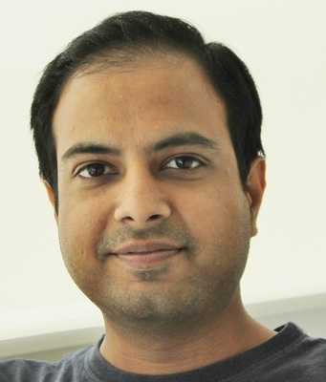
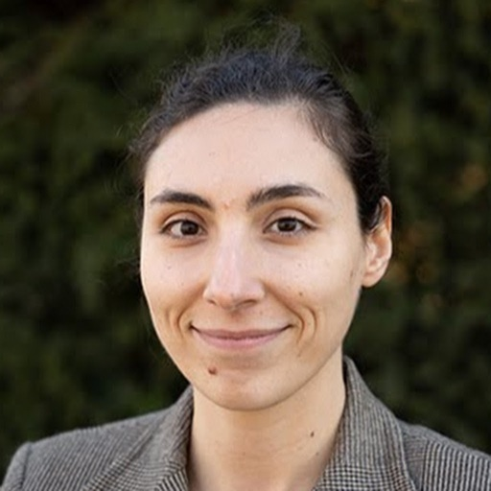
Deep Neural Networks and Brain Alignment: Brain Encoding and Decoding
Subba Reddy Oota¹, Manish Gupta^{2,3}, Raju S. Bapi², Mariya Toneva⁴
¹Inria Bordeaux, France; ²IIIT Hyderabad, India; ³Microsoft, India; ⁴MPI for Software Systems, Germany
subba-reddy.oota@inria.fr, gmanish@microsoft.com, raju.bapi@iiit.ac.in, mtoneva@mpi-sws.org

Slide 2
Agenda
Introduction to Brain encoding and decoding [30 min]
Stimulus Representations [1 hour]
Coffee break [30 min]
Deep Learning for Brain Decoding [1 hour 30 min]
Lunch break [1 hour 30 min]
Deep Learning for Brain Encoding [1 hour 30 min]
Coffee break [30 min]
Advanced Methods [1 hour 15 min]
Summary and Future Trends [15 min]

Slide 3
Agenda
Introduction to Brain encoding and decoding [30 min]
Stimulus Representations [1 hour]
Coffee break [30 min]
Deep Learning for Brain Decoding [1 hour 30 min]
Lunch break [1 hour 30 min]
Deep Learning for Brain Encoding [1 hour 30 min]
Coffee break [30 min]
Advanced Methods [1 hour 15 min]
Summary and Future Trends [15 min]

Slide 4
Agenda
Introduction to Brain encoding and decoding [30 min]
Brain Encoding/Decoding: Techniques and Research Goals
Introduction to popular datasets
Text, Visual, Audio, Multi-modal
Stimulus Representations [1 hour]
Coffee break [30 min]
Deep Learning for Brain Decoding [1 hour 30 min]
Lunch break [1 hour 30 min]
Deep Learning for Brain Encoding [1 hour 30 min]
Coffee break [30 min]
Advanced Methods [1 hour 15 min]
Summary and Future Trends [15 min]

Slide 5
Agenda
Introduction to Brain encoding and decoding [30 min]
Brain Encoding/Decoding: Techniques and Research Goals
Introduction to popular datasets
Text, Visual, Audio, Multi-modal
Stimulus Representations [1 hour]
Coffee break [30 min]
Deep Learning for Brain Decoding [1 hour 30 min]
Lunch break [1 hour 30 min]
Deep Learning for Brain Encoding [1 hour 30 min]
Coffee break [30 min]
Advanced Methods [1 hour 15 min]
Summary and Future Trends [15 min]

Slide 6
Neuroscience
Field of science that studies the structure and function of the nervous system of different species.
Involves answering interesting questions
How learning occurs during adolescence, and how it differs from the way adults learn and form memories.
Which specific cells in the brain (and what connections they form with other cells), have a role in how memories are formed.
How animals cancel out irrelevant information arriving from the senses and focus only on information that matters.
How do humans make decisions.
How humans develop speech and learn languages.
Neuroscientists study diverse topics that help us understand how the brain and nervous system work.

Slide 7
Brain encoding and decoding in cognitive neuroscience
Ivanova, Anna A., Martin Schrimpf, Stefano Anzellotti, Noga Zaslavsky, Evelina Fedorenko, and Leyla Isik. "Is it that simple? Linear mapping models in cognitive neuroscience." bioRxiv (2021).

Slide 8
Brain encoding and decoding

Slide 9
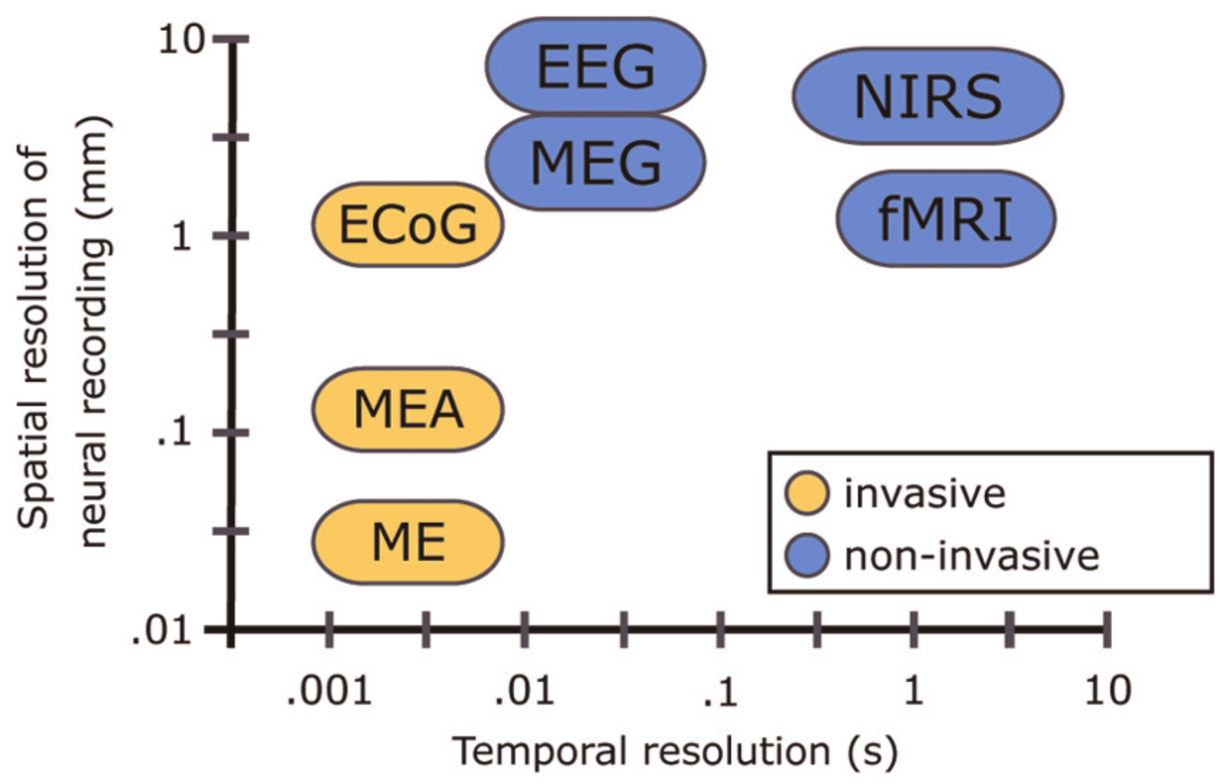
Techniques for studying the brain function
fMRI: high spatial but low time resolution.
Good to study a specific location in the brain
Unsuitable for sentence-level analysis. fMRI takes about two seconds to complete a scan. This is far lower than the speed at which humans can process language.
Cannot capture syntactic information (Gauthier and Levy, 2019)
EEG: high time but low spatial resolution.
Can preserve rich syntactic information (Hale et al., 2018)
But cannot use for source analysis.
fNIRS: compromise option
Time resolution better than fMRI
Spatial resolution better than EEG
Balance of spatial and temporal resolution may not be enough to compensate for the loss in both.
Single Micro-Electrode (ME), Micro-Electrode array (MEA), Electro-Cortico Graphy (ECoG), Positron emission tomography (PET), functional MRI (fMRI), Magneto-encephalography (MEG), Electro-encephalography (EEG), Near-Infrared Spectroscopy (NIRS)
Vogel, Jörn, Sami Haddadin, Beata Jarosiewicz, John D. Simeral, Daniel Bacher, Leigh R. Hochberg, John P. Donoghue, and Patrick van der Smagt. "An assistive decision-and-control architecture for force-sensitive hand–arm systems driven by human–machine interfaces." The International Journal of Robotics Research 34, no. 6 (2015): 763-780.
Notes:
FMRI scans use the same basic principles of atomic physics as MRI scans, but MRI scans image anatomical structure whereas FMRI image metabolic function. Thus, the images generated by MRI scans are like three dimensional pictures of anatomic structure. The images generated by FMRI scans are images of metabolic activity within these anatomic structures.

Slide 10
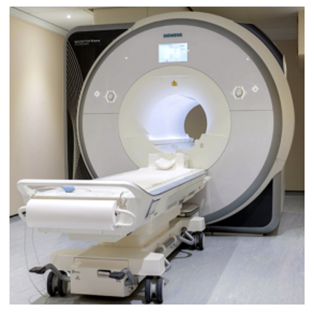
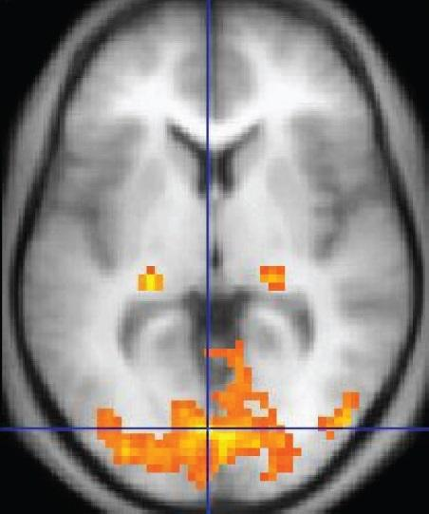
fMRI
No injections, surgery, the ingestion of substances, or exposure to ionizing radiation.
The primary form of fMRI uses the blood-oxygen-level dependent (BOLD) contrast, discovered by Seiji Ogawa in 1990.
Measures brain activity by detecting changes associated with blood flow.
When an area of the brain is in use, blood flow to that region also increases.
Hemodynamic response (HRF)
It takes a while for the vascular system to respond to the brain's need for glucose.
Blood flow lags the neuronal events triggering it by about 5 seconds.
An fMRI image with yellow areas showing increased activity compared with a control condition

Slide 11
Computational Cognitive Science Research goals
Predictive Accuracy
Compare feature sets: Which feature set provides the most faithful reflection of the neural representational space?
Test feature decodability: “Does neural data Y contain information about features X?”
Build accurate models of brain data: Aim is to enable simulations of neuroscience experiments.
Interpretability
Examine individual features: Which features contribute the most to neural activity?
Test correspondences between representational spaces
“CNNs vs ventral visual stream” or “Two text representations”
Interpret feature sets
Do features X, generated by a known process, accurately describe the space of neural responses Y?
Do voxels respond to a single feature or exhibit mixed selectivity?
How does the mapping relate to other models or theories of brain function?
Ivanova, Anna A., Martin Schrimpf, Stefano Anzellotti, Noga Zaslavsky, Evelina Fedorenko, and Leyla Isik. "Is it that simple? Linear mapping models in cognitive neuroscience." bioRxiv (2021).

Slide 12
Computational Cognitive Science Research goals
Biological plausibility
Simulate linear readout
If the features can be extracted with a linear mapping model, it means that they require few additional computations in order to be used downstream.
Incorporate measurement-related considerations
Rather than assuming a fixed HRF across voxels and/or conditions, what are better ways?
Ivanova, Anna A., Martin Schrimpf, Stefano Anzellotti, Noga Zaslavsky, Evelina Fedorenko, and Leyla Isik. "Is it that simple? Linear mapping models in cognitive neuroscience." bioRxiv (2021).

Slide 13
Agenda
Introduction to Brain encoding and decoding [30 min]
Introduction to Brain Encoding/Decoding and applications
Introduction to popular datasets
Text, Visual, Audio, Multi-modal
Stimulus Representations [1 hour]
Coffee break [30 min]
Deep Learning for Brain Decoding [1 hour 30 min]
Lunch break [1 hour 30 min]
Deep Learning for Brain Encoding [1 hour 30 min]
Coffee break [30 min]
Advanced Methods [1 hour 15 min]
Summary and Future Trends [15 min]

Slide 14
Types of stimuli and popular datasets
Text (Words, Sentences, Paragraphs): Harry Potter Story, ZUCO EEG, Question-Answering MEG.
Visual: Binary visual patterns, Natural Images (Vim-1), BOLD5000, Algonauts and SS-fMRI.
Audio: Alice’s Adventures in Wonderland, Narratives, The Moth Radio Hour, Audio stories.
Videos: BBC’s Doctor Who, Japanese Ads, Pippi Langkous, Algonauts.
Other Multimodal Stimuli: Words + line drawing of concept named by each word, Pereira.

Slide 15
Forms of stimulus presentation and data collection
Type: fMRI, EEG, MEG, …
TR: Sampling time.
Fixation points: location, color, shape.
Form of stimuli presentation: text, video, audio, images.
Task: question answering, property generation, understanding, …
Time given to participants: 1 minute to list properties, …
Type of participants: males/females, sighted/blind, …
Number of times the response to stimuli was recorded.
Language

Slide 16
Text Stimulus Datasets
Dataset | Type | Language | Stimulus | #Subjects | Paradigm | Size | Task
Wehbe et al., 2014 | fMRI | English | Chapter 9 of Harry Potter and the Sorcerer's Stone | 9 | Reading stories | 5000 word chapter was presented in 45 minutes. | Story understanding
Handjaras et al., 2016 | fMRI | Italian | Verbal, pictorial or auditory presentation of 40 concrete nouns | 20 | Reading, viewing or listening | 40 nouns * 4 times. | Property Generation
Anderson et al., 2017 | fMRI | Italian | 70 concrete and abstract nouns from law/music. | 7 | Reading | 70 nouns * 5 times. | Imagine a situation that they personally associate with the noun
Zurich Cognitive Language Processing Corpus (ZuCo): Hollenstein et al., 2018 | EEG and eye-tracking | English | Sentences from movie reviews or Wikipedia | 12 | Reading natural sentences | 21,629 words in 1107 sentences and 154,173 fixations | Rate movie quality, answer control questions, check for existence of a relation
Anderson et al., 2019 | fMRI | English | 240 active voice sentences describing everyday situations | 14 | Reading | 240 sentences seen 12 times (by 10 subjects) and 6 times (by 4 subjects) | Passive reading
BCCWJ-EEG: Oseki and Asahara, 2020 | EEG | Japanese | 20 newspaper articles | 40 | Reading | 1 time reading for ~30-40 minutes | Passive reading
Deniz et al., 2019 | fMRI | English | Subset of Moth Radio Hour. 11 stories | 9 | Reading | 11 10- to 15 min stories presented twice word by word | Passive reading and Listening

Slide 17
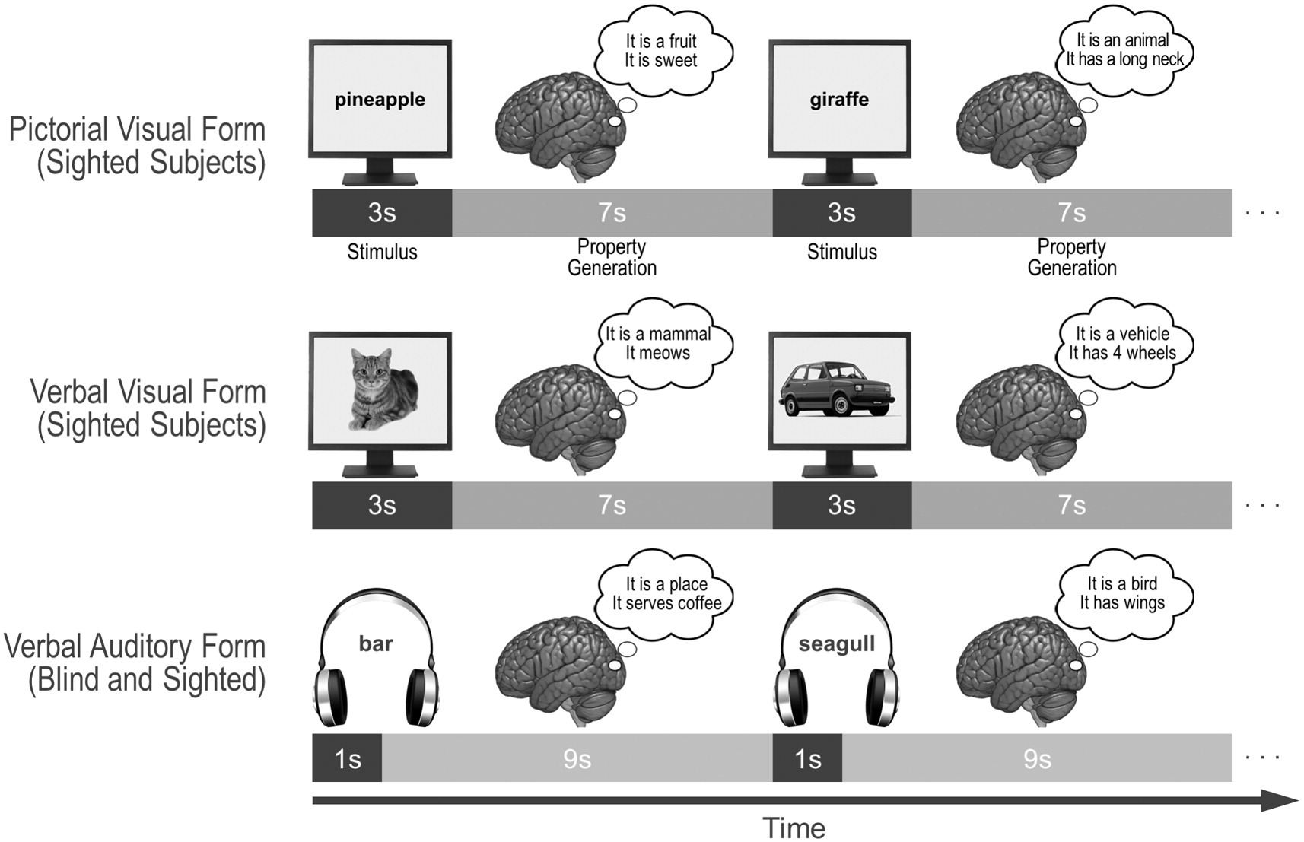
Data for concrete nouns from sighted/blind subjects
Participants were asked to verbally enumerate in one minute the properties (features) that describe the entities the words refer to.
4 groups of participants
5 sighted individuals were presented with a pictorial form of the nouns
5 sighted individuals with a verbal visual (i.e., written Italian words) form
5 sighted individuals with a verbal auditory (i.e., spoken Italian words) form
5 congenitally blind with a verbal auditory form.
Handjaras, Giacomo, Emiliano Ricciardi, Andrea Leo, Alessandro Lenci, Luca Cecchetti, Mirco Cosottini, Giovanna Marotta, and Pietro Pietrini. "How concepts are encoded in the human brain: a modality independent, category-based cortical organization of semantic knowledge." Neuroimage 135 (2016): 232-242.

Slide 18
70 - Italian word stimuli fMRI data
Taxonomic categories in law and music domain
Ur-abstract: that are classified as abstract in WordNet
Attribute: A construct whereby objects or individuals can be distinguished
Communication: Something that is communicated by, to or between groups
Event/action: Something that happens at a given place and time
Person/Social role: Individual, someone, somebody, mortal
Location: Points or extents in space
Object/Tool: A class of unambiguously concrete nouns
Anderson, Andrew J., Douwe Kiela, Stephen Clark, and Massimo Poesio. "Visually grounded and textual semantic models differentially decode brain activity associated with concrete and abstract nouns." Transactions of the Association for Computational Linguistics 5 (2017): 17-30.

Slide 19
Zurich Cognitive Language Processing Corpus (ZuCo)
Personal reading speed.
Sentences were presented to the subjects in a naturalistic reading scenario
Complete sentence is presented on the screen
Subjects read each sentence at their own speed, i.e., the reader determines for how long each word is fixated and which word to fixate next.
Hollenstein, Nora, Jonathan Rotsztejn, Marius Troendle, Andreas Pedroni, Ce Zhang, and Nicolas Langer. "ZuCo, a simultaneous EEG and eye-tracking resource for natural sentence reading." Scientific data 5, no. 1 (2018): 1-13.

Slide 20
Visual Stimulus Datasets
Dataset | Type | Stimulus | #S | Paradigm | Size | Task
Thirion et al., 2006 | fMRI | Rotating wedges, expanding/contracting rings, rotating Gabor filters, grid | 9 | Viewing visual patterns | Wedges/rings for 8 times, 36 Gabor filters for 4 times, grid 36 times | Passive viewing, imagine one of the 6 domino stimuli when prompted to.
Vim-1: Kay et al., 2008 | fMRI | Sequences of natural photos | 2 | Viewing natural images | Each subject viewed 1750 (Stage 1)+ 120 (Stage 2) novel natural images | Passive viewing
Horikawa et al., 2017 | fMRI | Object images | 5 | Viewing and Reading | Each subject: (1) Image presentation: 1,200 images from 150 object categories and 50 images from 50 object categories; (2) Imagery: 10 times. | One-back repetition detection task, imagine object images pertaining to the category
BOLD5000: Chang et al., 2019 | fMRI | 5254 images depicting real-world scenes | 4 | Viewing natural images | ∼20 hours of MRI scans per each of four participants | Passive viewing
Algonauts: Cichy et al., 2019 | fMRI (EVC and IT)/MEG (early and late in time) | Object images | 15 | Viewing object images | 92 silhouette object images and 118 images of objects on natural background | Passive viewing
Natural Scenes Dataset: Allen et al., 2022 | fMRI | 73000 natural scenes | 8 | Viewing natural scenes | ~73000 distinct natural scene images from MSCOCO. | Passive viewing
THINGS: Hebart et al., 2023 | fMRI/EEG | 31188 natural images across 1,854 object concepts. | 8 | Viewing natural images | fMRI: 3 Participants. 8,740 unique images. 720 objects. MEG: 4 Participants. 22,448 unique images. 1,854 objects | oddball detection task (synthetic image).

Slide 21
Visual Binary Patterns
Retinotopic mapping experiment: flickering rotating wedges and expanding/contracting rings.
Domino experiment: groups of quickly rotating Gabor filters in an event-related design. Disks appeared simultaneously on the left and right side of the visual field.
6 different patterns in each hemifield.
Subject was presented with the same grid. When the central fixation cross (left) became a left arrow (middle) or a right arrow (right), the subject had to imagine one of the 6 patterns presented previously, either in the left or right hemifield.
Thirion, Bertrand, Edouard Duchesnay, Edward Hubbard, Jessica Dubois, Jean-Baptiste Poline, Denis Lebihan, and Stanislas Dehaene. "Inverse retinotopy: inferring the visual content of images from brain activation patterns." Neuroimage 33, no. 4 (2006): 1104-1116.

Slide 22
Seen and imagined objects
Two fMRI experiments: An image presentation experiment, and an imagery experiment.
Image presentation experiment
Subjects performed a one-back repetition detection task on the images, responding with a button press for each repetition.
Imagery experiment
Cue stimuli composed of an array of object names were visually presented.
The onset and the end of the imagery periods were signalled by auditory beeps.
After the first beep, the subjects were instructed to imagine as many object images as possible pertaining to the category indicated by red letters.
They continued imagining with their eyes closed (15 s) until the second beep.
Subjects were then instructed to evaluate the vividness of their mental imagery (3 s).
Horikawa, Tomoyasu, and Yukiyasu Kamitani. "Generic decoding of seen and imagined objects using hierarchical visual features." Nature communications 8, no. 1 (2017): 1-15.

Slide 23
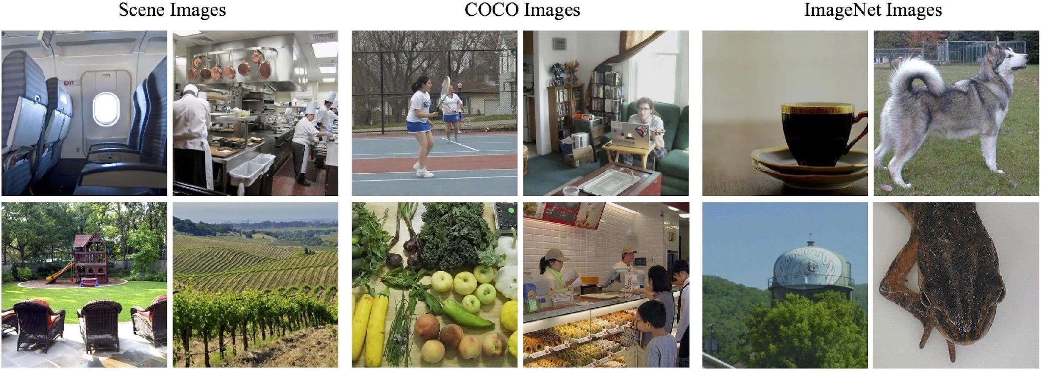
BOLD5000
∼20 hours of MRI scans per each of the four participants.
4,916 unique images were used as stimuli from 3 image sources
Chang, Nadine, John A. Pyles, Austin Marcus, Abhinav Gupta, Michael J. Tarr, and Elissa M. Aminoff. "BOLD5000, a public fMRI dataset while viewing 5000 visual images." Scientific data 6, no. 1 (2019): 1-18.
Notes:
Scenes
1,000 hand-curated indoor (e.g., restaurant) and outdoor (e.g., mountains) scene images covering 250 categories which are also included in the SUN scene categorization dataset
More scenic images, with less of a focus on any particular object, action, or person.
COCO
2,000 images of multiple objects from the COCO object detection dataset
Objects embedded in a realistic context and are frequently shown as interacting with other objects–both inanimate and animate.
ImageNet
1,916 images of mostly singular objects from the ImageNet object categorization dataset
Images that depict a single object as the focus of the picture. The object is often centered and clearly distinguishable from the image background.

Slide 24
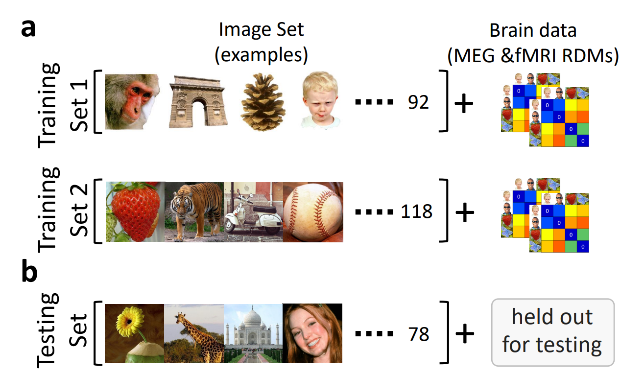
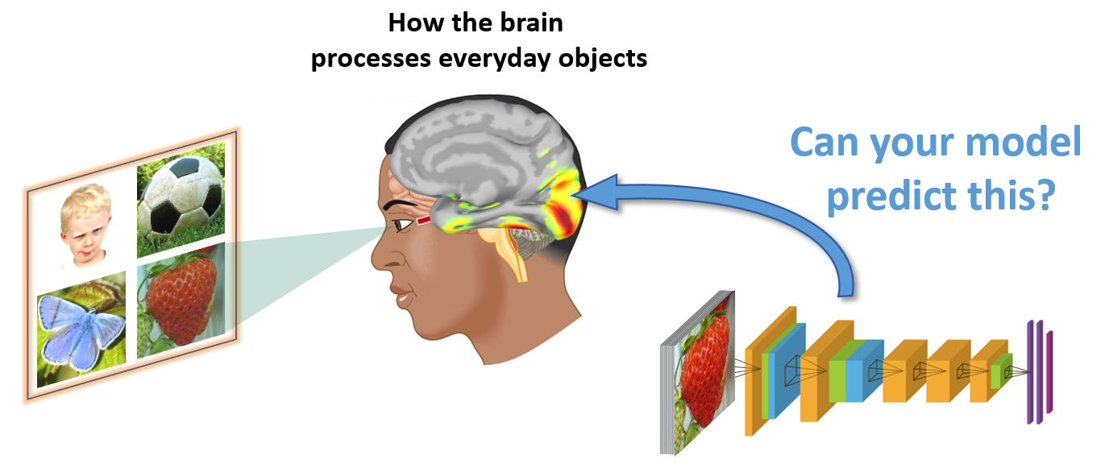
Algonauts
Training and Testing Material.
There are two sets of training data, each consisting of an image set and brain activity in RDM format (for fMRI and MEG). Training set 1 has 92 silhouette object images, and training set 2 has 118 object images with natural backgrounds.
Testing data consists of 78 images of objects on natural backgrounds.
Cichy, Radoslaw Martin, Gemma Roig, Alex Andonian, Kshitij Dwivedi, Benjamin Lahner, Alex Lascelles, Yalda Mohsenzadeh, Kandan Ramakrishnan, and Aude Oliva. "The algonauts project: A platform for communication between the sciences of biological and artificial intelligence." arXiv preprint arXiv:1905.05675 (2019).
Notes:
representational dissimilarity matrices (RDMs).

Slide 25
Audio Stimulus Datasets
Dataset | Type | Language | Stimulus | #S | Paradigm | Size | Task
Handjaras et al., 2016 | fMRI | Italian | Verbal, pictorial or auditory presentation of 40 concrete nouns | 20 | Reading, viewing or listening | 40 nouns * 4 times. | Property Generation
Huth et al., 2016 | fMRI | English | Eleven 10-minute stories | 7 | Listening | 2 hours of stories from The Moth Radio Hour | Passive Listening
Brennan and Hale, 2019 | EEG | English | Chapter one of Alice’s Adventures in Wonderland as read by Kristen McQuillan | 33 | Listening | 2,129 words in 84 sentences. The entire experimental session lasted 1–1.5 h (including QA). | 8 MCQ Question answering concerning the contents of the story
Anderson et al., 2020 | fMRI | English | One of 20 scenario names | 26 | Listening scenario name | 20 scenario prompts displayed 5 times. | Imagine themselves personally experiencing common scenarios
Narratives: Nastase et al., 2021 | fMRI | English | 27 diverse naturalistic spoken stories | 345 | Listening | 891 functional scans, totaling ~4.6 hours of unique stimuli (~43,000 words) | Passive Listening
Natural Stories: Zhang et al., 2020 | fMRI | English | Moth-Radio-Hour naturalistic spoken stories | 19 | Listening | 5 h 33 m (repeated twice). Each story is 6 m 48 s avg or 2492 words. | Passive Listening
The Little Prince: Li et al., 2021 | fMRI | English, Chinese, French | Audiobook | 112 | Listening | English audiobook is 94 minutes long. Chinese: 99min. French: 97 min. | Passive Listening. 4 quiz questions.
MEG-MASC: Gwilliams et al., 2022 | MEG | English | 4 English fictional stories: Cable spool boy, LW1, Black willow, Easy money. | 27 | Listening | Two hours of naturalistic stories. 208 MEG sensors. | Passive Listening

Slide 26
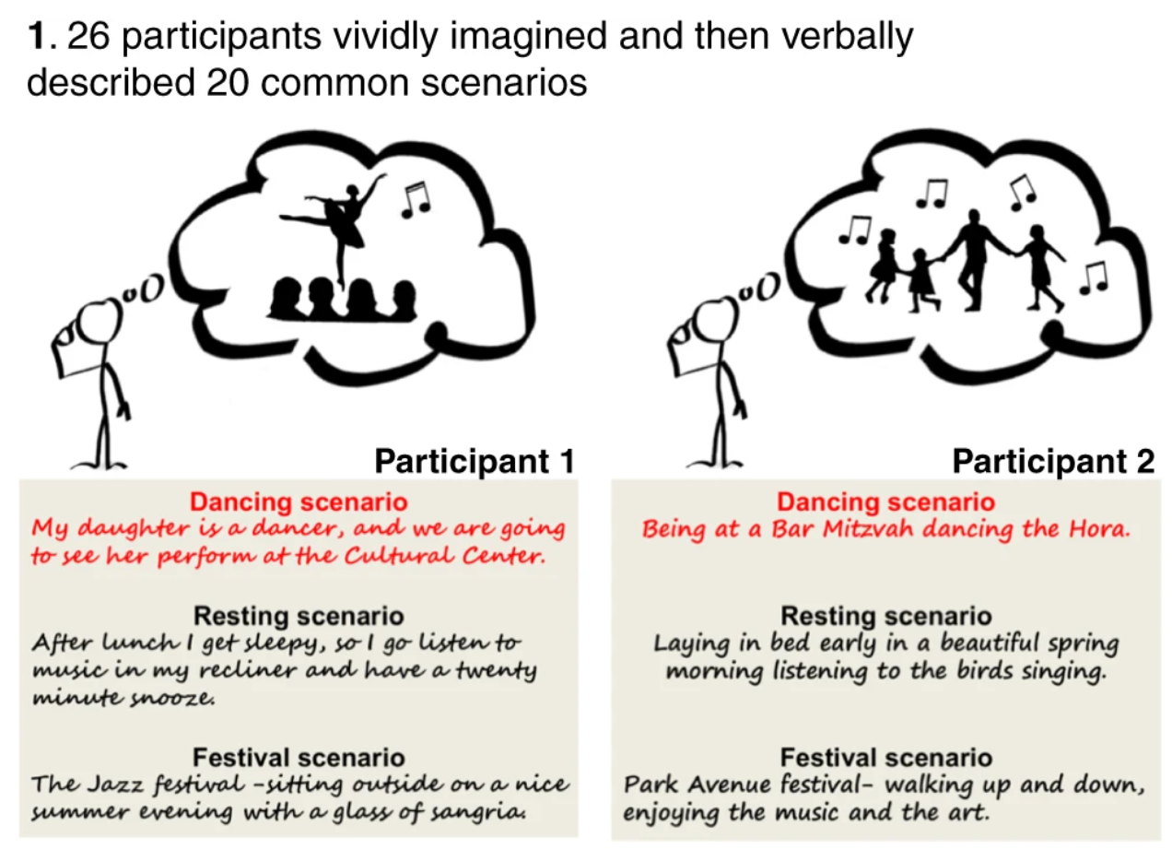
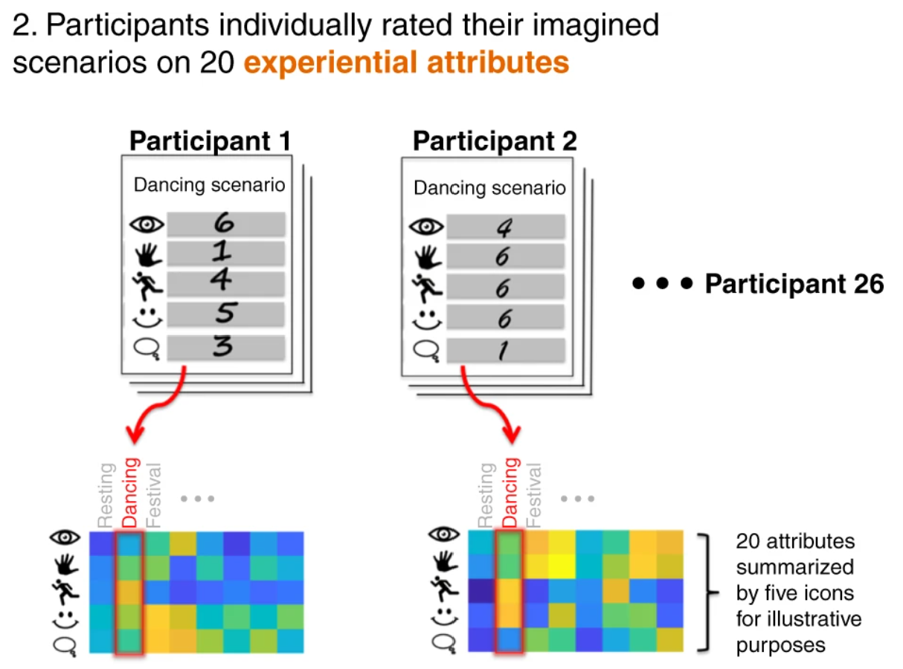
Imagining common scenarios
Participants underwent fMRI as they reimagined the scenarios when prompted by standardized cues.
20 Scenarios: resting, reading, writing, bathing, cooking, housework, exercising, internet, telephoning, driving, shopping, movie, museum, restaurant, barbecue, party, dancing, wedding, funeral, festival.
20 attributes: bright, color, motion, touch, audition, music, speech, taste, head, upperlimb, lowerlimb, body, path, landmark, time, social, communication, cognition, pleasant, unpleasant.
Anderson, Andrew James, Kelsey McDermott, Brian Rooks, Kathi L. Heffner, David Dodell-Feder, and Feng V. Lin. "Decoding individual identity from brain activity elicited in imagining common experiences." Nature communications 11, no. 1 (2020): 1-14.

Slide 27
Narratives
Nastase, Samuel A., Yun-Fei Liu, Hanna Hillman, Asieh Zadbood, Liat Hasenfratz, Neggin Keshavarzian, Janice Chen et al. "The “Narratives” fMRI dataset for evaluating models of naturalistic language comprehension." Scientific data 8, no. 1 (2021): 1-22.

Slide 28
Video Stimulus Datasets
Dataset | Type | Language | Stimulus | #Subjects | Paradigm | Size | Task
BBC’s Doctor Who: Seeliger et al., 2019 | fMRI | English | Spatiotemporal visual and auditory naturalistic stimuli (30 episodes of BBC’s Doctor Who) | 1 | Viewing episode videos | 120.830 whole-brain volumes (approx. 23 h) of single-presentation data, and 1.178 volumes (11 min) of repeated narrative short episodes (22 repetitions) | Passive viewing
Japanese Ads: Nishida et al., 2020 | fMRI | Japanese | 368 web and 2452 TV Japanese ad movies (15-30s) | 40 and 28 for web and TV ads. 16 were overlapped | Viewing Ads | 7200 train and 1200 test fMRIs for web; fMRIs from 420 ads. | Passive viewing
Pippi Langkous: Berezutskaya et al., 2020 | ECoG | The movie was originally in Swedish but dubbed in Dutch | 30 s excerpts of a feature film (in total, 6.5 min long), edited together for a coherent story | 37 patients | Viewing | 6.5 min movie. | Passive viewing
Algonauts: Cichy et al., 2021 | fMRI | English | 1000 short video clips | 10 | Viewing video clips | 1000 short video clips (3 sec each) | Passive viewing
Natural Short Clips: Huth et al., 2022 | fMRI | English | Natural short movie clips | 5 | Watching natural short movie clips | 3870 responses per subject. | Passive viewing

Slide 29
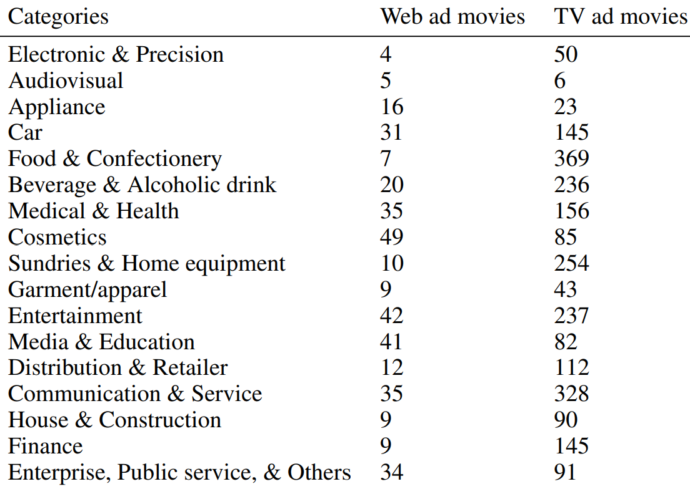
Japanese Ads
Two sets of movies were provided by NTT DATA Corp: web and TV ads.
Four types of cognitive labels associated with the movie datasets
Scene descriptions
Human judges create scene descriptions with 50+ words per 1s scene.
Impression ratings
Human rating on 30 factors for every 2s clip on a scale of 0-4.
Ad effectiveness indices
Click rate: fraction of viewers who clicked the frame of a movie and jumped to a linked web page
View completion rate: fraction of viewers who continued to watch an ad movie until the end without choosing a skip option.
Ad preference votes
Each tester was asked to freely recall a small number of favorite TV ads from among the ads recently broadcasted.
The total number of recalls of an ad was regarded as its preference value.
Nishida, Satoshi, Yusuke Nakano, Antoine Blanc, Naoya Maeda, Masataka Kado, and Shinji Nishimoto. "Brain-mediated transfer learning of convolutional neural networks." In Proceedings of the AAAI Conference on Artificial Intelligence, vol. 34, no. 04, pp. 5281-5288. 2020.

Slide 30
Algonauts 2021
fMRI from 10 human subjects that watched over 1,000 short (3 sec) video clips.
Cichy, Radoslaw Martin, Kshitij Dwivedi, Benjamin Lahner, Alex Lascelles, Polina Iamshchinina, M. Graumann, A. Andonian et al. "The Algonauts Project 2021 Challenge: How the Human Brain Makes Sense of a World in Motion." arXiv preprint arXiv:2104.13714 (2021).

Slide 31
Other Multimodal Stimulus Datasets
Dataset | Type | Language | Stimulus | #Subjects | Paradigm | Size | Task
Mitchell et al., 2008 | fMRI | English | 60 different word-picture pairs from 12 categories. | 9 | Viewing word-picture pairs | 60 different word-picture pairs presented six times each | Passive viewing
Sudre et al., 2012 | MEG | English | 60 concrete nouns along with line drawings | 9 | Reading | 60 stimuli × 20 questions = 1200 examples | Question answering
Zinszer et al., 2017 | fNIRS | English | 8 concrete nouns (audiovisual word and picture stimuli): bunny, bear, kitty, dog, mouth, foot, hand, and nose | 24 | Viewing and listening | 12 blocks with the 8 stimuli per subject. | Passive viewing and listening
Pereira et al., 2018 | fMRI | English | 180 Words with Picture, Sentences, word clouds; 96 text passages; 72 passages | 16 | Viewing WP, sentences or word clouds | 180 WP, S and WC per subject; 96+72 passages shown 3 times | Passive viewing
Cao et al., 2021 | fNIRS | Chinese | 50 concrete nouns from 10 semantic categories | 7 | Viewing and listening | Each stimulus is presented 7 times. | Passive viewing and listening
Courtois Neuromod | fMRI | full-length movies and TV show | 6 | Viewing and Listening | ~100 hours of data per participant | Passive viewing

Slide 32
Concrete nouns with line drawings
Subjects were asked to perform a QA task, while their brain activity was recorded using MEG.
Subjects were first presented with a question (e.g., “Is it manmade?”), followed by 60 concrete nouns, along with their line drawings, in a random order.
Each stimulus was presented until the subject pressed a button to respond “yes” or “no” to the initial question.
Once all 60 stimuli are presented, a new question is shown for a total of 20 questions.
Sudre, Gustavo, Dean Pomerleau, Mark Palatucci, Leila Wehbe, Alona Fyshe, Riitta Salmelin, and Tom Mitchell. "Tracking neural coding of perceptual and semantic features of concrete nouns." NeuroImage 62, no. 1 (2012): 451-463.

Slide 33
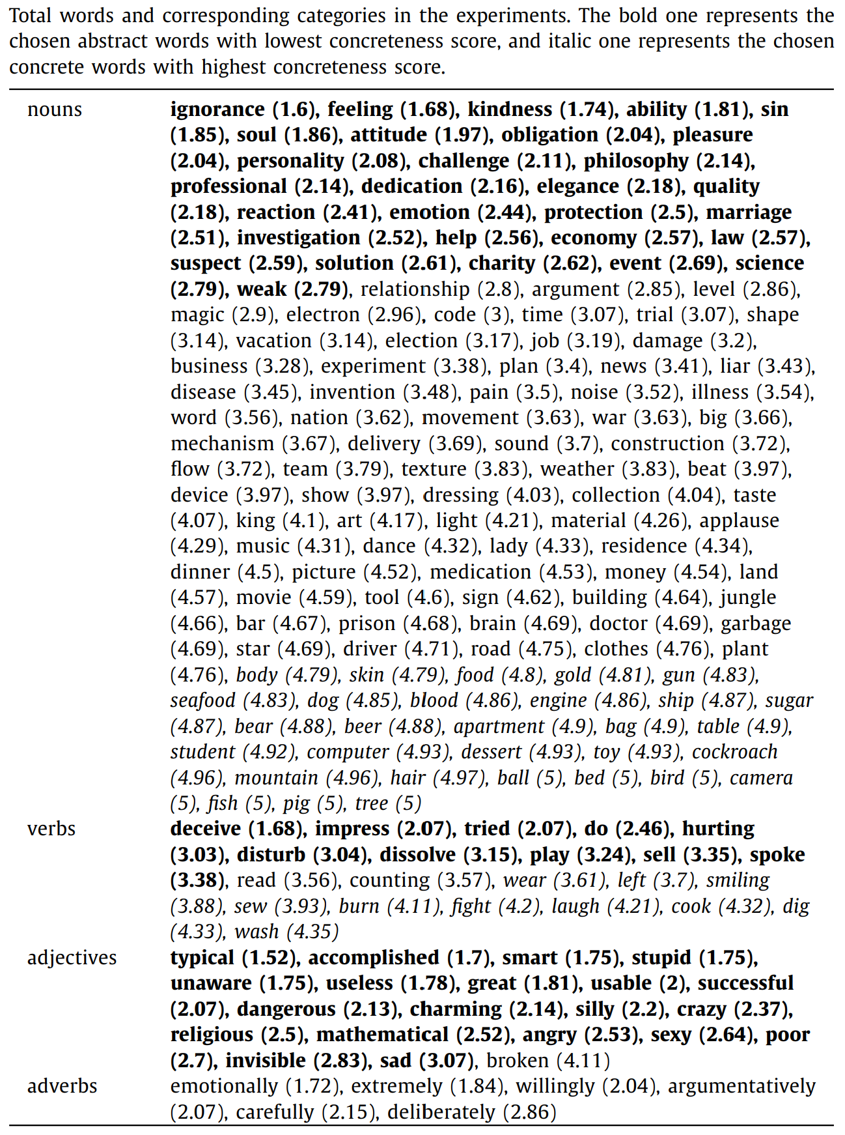
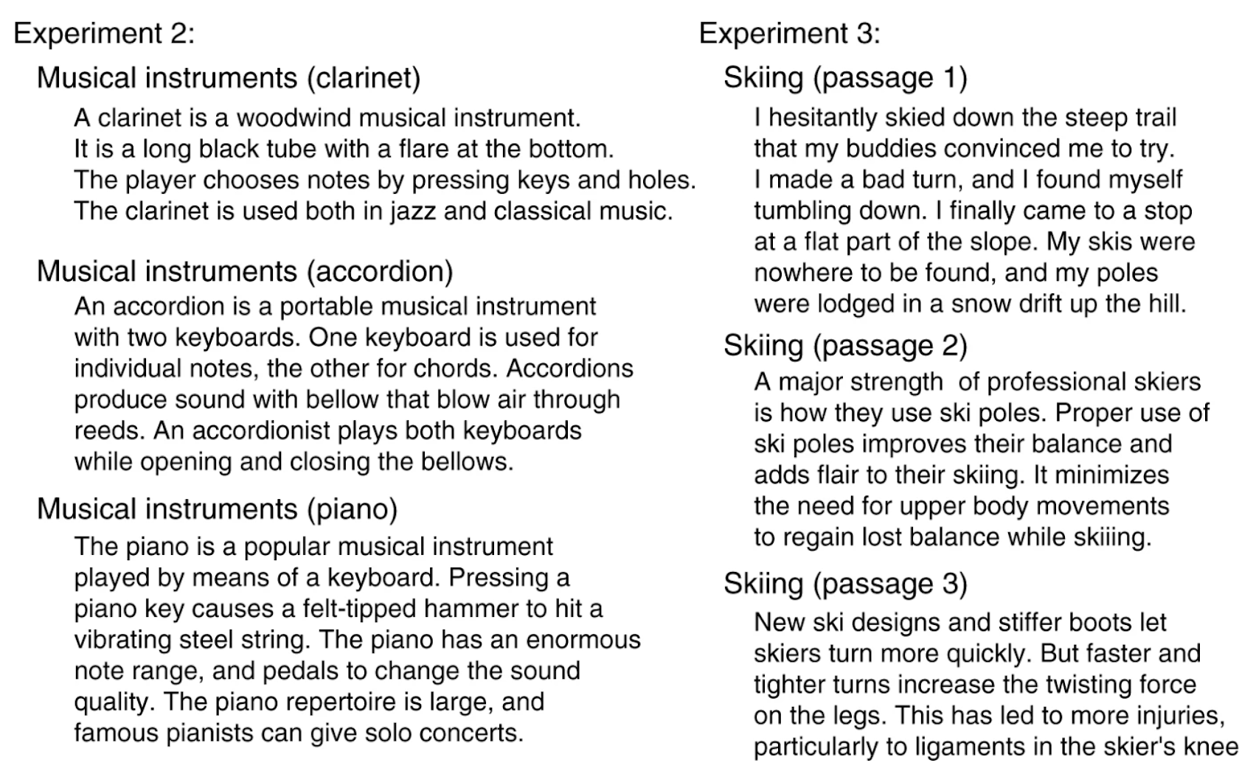
Word+Picture, Sentences, Word Clouds, Passages
Experiment 1: 180 words (128 nouns, 22 verbs, 29 adjectives and adverbs, and 1 function word). 3 paradigms.
Experiment 2: 96 text passages, each with 4 sentences from 24 broad topics (e.g., professions, clothing, birds, musical instruments, natural disasters, crimes, etc.)
Experiment 3: 72 passages, each with 3-4 sentences from another 24 topics.
Pereira, Francisco, Bin Lou, Brianna Pritchett, Samuel Ritter, Samuel J. Gershman, Nancy Kanwisher, Matthew Botvinick, and Evelina Fedorenko. "Toward a universal decoder of linguistic meaning from brain activation." Nature communications 9, no. 1 (2018): 1-13.

Slide 34
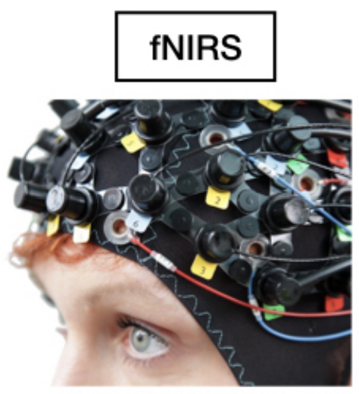
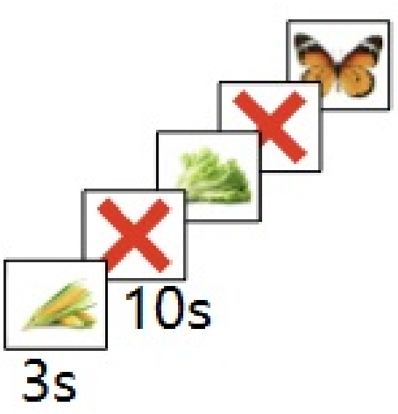
fNIRS with audio-visual stimuli
Stimuli are pictures and audios of 50 objects from 10 categories.
Visual presentation lasts for 3s, with audio presented immediately at the onset, followed by a 10s rest period.
During rest period, participants are instructed to fixate on an X displayed in the center of the screen.
Cao, Lu, Dandan Huang, Yue Zhang, Xiaowei Jiang, and Yanan Chen. "Brain decoding using fnirs." In Proceedings of the AAAI Conference on Artificial Intelligence, vol. 35, no. 14, pp. 12602-12611. 2021.

Slide 35
Text Stimulus Datasets References
Wehbe, Leila, Brian Murphy, Partha Talukdar, Alona Fyshe, Aaditya Ramdas, and Tom Mitchell. "Simultaneously uncovering the patterns of brain regions involved in different story reading subprocesses." PloS one 9, no. 11 (2014): e112575.
Hollenstein, Nora, Jonathan Rotsztejn, Marius Troendle, Andreas Pedroni, Ce Zhang, and Nicolas Langer. "ZuCo, a simultaneous EEG and eye-tracking resource for natural sentence reading." Scientific data 5, no. 1 (2018): 1-13.
Handjaras, Giacomo, Emiliano Ricciardi, Andrea Leo, Alessandro Lenci, Luca Cecchetti, Mirco Cosottini, Giovanna Marotta, and Pietro Pietrini. "How concepts are encoded in the human brain: a modality independent, category-based cortical organization of semantic knowledge." Neuroimage 135 (2016): 232-242.
Anderson, Andrew J., Douwe Kiela, Stephen Clark, and Massimo Poesio. "Visually grounded and textual semantic models differentially decode brain activity associated with concrete and abstract nouns." Transactions of the Association for Computational Linguistics 5 (2017): 17-30.
Anderson, Andrew James, Jeffrey R. Binder, Leonardo Fernandino, Colin J. Humphries, Lisa L. Conant, Rajeev DS Raizada, Feng Lin, and Edmund C. Lalor. "An integrated neural decoder of linguistic and experiential meaning." Journal of Neuroscience 39, no. 45 (2019): 8969-8987.
Oseki, Yohei, and Masayuki Asahara. "Design of BCCWJ-EEG: Balanced corpus with human electroencephalography." In Proceedings of the 12th Language Resources and Evaluation Conference, pp. 189-194. 2020.
Deniz, Fatma, Anwar O. Nunez-Elizalde, Alexander G. Huth, and Jack L. Gallant. "The representation of semantic information across human cerebral cortex during listening versus reading is invariant to stimulus modality." Journal of Neuroscience 39, no. 39 (2019): 7722-7736.

Slide 36
Visual Stimulus Datasets References
Thirion, Bertrand, Edouard Duchesnay, Edward Hubbard, Jessica Dubois, Jean-Baptiste Poline, Denis Lebihan, and Stanislas Dehaene. "Inverse retinotopy: inferring the visual content of images from brain activation patterns." Neuroimage 33, no. 4 (2006): 1104-1116.
Kay, Kendrick N., Thomas Naselaris, Ryan J. Prenger, and Jack L. Gallant. "Identifying natural images from human brain activity." Nature 452, no. 7185 (2008): 352-355.
Horikawa, Tomoyasu, and Yukiyasu Kamitani. "Generic decoding of seen and imagined objects using hierarchical visual features." Nature communications 8, no. 1 (2017): 1-15.
Chang, Nadine, John A. Pyles, Austin Marcus, Abhinav Gupta, Michael J. Tarr, and Elissa M. Aminoff. "BOLD5000, a public fMRI dataset while viewing 5000 visual images." Scientific data 6, no. 1 (2019): 1-18.
Cichy, Radoslaw Martin, Gemma Roig, Alex Andonian, Kshitij Dwivedi, Benjamin Lahner, Alex Lascelles, Yalda Mohsenzadeh, Kandan Ramakrishnan, and Aude Oliva. "The algonauts project: A platform for communication between the sciences of biological and artificial intelligence." arXiv preprint arXiv:1905.05675 (2019).
Allen, Emily J., Ghislain St-Yves, Yihan Wu, Jesse L. Breedlove, Jacob S. Prince, Logan T. Dowdle, Matthias Nau et al. "A massive 7T fMRI dataset to bridge cognitive neuroscience and artificial intelligence." Nature neuroscience 25, no. 1 (2022): 116-126.
Hebart, Martin N., Oliver Contier, Lina Teichmann, Adam H. Rockter, Charles Y. Zheng, Alexis Kidder, Anna Corriveau, Maryam Vaziri-Pashkam, and Chris I. Baker. "THINGS-data, a multimodal collection of large-scale datasets for investigating object representations in human brain and behavior." Elife 12 (2023): e82580.

Slide 37
Audio Stimulus Datasets References
Handjaras, Giacomo, Emiliano Ricciardi, Andrea Leo, Alessandro Lenci, Luca Cecchetti, Mirco Cosottini, Giovanna Marotta, and Pietro Pietrini. "How concepts are encoded in the human brain: a modality independent, category-based cortical organization of semantic knowledge." Neuroimage 135 (2016): 232-242.
Huth, Alexander G., Wendy A. De Heer, Thomas L. Griffiths, Frédéric E. Theunissen, and Jack L. Gallant. "Natural speech reveals the semantic maps that tile human cerebral cortex." Nature 532, no. 7600 (2016): 453-458.
Jain, Shailee, and Alexander Huth. "Incorporating context into language encoding models for fMRI." Advances in neural information processing systems 31 (2018).
Brennan, Jonathan R., and John T. Hale. "Hierarchical structure guides rapid linguistic predictions during naturalistic listening." PloS one 14, no. 1 (2019): e0207741.
Anderson, Andrew James, Kelsey McDermott, Brian Rooks, Kathi L. Heffner, David Dodell-Feder, and Feng V. Lin. "Decoding individual identity from brain activity elicited in imagining common experiences." Nature communications 11, no. 1 (2020): 1-14.
Nastase, Samuel A., Yun-Fei Liu, Hanna Hillman, Asieh Zadbood, Liat Hasenfratz, Neggin Keshavarzian, Janice Chen et al. "The “Narratives” fMRI dataset for evaluating models of naturalistic language comprehension." Scientific data 8, no. 1 (2021): 1-22.
Zhang, Yizhen, Kuan Han, Robert Worth, and Zhongming Liu. "Connecting concepts in the brain by mapping cortical representations of semantic relations." Nature communications 11, no. 1 (2020): 1877.
Li, Jixing, Shohini Bhattasali, Shulin Zhang, Berta Franzluebbers, Wen-Ming Luh, R. Nathan Spreng, Jonathan R. Brennan, Yiming Yang, Christophe Pallier, and John Hale. "Le Petit Prince: A multilingual fMRI corpus using ecological stimuli." Biorxiv (2021): 2021-10.
Gwilliams, Laura, Graham Flick, Alec Marantz, Liina Pylkkanen, David Poeppel, and Jean-Remi King. "MEG-MASC: a high-quality magneto-encephalography dataset for evaluating natural speech processing." arXiv preprint arXiv:2208.11488 (2022).

Slide 38
Video Stimulus Datasets References
Seeliger, K., R. P. Sommers, Umut Güçlü, Sander E. Bosch, and M. A. J. Van Gerven. "A large single-participant fMRI dataset for probing brain responses to naturalistic stimuli in space and time." bioRxiv (2019): 687681.
Nishida, Satoshi, Yusuke Nakano, Antoine Blanc, Naoya Maeda, Masataka Kado, and Shinji Nishimoto. "Brain-mediated transfer learning of convolutional neural networks." In Proceedings of the AAAI Conference on Artificial Intelligence, vol. 34, no. 04, pp. 5281-5288. 2020.
Cichy, Radoslaw Martin, Kshitij Dwivedi, Benjamin Lahner, Alex Lascelles, Polina Iamshchinina, M. Graumann, A. Andonian et al. "The Algonauts Project 2021 Challenge: How the Human Brain Makes Sense of a World in Motion." arXiv preprint arXiv:2104.13714 (2021).
Berezutskaya, Julia, Zachary V. Freudenburg, Luca Ambrogioni, Umut Güçlü, Marcel AJ van Gerven, and Nick F. Ramsey. "Cortical network responses map onto data-driven features that capture visual semantics of movie fragments." Scientific reports 10, no. 1 (2020): 1-21.
Huth, Alexander G., Shinji Nishimoto, An T. Vu, and T. Dupre La Tour. "Gallant lab natural short clips 3T fmri data." 50 GiB (2022).

Slide 39
Multimodal Stimulus Datasets References
Mitchell, Tom M., Svetlana V. Shinkareva, Andrew Carlson, Kai-Min Chang, Vicente L. Malave, Robert A. Mason, and Marcel Adam Just. "Predicting human brain activity associated with the meanings of nouns." science 320, no. 5880 (2008): 1191-1195.
Sudre, Gustavo, Dean Pomerleau, Mark Palatucci, Leila Wehbe, Alona Fyshe, Riitta Salmelin, and Tom Mitchell. "Tracking neural coding of perceptual and semantic features of concrete nouns." NeuroImage 62, no. 1 (2012): 451-463.
Zinszer, Benjamin D., Laurie Bayet, Lauren L. Emberson, Rajeev DS Raizada, and Richard N. Aslin. "Decoding semantic representations from functional near-infrared spectroscopy signals." Neurophotonics 5, no. 1 (2017): 011003.
Pereira, Francisco, Bin Lou, Brianna Pritchett, Samuel Ritter, Samuel J. Gershman, Nancy Kanwisher, Matthew Botvinick, and Evelina Fedorenko. "Toward a universal decoder of linguistic meaning from brain activation." Nature communications 9, no. 1 (2018): 1-13.
Cao, Lu, Dandan Huang, Yue Zhang, Xiaowei Jiang, and Yanan Chen. "Brain decoding using fnirs." In Proceedings of the AAAI Conference on Artificial Intelligence, vol. 35, no. 14, pp. 12602-12611. 2021.
Boyle, Julie A., Basile Pinsard, A. Boukhdhir, S. Belleville, S. Bram-batti, J. Chen, J. Cohen-Adad et al. "The Courtois project on neuronal modelling: 2020 data release." In Presented at the 26th annual meeting of the Organization for Human Brain Mapping. 2020.

Slide 40
Agenda
Introduction to Brain encoding and decoding [30 min]
Stimulus Representations [1 hour]
Coffee break [30 min]
Deep Learning for Brain Decoding [1 hour 30 min]
Lunch break [1 hour 30 min]
Deep Learning for Brain Encoding [1 hour 30 min]
Coffee break [30 min]
Advanced Methods [1 hour 15 min]
Summary and Future Trends [15 min]

Slide 41
Agenda
Introduction to Brain encoding and decoding [30 min]
Stimulus Representations [1 hour]
Text Stimulus Representations
Visual Stimulus Representations
Audio Stimulus Representations
Multimodal Stimulus Representations
Coffee break [30 min]
Deep Learning for Brain Decoding [1 hour 30 min]
Lunch break [1 hour 30 min]
Deep Learning for Brain Encoding [1 hour 30 min]
Coffee break [30 min]
Advanced Methods [1 hour 15 min]
Summary and Future Trends [15 min]

Slide 42
Stimulus Representations
Text Stimuli
Basic NLP Representations: Corpus co-occurrence counts, topic models, Linguistic (POS, dependencies, roles)
Discourse features.
Semantic: word embedding methods, sentence representation models, recurrent neural networks and Transformer methods.
Experiential attributes: Rated on 0-6 scale or binary.
Visual Stimuli
Visual field filter banks
Gabor wavelet pyramid
HMAX model
Convolutional neural networks
Audio Stimuli
Phoneme rate and presence of phonemes.
Multimodal Stimuli

Slide 43
Agenda
Introduction to Brain encoding and decoding [30 min]
Stimulus Representations [1 hour]
Text Stimulus Representations
Visual Stimulus Representations
Audio Stimulus Representations
Multimodal Stimulus Representations
Coffee break [30 min]
Deep Learning for Brain Decoding [1 hour 30 min]
Lunch break [1 hour 30 min]
Deep Learning for Brain Encoding [1 hour 30 min]
Coffee break [30 min]
Advanced Methods [1 hour 15 min]
Summary and Future Trends [15 min]

Slide 44
Text Stimulus Representations
Basic NLP Representations
Corpus co-occurrence counts
Topic models
Linguistic: POS, dependencies, roles.
Discourse
Characters, motion, speech, emotions, non-motion verbs
Deep Learning based Representations
Embeddings
Longer context using LSTMs
Transformers
Experiential attributes
Rated on 0-6 scale
Binary

Slide 45
Basic NLP Representations for Word Stimuli
Corpus co-occurrence counts
25 verbs (Mitchell et al., 2008; Pereira et al., 2013)
Verbs: see, hear, listen, taste, smell, eat, touch, nib, lift, manipulate, run, push, fill, move, ride, say, fear, open, approach, near, enter, drive, wear, break, and clean.
These verbs generally correspond to basic sensory and motor activities, actions per formed on objects, and actions involving changes to spatial relationships.
For each (verb, stimulus word w), feature value = normalized co-occurrence count of w with any of three forms of the verb (e.g., taste, tastes, or tasted) over the text corpus.
985 common English words (such as above, worry, and mother) in (Huth et al., 2016).
Topic models (Pereira et al., 2013)
Get relevant Wiki pages (e.g., “airplane” is “Fixed-Wing Aircraft”) and other linked pages (e.g. “Aircraft cabin”)
LDA topic modelling on 3500 pages with #topics from 10 to 100, in increments of 5, setting the α parameter to 25/#topics.
LSA topic modelling (Wang et al., 2017)

Slide 46
Basic NLP Representations for Word Stimuli
Word length
Is the word related to one of the 28 unique parts of speech and 17 unique dependency relationships?
Position of word in the sentence
Roles
Main verb
Agent or experiencer
Patient or recipient
Predicate of a sentence (The window was dusty)
Modifier (The angry activist broke the chair)
Complement in adjunct and propositional phrase, including direction, location, and time (The restaurant was loud at night).
Wehbe, Leila, Brian Murphy, Partha Talukdar, Alona Fyshe, Aaditya Ramdas, and Tom Mitchell. "Simultaneously uncovering the patterns of brain regions involved in different story reading subprocesses." PloS one 9, no. 11 (2014): e112575.
Wang, Jing, Vladimir L. Cherkassky, and Marcel Adam Just. "Predicting the brain activation pattern associated with the propositional content of a sentence: modeling neural representations of events and states." Human brain mapping 38, no. 10 (2017): 4865-4881.

Slide 47
Discourse features (for Harry Potter dataset)
Characters: Resolve all pronouns to the character to whom they refer, and make binary features to signal which of the 10 characters are mentioned.
Motions: Identify a set of motions that occurred frequently in the chapter (e.g. fly, manipulate, collide physically, etc.).
Speech: Indicate the parts of the story that correspond to direct speech between the characters. Used the presence of dialog as a feature.
Emotions: Identified a set of emotions that were felt by the characters in the chapter (e.g. annoyance, nervousness, pride, etc.).
Verbs: Identified a set of actions that occurred frequently in the chapter that were distinct from motion (e.g. hear, know, see, etc.).
Wehbe, Leila, Brian Murphy, Partha Talukdar, Alona Fyshe, Aaditya Ramdas, and Tom Mitchell. "Simultaneously uncovering the patterns of brain regions involved in different story reading subprocesses." PloS one 9, no. 11 (2014): e112575.
Wang, Jing, Vladimir L. Cherkassky, and Marcel Adam Just. "Predicting the brain activation pattern associated with the propositional content of a sentence: modeling neural representations of events and states." Human brain mapping 38, no. 10 (2017): 4865-4881.

Slide 48
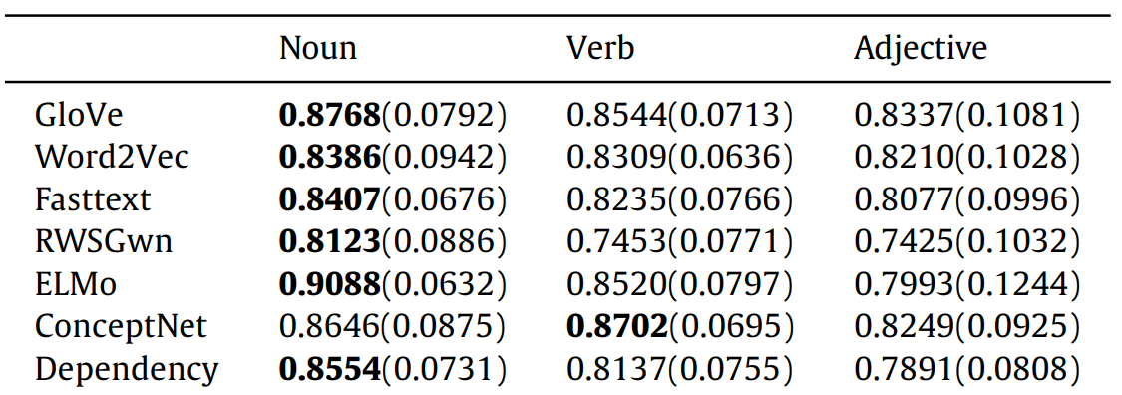
DL Representations: Using embeddings for word stimuli
GloVe 300D vectors (Pereira et al., 2016; Wang et al., 2017; Pereira et al., 2018; Anderson et al., 2019)
1000D Non-negative sparse embeddings (Wehbe et al., 2014).
300D embeddings by training a skip-gram model using negative sampling (SGNS) on Italian and English Wikipedia dumps using Gensim. (Anderson et al., 2017a)
FastText (Berezutskaya et al., 2020)
Comparison across multiple embedding methods
GloVe, word2vec, WordNet2Vec, FastText, ELMo (Hollenstein et al., 2019)
word2Vec, fastText, GloVe, Dependency-based word2vec, RWSGwn, ConceptNet, ELMo, averaged and concatenated combinations (Wang et al., 2020)
Notes:
Dependency-based Word2Vec: The dependency-based Word2Vec introduced in [22] is a Word2Vec model in which the context of the words is computed based on the dependency relations.
fastText: fastText is a modification of Word2Vec that takes morphological information into account
GloVe is a count-based method that performs a dimensionality reduction on the cooccurrence matrix
RWSGwn: RWSGwn embeddings are computed on WordNet with random walks and dimensionality reduction techniques
ConceptNet: ConceptNet is a knowledge graph that connects words and phrases of natural language with labeled edges, representing the general knowledge involved in understanding language. The ConceptNet embeddings are computed on a ConceptNet graph using the PPMI (Positive Pointwise Mutual Information) method.

Slide 49
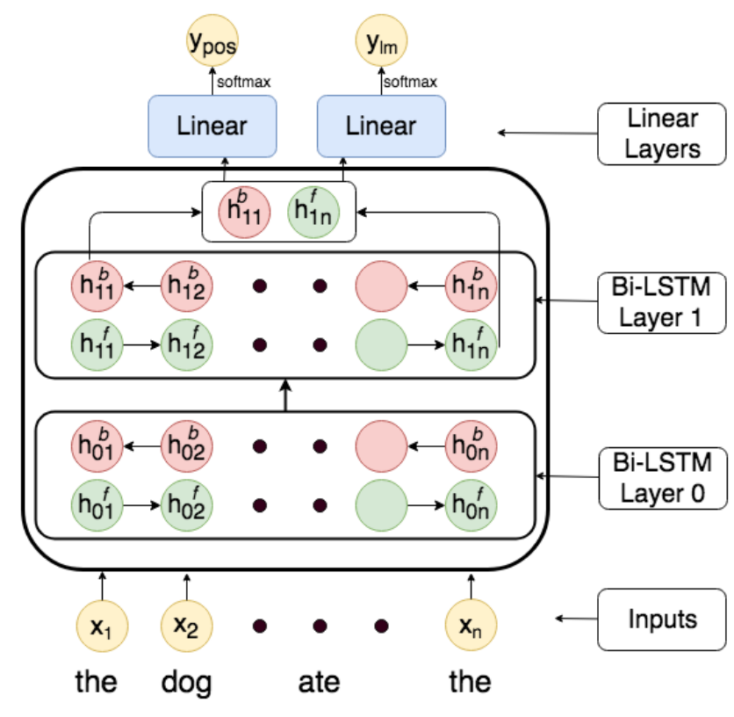
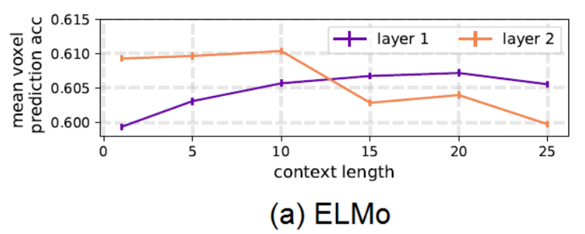
DL Representations: Using longer context for word stimuli
Multi-task LSTMs
Predict next word and POS of next word.
ELMo embeddings: LSTM based pretrained language model
Toneva, Mariya, and Leila Wehbe. "Interpreting and improving natural-language processing (in machines) with natural language-processing (in the brain)." Advances in Neural Information Processing Systems 32 (2019).
Jain, Shailee, and Alexander Huth. "Incorporating context into language encoding models for fMRI." Advances in neural information processing systems 31 (2018).
Jat, Sharmistha, Hao Tang, Partha Talukdar, and Tom Mitchell. "Relating simple sentence representations in deep neural networks and the brain." arXiv preprint arXiv:1906.11861 (2019).

Slide 50
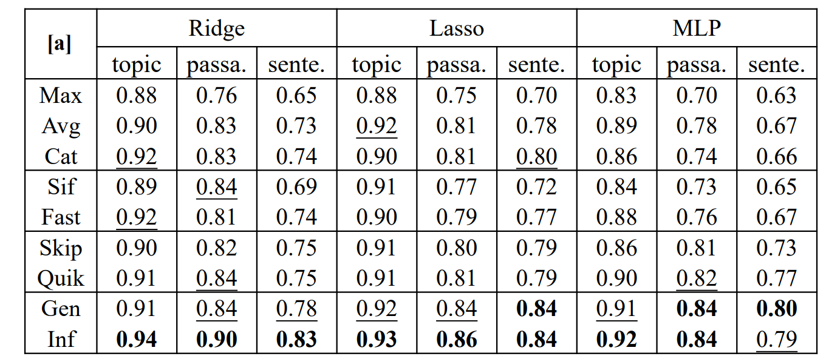
DL Representations: Using sentence embeddings
Unstructured Models: Ignore sentence structure
Simple Pooling Methods
Average/max/concat(max, avg) pooling over word embeddings.
Advanced Pooling Methods
FastSent (Hill, Cho, and Korhonen 2016) sums word embeddings in a sentence as its representation to predict the surrounding sentences.
SIF (Arora, Liang, and Ma 2016) adapts the naïve averaging of word embeddings to weighted averaging.
Structured Models
Unsupervised Methods: Skip-thought, QuickThought.
Supervised Methods: InferSent, GenSen (Subramanian et al. 2018), Universal Sentence Encoder
Toneva, Mariya, and Leila Wehbe. "Interpreting and improving natural-language processing (in machines) with natural language-processing (in the brain)." Advances in Neural Information Processing Systems 32 (2019).
Sun, Jingyuan, Shaonan Wang, Jiajun Zhang, and Chengqing Zong. "Towards sentence-level brain decoding with distributed representations." In Proceedings of the AAAI Conference on Artificial Intelligence, vol. 33, no. 01, pp. 7047-7054. 2019.

Slide 51
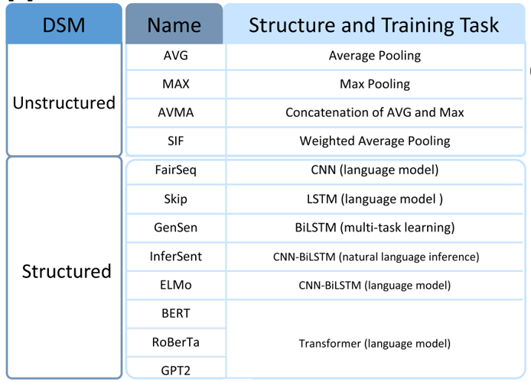
DL Representations: Transformer-based methods for text stimuli (Layer #, context length, architecture)
Transformer-XL is the only model that continues to increase performance as the context length is increased. In all networks, the middle layers perform the best for contexts longer than 15 words. The deepest layers across all networks show a sharp increase in performance at short-range context (fewer than 10 words), followed by a decrease in performance. [Toneva and Wehbe, 2019]
Toneva, Mariya, and Leila Wehbe. "Interpreting and improving natural-language processing (in machines) with natural language-processing (in the brain)." Advances in Neural Information Processing Systems 32 (2019).
Sun, Jingyuan, Shaonan Wang, Jiajun Zhang, and Chengqing Zong. "Neural encoding and decoding with distributed sentence representations." IEEE Transactions on Neural Networks and Learning Systems 32, no. 2 (2020): 589-603.

Slide 52
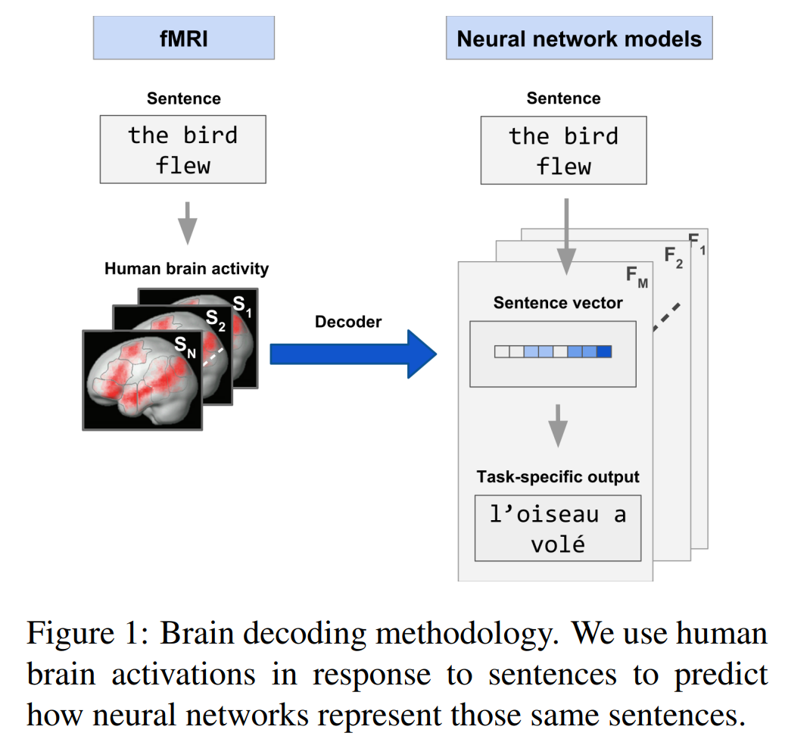
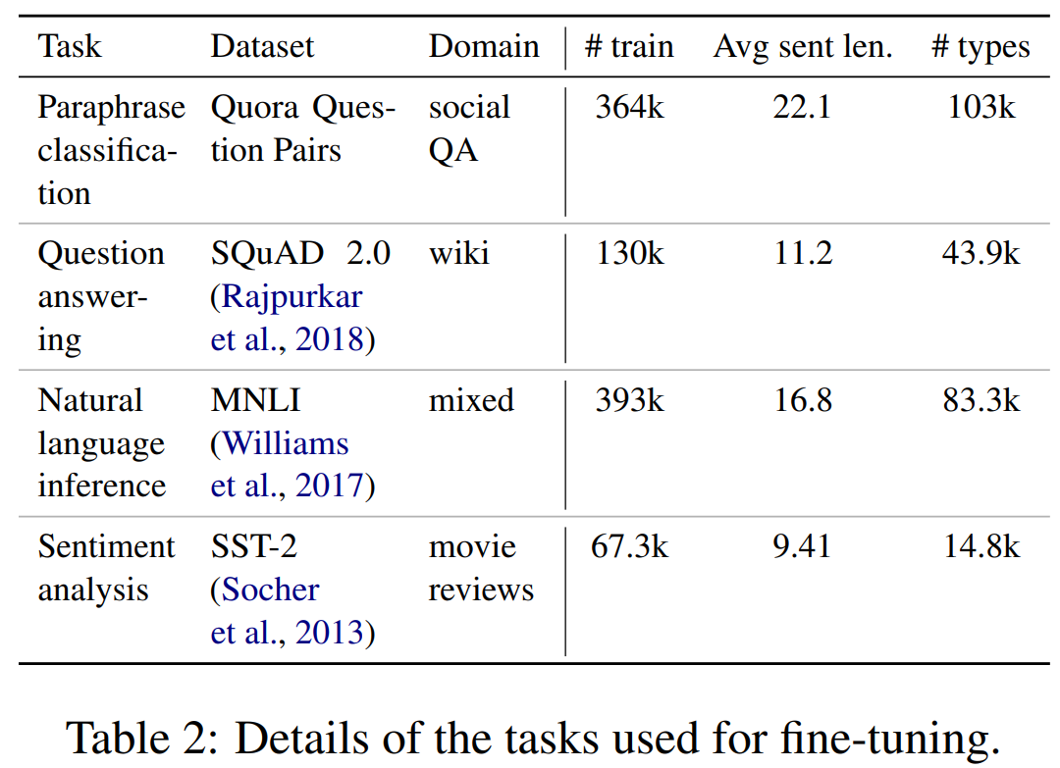
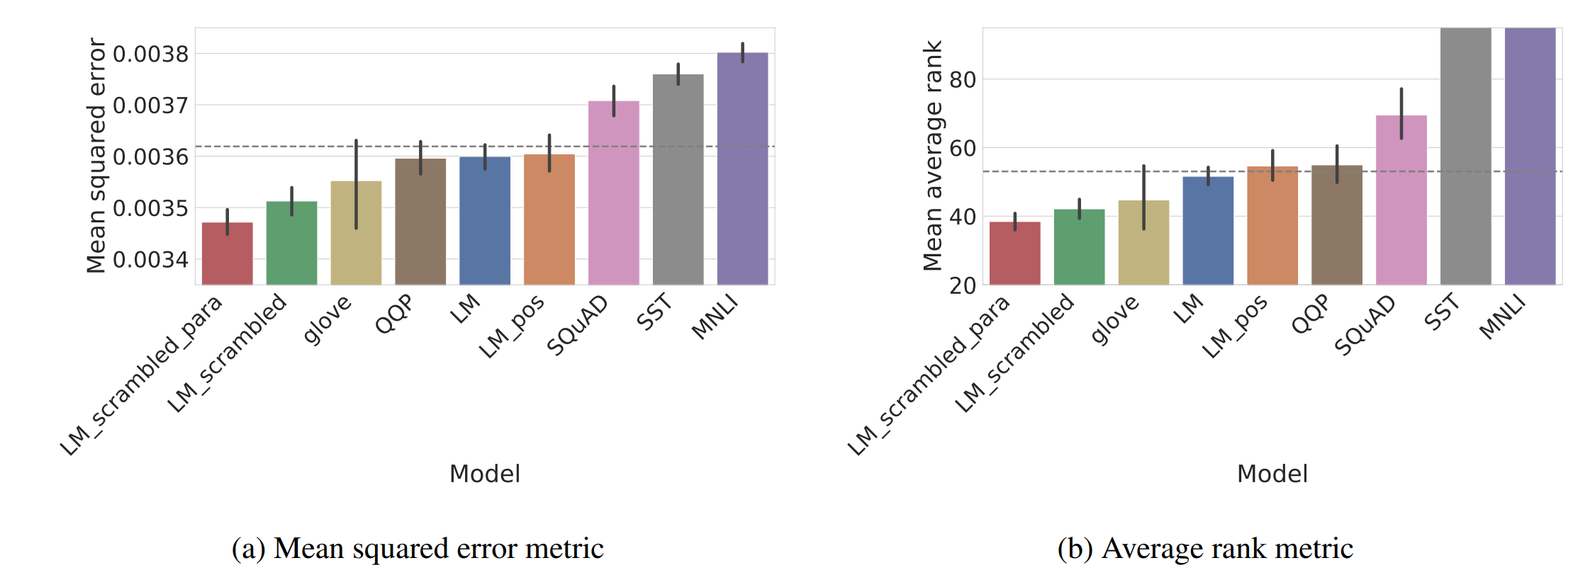
DL Representations: Transformer-based methods for text stimuli (NLP task finetuning and scrambled LM)
Scrambled LM
Randomly shuffle words from the corpus samples, to remove all first order cues to syntactic structure.
LM-scrambled: words are shuffled within sentences
LM-scrambled-para: words are shuffled within their containing paragraphs in the corpus.
LM_pos: predict only the part of speech of a masked word, rather than the word itself.
Scrambled LMs work best!
Gauthier, Jon, and Roger Levy. "Linking artificial and human neural representations of language." arXiv preprint arXiv:1910.01244 (2019).

Slide 53
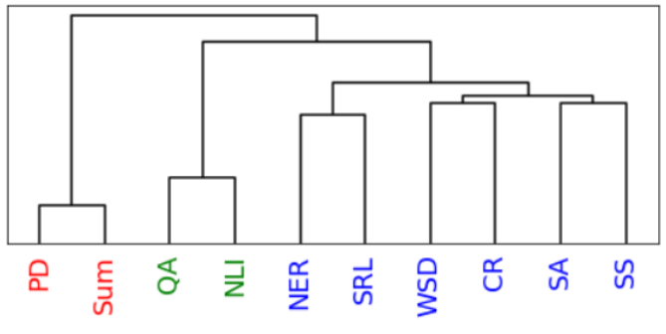
DL Representations: Transformer-based methods for text stimuli (NLP task finetuning)
Pereira dataset: CR, NER, and SS perform the best.
Tasks
Paraphrase, Summarization, Question Answering, Sentiment Analysis, NER, Word Sense Disambiguation, Natural Language Inference, Semantic Role Labeling, Coreference Resolution, Shallow Syntax Parsing
Dendrogram constructed using similarity on representations from task-specific Transformer encoder models with stimuli from the dataset passed as input.
Oota, Subba Reddy, Jashn Arora, Veeral Agarwal, Mounika Marreddy, Manish Gupta, and Bapi Raju Surampudi. "Neural Language Taskonomy: Which NLP Tasks are the most Predictive of fMRI Brain Activity?." arXiv preprint arXiv:2205.01404 (2022).

Slide 54
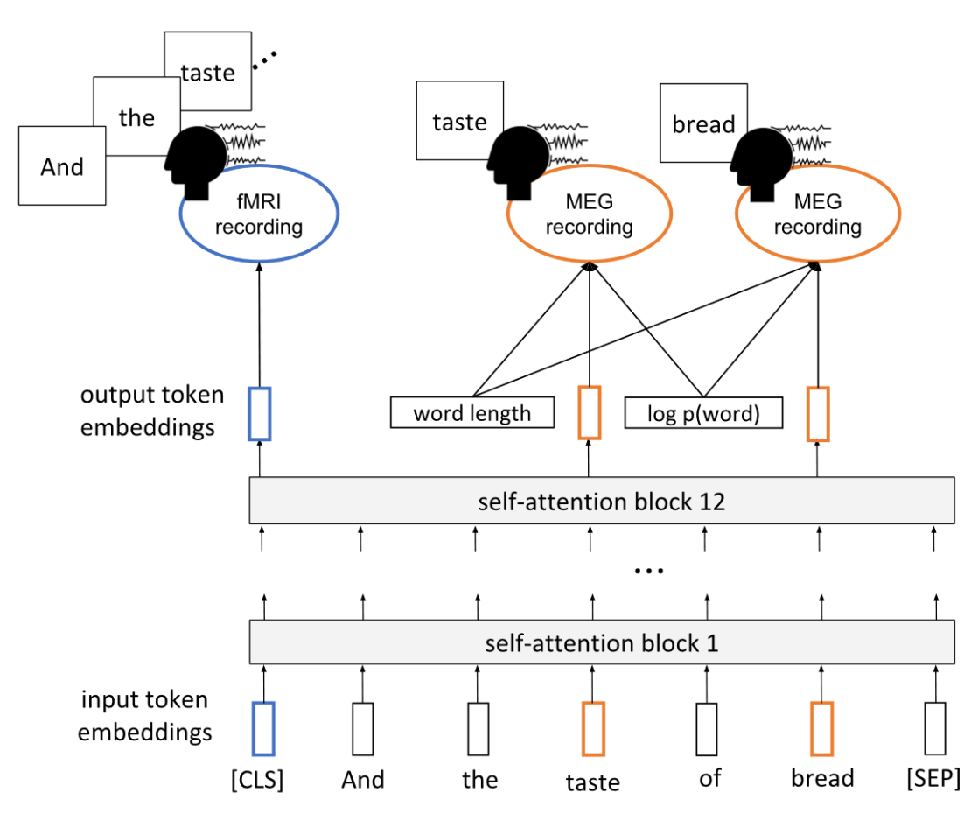
DL Representations: Transformer-based methods for text stimuli (Multi-task setup)
Settings
Finetune BERT vs not
Finetune BERT using one representative subject and train dense layer for each subject, vs finetune BERT for each subject.
Finetune BERT on MEG for all subjects, then finetune BERT on fMRI.
Multi-task finetune BERT for fMRI+MEG prediction task
Results
Fine-tuned models predict fMRI data better than vanilla BERT
Relationships between text and brain activity generalize across experiment participants.
Using MEG data can improve fMRI predictions.
A single model can be used to predict fMRI activity across multiple experiment participants.
Schwartz, Dan, Mariya Toneva, and Leila Wehbe. "Inducing brain-relevant bias in natural language processing models." Advances in neural information processing systems 32 (2019).

Slide 55
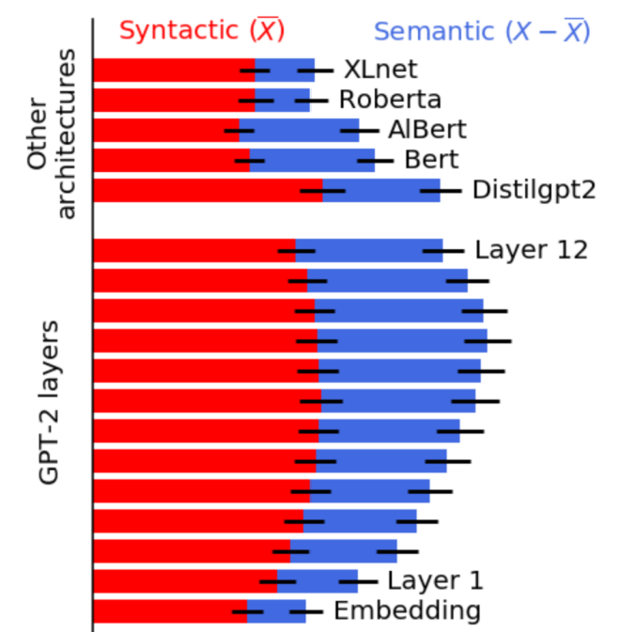
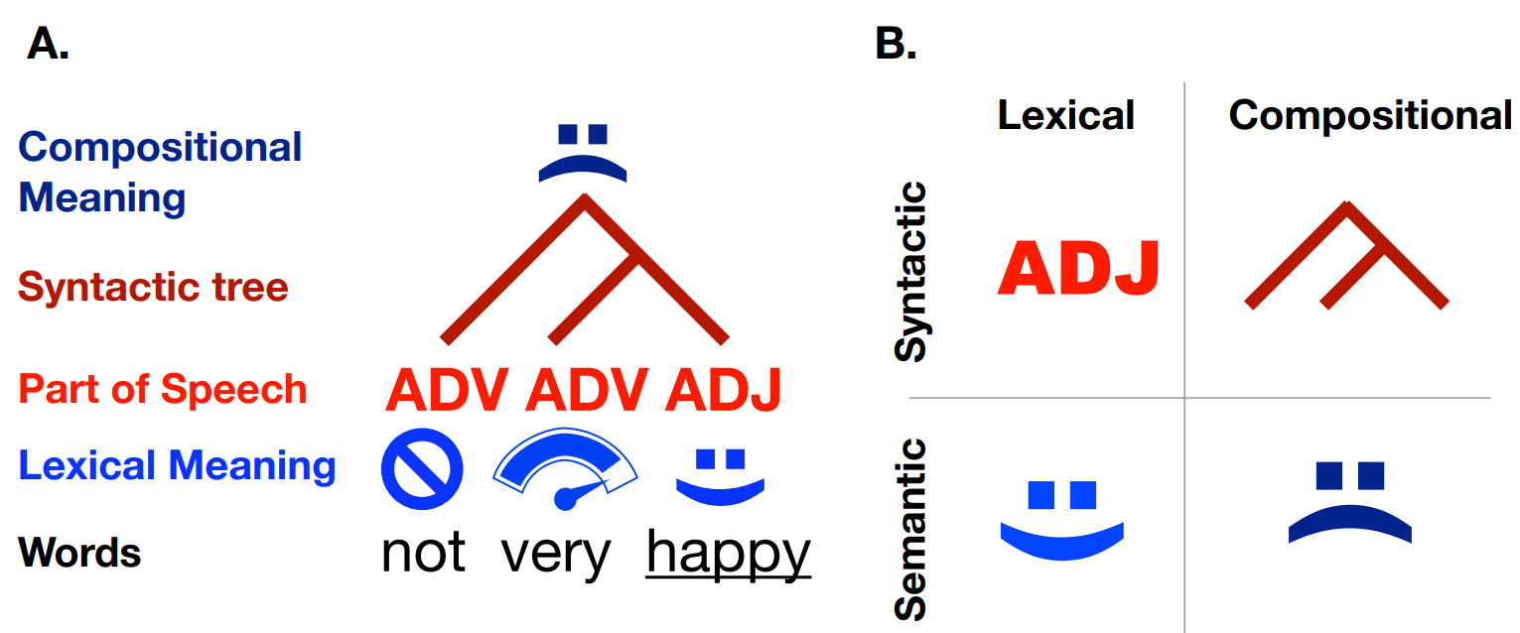
DL Representations: Comparing Transformers and extracting syntax vs semantics
Representations:
Lexical: representation that is context-invariant. E.g., word embeddings.
Compositional: “contextualized” representation generated by a system combining multiples words. E.g., parse trees
Syntax: representation associated with the structure of sentences independently of their meaning
Semantics: representation of a language system that are not syntactic.
Caucheteux, Charlotte, Alexandre Gramfort, and Jean-Remi King. "Disentangling syntax and semantics in the brain with deep networks." In International Conference on Machine Learning, pp. 1336-1348. PMLR, 2021.

Slide 56
Experiential attributes model for text stimuli
Represents words in terms of human (Amazon Mechanical Turk) ratings of their degree of association with different attributes of experience
“On a scale of 0 to 6, to what degree do you think of a banana as having a characteristic or defining color?”
Anderson et al., 2019: 65 attributes spanning sensory, motor, affective, spatial, temporal, causal, social, and abstract cognitive experiences.
Value-add on top of text models: a lot of experiential information goes unstated in natural verbal communication.
E.g., it is rarely useful to communicate the color of bananas because it is obvious to all those with experience of bananas.
E.g., it would be unusual to specify that dropping things involves movement.
Nishida et al., 2020 use a subset of 20 attributes.
Anderson, Andrew James, Jeffrey R. Binder, Leonardo Fernandino, Colin J. Humphries, Lisa L. Conant, Rajeev DS Raizada, Feng Lin, and Edmund C. Lalor. "An integrated neural decoder of linguistic and experiential meaning." Journal of Neuroscience 39, no. 45 (2019): 8969-8987.
Anderson, Andrew James, Jeffrey R. Binder, Leonardo Fernandino, Colin J. Humphries, Lisa L. Conant, Mario Aguilar, Xixi Wang, Donias Doko, and Rajeev DS Raizada. "Predicting neural activity patterns associated with sentences using a neurobiologically motivated model of semantic representation." Cerebral Cortex 27, no. 9 (2017): 4379-4395.
Anderson, Andrew James, Kelsey McDermott, Brian Rooks, Kathi L. Heffner, David Dodell-Feder, and Feng V. Lin. "Decoding individual identity from brain activity elicited in imagining common experiences." Nature communications 11, no. 1 (2020): 1-14.

Slide 57
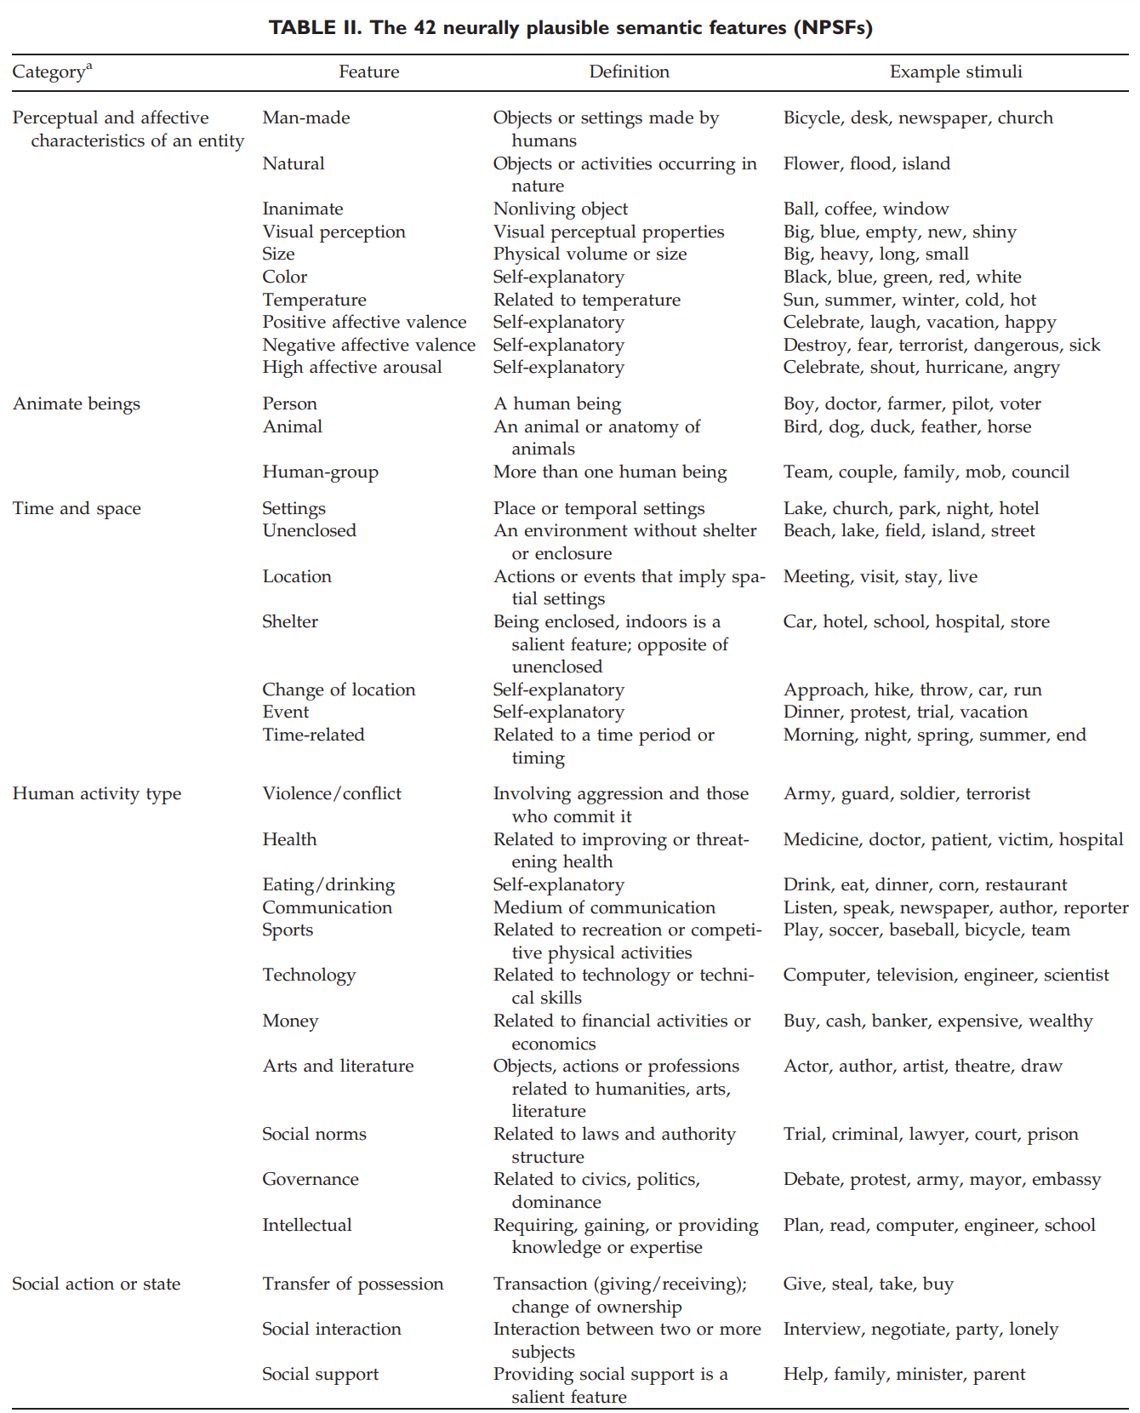
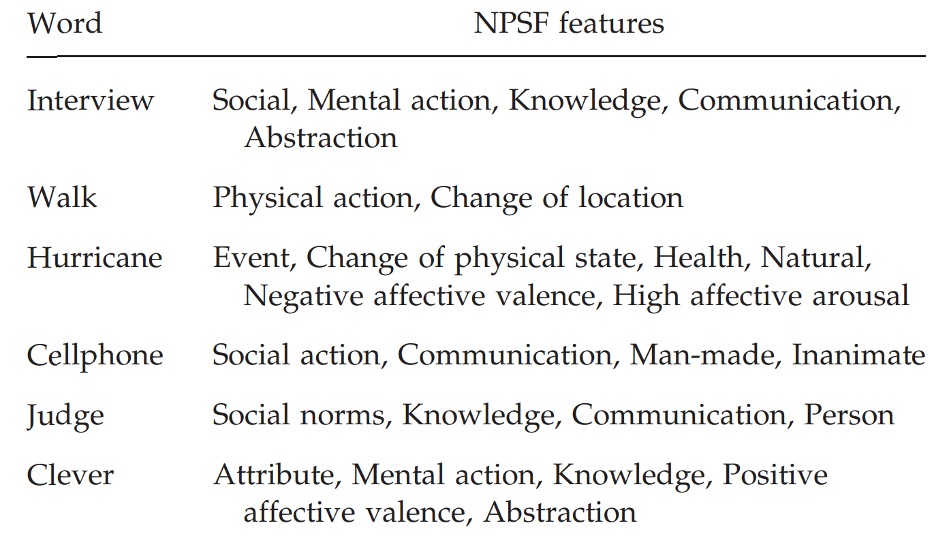
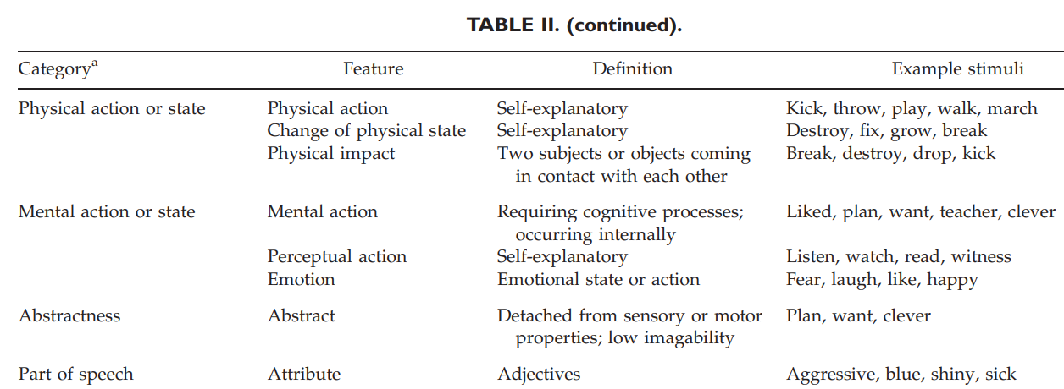
Binary attribute representations
Each stimulus is represented using a binary vector capturing membership to one of the eight semantic categories.
42 neurally plausible semantic features (NPSFs)
Perceptual and affective characteristics of an entity (10 NPSFs coded such features, such as man-made, size, color, temperature, positive affective valence, high affective arousal), animate beings (person, human-group, animal), and time and space properties (e.g. unenclosed setting, change of location)
Handjaras, Giacomo, Emiliano Ricciardi, Andrea Leo, Alessandro Lenci, Luca Cecchetti, Mirco Cosottini, Giovanna Marotta, and Pietro Pietrini. "How concepts are encoded in the human brain: a modality independent, category-based cortical organization of semantic knowledge." Neuroimage 135 (2016): 232-242.
Wang, Jing, Vladimir L. Cherkassky, and Marcel Adam Just. "Predicting the brain activation pattern associated with the propositional content of a sentence: modeling neural representations of events and states." Human brain mapping 38, no. 10 (2017): 4865-4881.

Slide 58
Agenda
Introduction to Brain encoding and decoding [30 min]
Stimulus Representations [1 hour]
Text Stimulus Representations
Visual Stimulus Representations
Audio Stimulus Representations
Multimodal Stimulus Representations
Coffee break [30 min]
Deep Learning for Brain Decoding [1 hour 30 min]
Lunch break [1 hour 30 min]
Deep Learning for Brain Encoding [1 hour 30 min]
Coffee break [30 min]
Advanced Methods [1 hour 15 min]
Summary and Future Trends [15 min]

Slide 59
Visual Stimuli
Visual field filter banks (Thirion et al., 2006; Nishimoto et al., 2011).
Gabor wavelet pyramid (Kay et al., 2008).
HMAX model (Horikawa et al., 2017).
Convolutional neural networks (Yamins et al., 2014; Anderson et al., 2017a; Beliy et al., 2019; Du et al., 2020; Nishida et al., 2020).

Slide 60
Visual Stimuli: Gabor wavelet pyramid
Gabor wavelet pyramid model. Each image is projected onto the individual Gabor wavelets comprising the Gabor wavelet pyramid. Gabor wavelets differ in size, position, orientation, spatial frequency, and phase. The projections for each quadrature pair of wavelets are squared, summed, and square-rooted, yielding a measure of contrast energy. The contrast energies for different quadrature wavelet pairs are weighted and then summed. Finally, a DC offset is added. The weights are determined by gradient descent with early stopping.
a, Spatial frequency and position. Wavelets occur at five spatial frequencies. This panel depicts one wavelet at each of the first five spatial frequencies. At each spatial frequency f cycles/field-of-view (FOV), wavelets are positioned on an f × f grid, as indicated by the translucent lines.
b, Orientation and phase. At each grid position, wavelets occur at eight orientations and two phases. This panel depicts a complete set of wavelets for a single grid position. Dashed lines indicate the bounds of the mask associated with each wavelet.
Kay, Kendrick N., Thomas Naselaris, Ryan J. Prenger, and Jack L. Gallant. "Identifying natural images from human brain activity." Nature 452, no. 7185 (2008): 352-355.

Slide 61
Visual Stimuli: HMAX model
Simple Cells S1
Input images are densely sampled by arrays of two-dimensional filters.
Output: -1 to 1
Complex Cells C1: max pooling
Simple Cells S2
Gaussian with mean 1 and standard deviation 1.
Complex Cells C2: max pooling
View Tuned Units (VTUs)
C2 units provide input to VTUs
C2 → VTU connections are the only stage of the HMAX model where learning occurs.
Riesenhuber, Maximilian, and Tomaso Poggio. "Hierarchical models of object recognition in cortex." Nature neuroscience 2, no. 11 (1999): 1019-1025.
Horikawa, Tomoyasu, and Yukiyasu Kamitani. "Generic decoding of seen and imagined objects using hierarchical visual features." Nature communications 8, no. 1 (2017): 1-15.

Slide 62
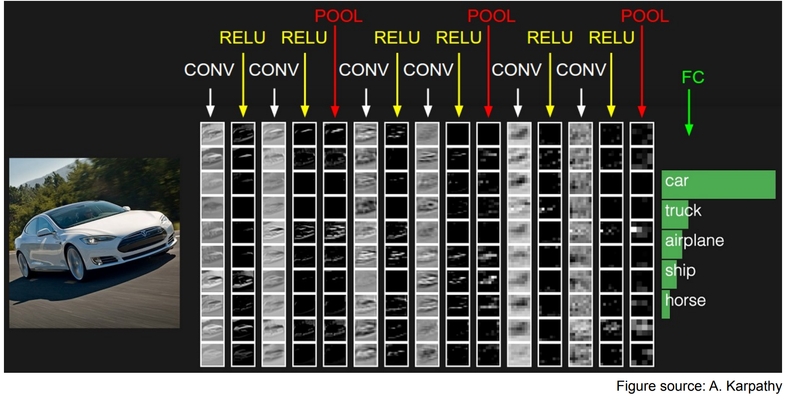
Visual Stimuli: Convolutional Neural Networks (CNNs)
For word stimuli, gather 20 most relevant images using Google search, then get CNN representation (Anderson et al., 2017).
AlexNet, VGG-16 (Nishida et al., 2020; Berezutskaya et al., 2020), Inception, ResNet, DenseNet.

Slide 63
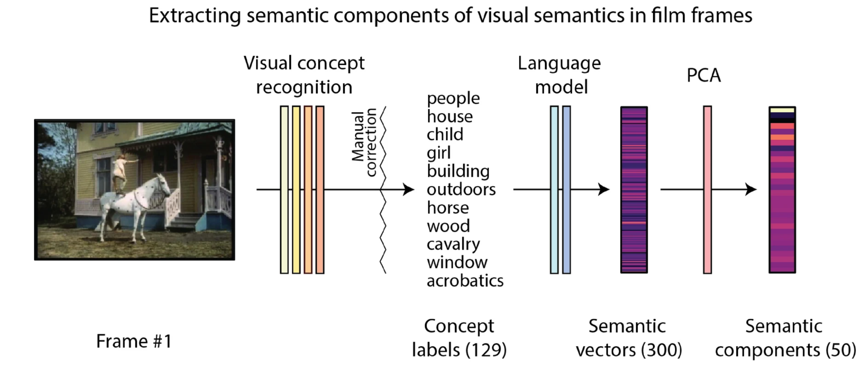
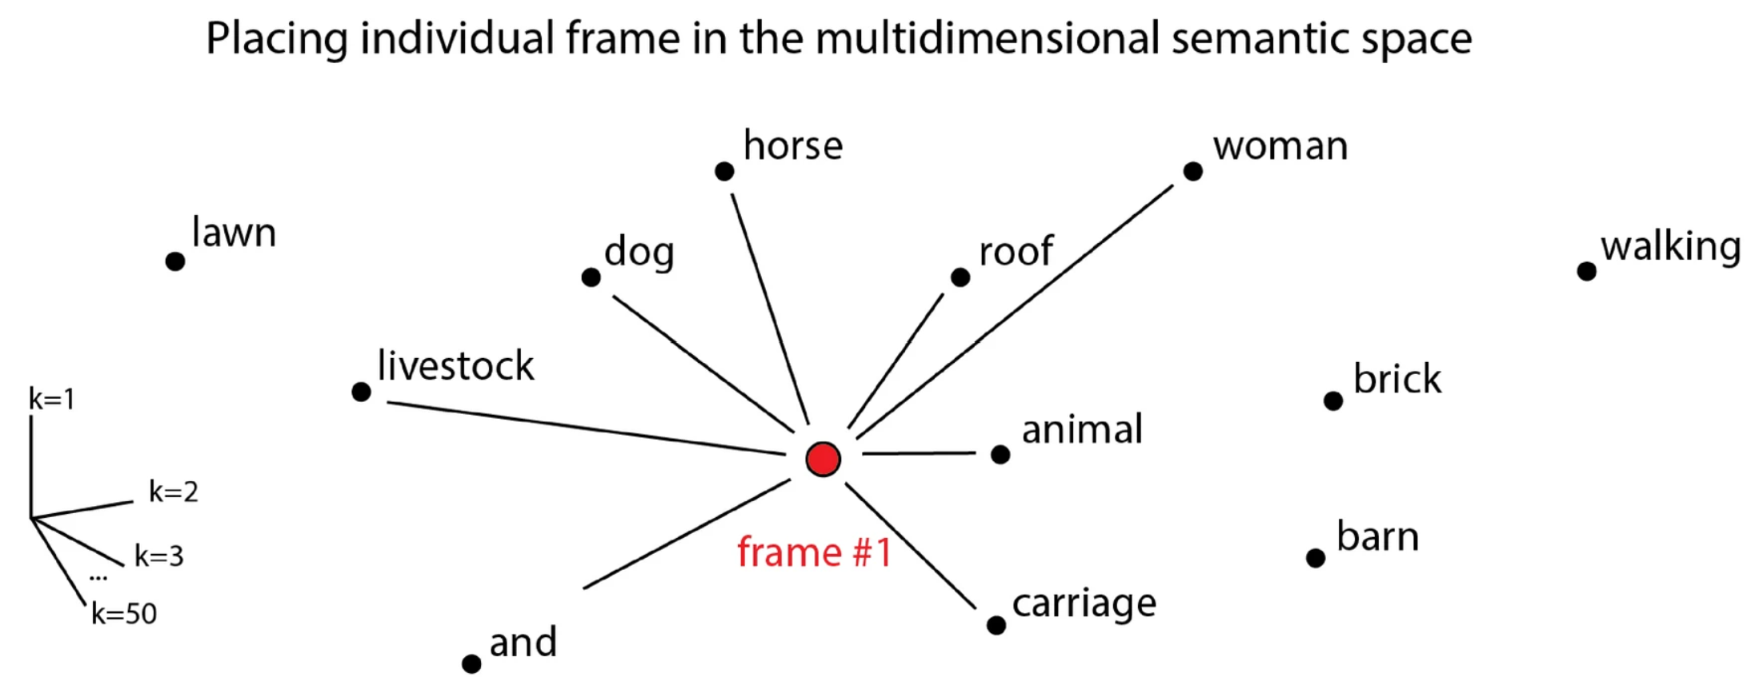
Visual Stimuli: Object Recognition with Word embeddings
Step 1: Pass film frames through concept recognition module to get up to 20 concept labels per frame.
Used Clarifai.
Step 2: Get fastText embeddings for each concept label. Frame embedding is average of word embeddings.
Step 3: PCA for dimensionality reduction.
Berezutskaya, Julia, Zachary V. Freudenburg, Luca Ambrogioni, Umut Güçlü, Marcel AJ van Gerven, and Nick F. Ramsey. "Cortical network responses map onto data-driven features that capture visual semantics of movie fragments." Scientific reports 10, no. 1 (2020): 1-21.

Slide 64
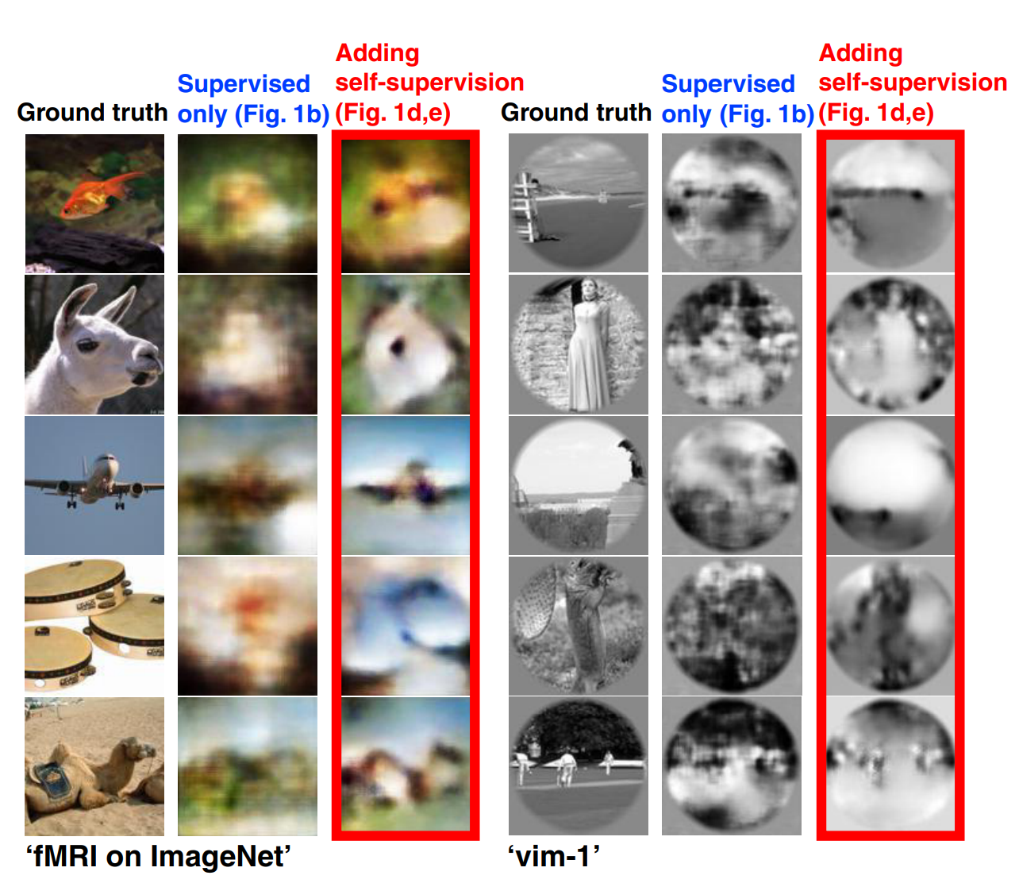
Visual Stimuli: Semi-supervised CNNs
Problem: Scarce labeled data.
Training phases & Architecture. (a) The first training phase: Supervised training of the Encoder with {Image, fMRI} pairs. (b) Second phase: Training the Decoder simultaneously with 3 types of data: {Image, fMRI} pairs (supervised examples), unlabeled natural images (self-supervision), and unlabeled test-fMRI (self-supervision). Note that the test-images are never used for training. The pretrained Encoder from the first training phase is kept fixed in the second phase. (c) Encoder and Decoder architectures. BN, US, and ReLU stand for batch normalization, up-sampling, and rectified linear unit, respectively.
Beliy, Roman, Guy Gaziv, Assaf Hoogi, Francesca Strappini, Tal Golan, and Michal Irani. "From voxels to pixels and back: Self-supervision in natural-image reconstruction from fMRI." Advances in Neural Information Processing Systems 32 (2019).

Slide 65
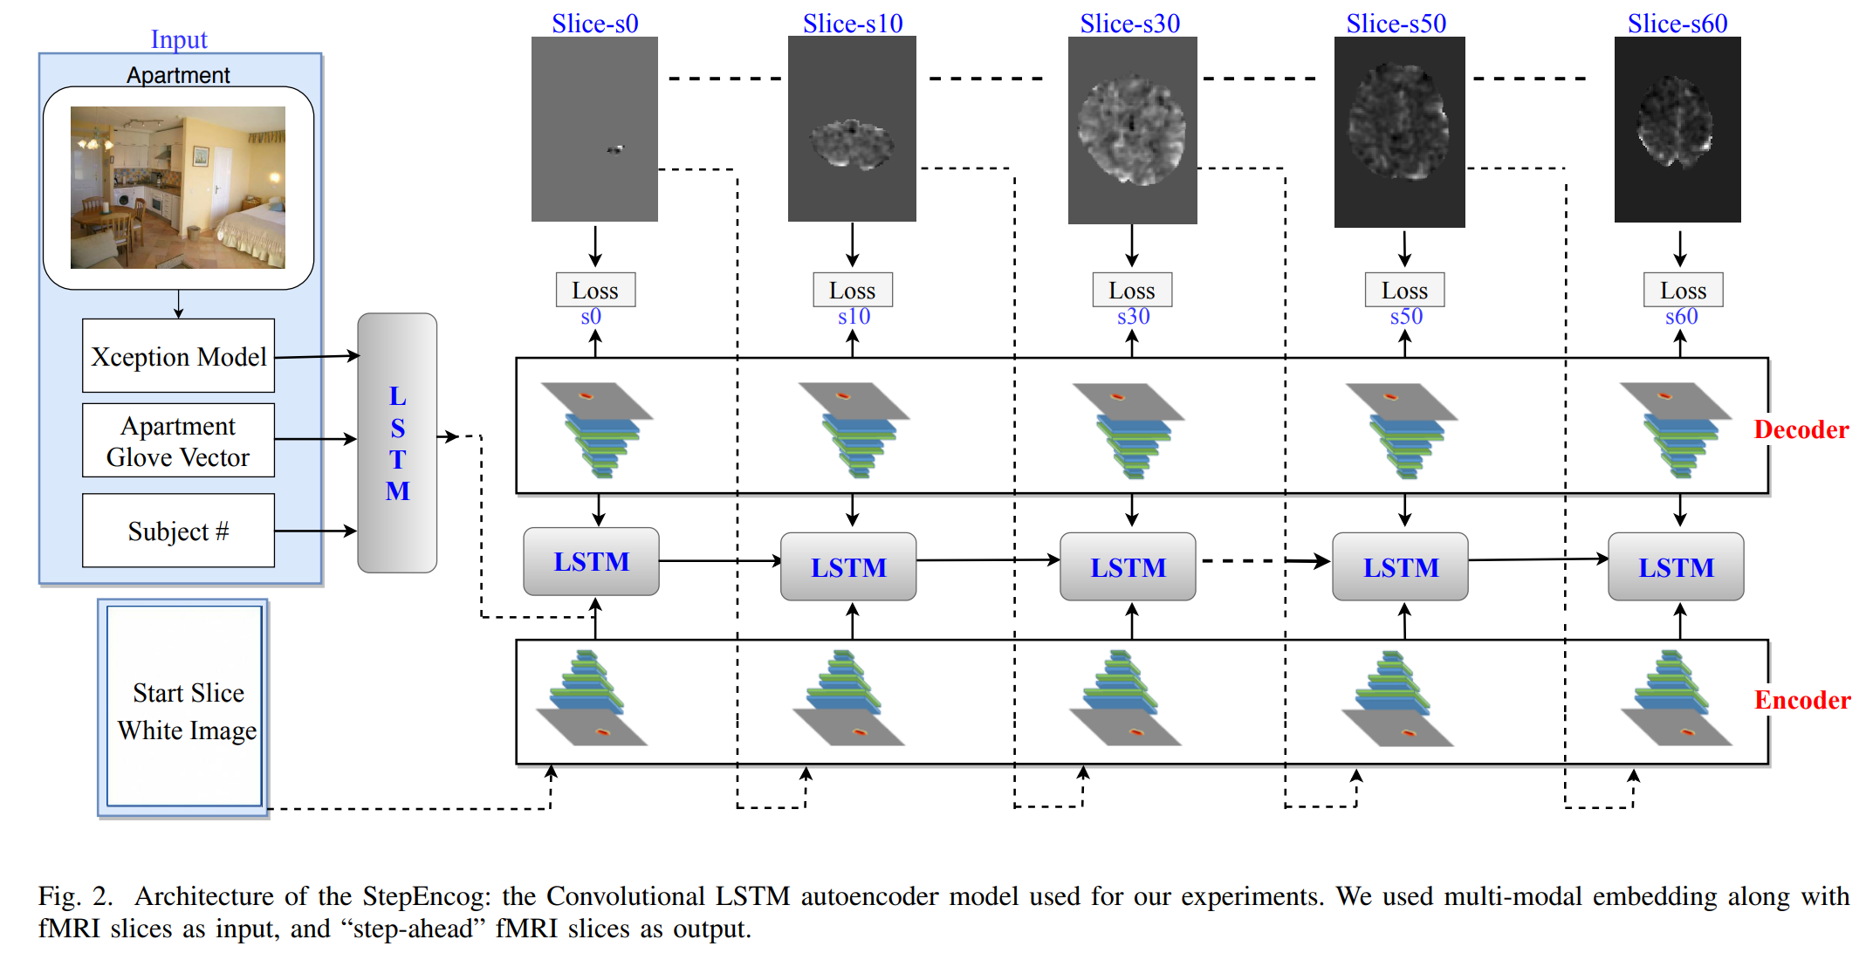
Visual Stimuli: Convolutional LSTM Autoencoder
StepEncog, a convolutional LSTM autoencoder model trained on fMRI voxels.
Oota, Subba Reddy, Vijay Rowtula, Manish Gupta, and Raju S. Bapi. "StepEncog: A convolutional LSTM autoencoder for near-perfect fMRI encoding." In 2019 International Joint Conference on Neural Networks (IJCNN), pp. 1-8. IEEE, 2019.

Slide 66
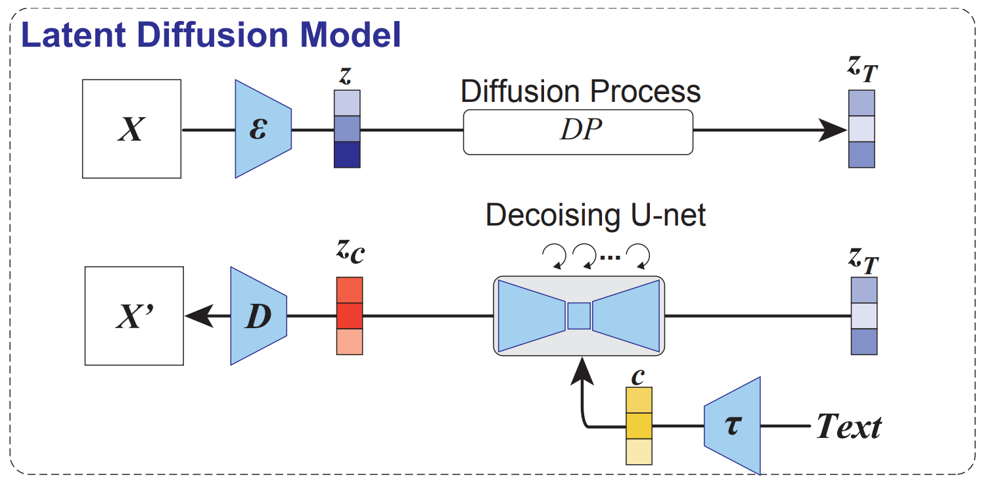
Latent Diffusion Models
Takagi, Yu, and Shinji Nishimoto. "High-resolution image reconstruction with latent diffusion models from human brain activity." In CVPR, pp. 14453-14463. 2023.

Slide 67
Agenda
Introduction to Brain encoding and decoding [30 min]
Stimulus Representations [1 hour]
Text Stimulus Representations
Visual Stimulus Representations
Audio Stimulus Representations
Multimodal Stimulus Representations
Coffee break [30 min]
Deep Learning for Brain Decoding [1 hour 30 min]
Lunch break [1 hour 30 min]
Deep Learning for Brain Encoding [1 hour 30 min]
Coffee break [30 min]
Advanced Methods [1 hour 15 min]
Summary and Future Trends [15 min]

Slide 68
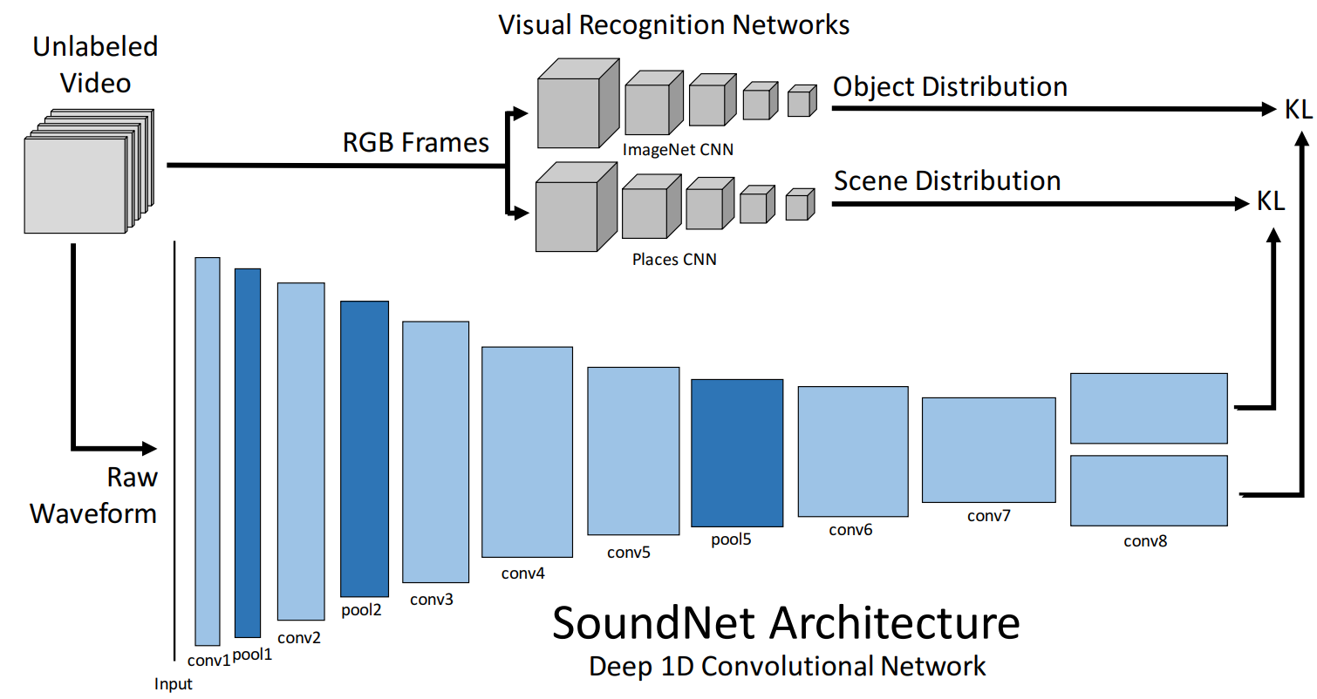
Audio Stimuli
Word rate, Phoneme rate, Presence of phonemes (Huth et al., 2016).
SoundNet (Aytar, Vondrick, and Torralba 2016) features (Nishida et al., 2020)
Huth, Alexander G., Wendy A. De Heer, Thomas L. Griffiths, Frédéric E. Theunissen, and Jack L. Gallant. "Natural speech reveals the semantic maps that tile human cerebral cortex." Nature 532, no. 7600 (2016): 453-458.
Nishida, Satoshi, Yusuke Nakano, Antoine Blanc, Naoya Maeda, Masataka Kado, and Shinji Nishimoto. "Brain-mediated transfer learning of convolutional neural networks." In Proceedings of the AAAI Conference on Artificial Intelligence, vol. 34, no. 04, pp. 5281-5288. 2020.

Slide 69
Agenda
Introduction to Brain encoding and decoding [30 min]
Stimulus Representations [1 hour]
Text Stimulus Representations
Visual Stimulus Representations
Audio Stimulus Representations
Multimodal Stimulus Representations
Coffee break [30 min]
Deep Learning for Brain Decoding [1 hour 30 min]
Lunch break [1 hour 30 min]
Deep Learning for Brain Encoding [1 hour 30 min]
Coffee break [30 min]
Advanced Methods [1 hour 15 min]
Summary and Future Trends [15 min]

Slide 70
Multimodal Stimulus Representations
Processing videos required audio+image representations
E.g., VGG+SoundNet (Nishida et al., 2020)
Image+text combination models (Wang et al., 2020)
GloVe+VGG, and ELMo+VGG
Averaging or concatenation
Wang, Shaonan, Jiajun Zhang, Haiyan Wang, Nan Lin, and Chengqing Zong. "Fine-grained neural decoding with distributed word representations." Information Sciences 507 (2020): 256-272.

Slide 71
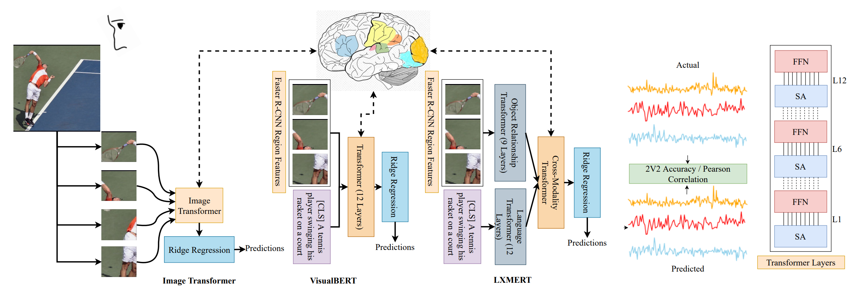
Multimodal Stimuli: Visio-linguistic representations
Pretrained CNNs: VGGNet19, ResNet50, InceptionV2ResNet and EfficientNetB5
Pretrained text Transformers: RoBERTa
Image Transformers: Vision Transformer (ViT), Data Efficient Image Transformer (DEiT), and Bidirectional Encoder representation from Image Transformer (BEiT).
Late-fusion models: VGGNet19+RoBERTa, ResNet50+RoBERTa, InceptionV2ResNet+RoBERTa and EfficientNetB5+RoBERTa.
Multi-modal Transformers: Contrastive Language-Image Pre-training (CLIP), Learning Cross-Modality Encoder Representations from Transformers (LXMERT), and VisualBERT.
VisualBERT performs the best for brain encoding!
Oota, Subba Reddy, Jashn Arora, Vijay Rowtula, Manish Gupta, and Raju S. Bapi. "Visio-Linguistic Brain Encoding." arXiv preprint arXiv:2204.08261 (2022).

Slide 72
Agenda
Introduction to Brain encoding and decoding [30 min]
Stimulus Representations [1 hour]
Coffee break [30 min]
Deep Learning for Brain Decoding [1 hour 30 min]
Lunch break [1 hour 30 min]
Deep Learning for Brain Encoding [1 hour 30 min]
Coffee break [30 min]
Advanced Methods [1 hour 15 min]
Summary and Future Trends [15 min]

Slide 73
References
[1] Nicolas Affolter, Beni Egressy, Damian Pascual, and Roger Wattenhofer. Brain2word: Decoding brain activity for language generation. arXiv preprint arXiv:2009.04765, 2020.
[2] Andrew J Anderson, Douwe Kiela, Stephen Clark, and Massimo Poesio. Visually grounded and textual semantic models differentially decode brain activity associated with concrete and abstract nouns. Transactions of the Association for Computational Linguistics, 5:17–30, 2017.
[3] Andrew James Anderson, Jeffrey R Binder, Leonardo Fernandino, Colin J Humphries, Lisa L Conant, Mario Aguilar, Xixi Wang, Donias Doko, and Rajeev DS Raizada. Predicting neural activity patterns associated with sentences using a neurobiologically motivated model of semantic representation. Cerebral Cortex, 27(9):4379–4395, 2017.
[4] Andrew James Anderson, Jeffrey R Binder, Leonardo Fernandino, Colin J Humphries, Lisa L Conant, Rajeev DS Raizada, Feng Lin, and Edmund C Lalor. An integrated neural decoder of linguistic and experiential meaning. Journal of Neuroscience, 39(45):8969–8987, 2019.
[5] Andrew James Anderson, Kelsey McDermott, Brian Rooks, Kathi L Heffner, David Dodell-Feder, and Feng V Lin. Decoding individual identity from brain activity elicited in imagining common experiences. Nature communications, 11(1):1–14, 2020.
[6] Richard Antonello, Javier Turek, Vy Vo, and Alexander Huth. Low-dimensional structure in the space of language representations is reflected in brain responses. arXiv preprint arXiv:2106.05426, 2021.
[7] Roman Beliy, Guy Gaziv, Assaf Hoogi, Francesca Strappini, Tal Golan, and Michal Irani. From voxels to pixels and back: Self-supervision in naturalimage reconstruction from fmri. arXiv preprint arXiv:1907.02431, 2019.
[8] Julia Berezutskaya, Zachary V Freudenburg, Luca Ambrogioni, Umut Güçlü, Marcel AJ van Gerven, and Nick F Ramsey. Cortical network responses map onto data-driven features that capture visual semantics of movie fragments. Scientific reports, 10(1):1–21, 2020.
[9] Charlotte Caucheteux, Alexandre Gramfort, and Jean-Remi King. Disentangling syntax and semantics in the brain with deep networks. In International Conference on Machine Learning, pages 1336–1348. PMLR, 2021.
[10] Charlotte Caucheteux and Jean-Rémi King. Language processing in brains and deep neural networks: computational convergence and its limits. BioRxiv, 2020.
[11] Joshua S Cetron, Andrew C Connolly, Solomon G Diamond, Vicki V May, James V Haxby, and David JM Kraemer. Decoding individual differences in stem learning from functional mri data. Nature communications, 10(1):1–10, 2019.

Slide 74
References
[12] Nadine Chang, John A Pyles, Austin Marcus, Abhinav Gupta, Michael J Tarr, and Elissa M Aminoff. Bold5000, a public fmri dataset while viewing 5000 visual images. Scientific data, 6(1):1–18, 2019.
[13] Radoslaw Martin Cichy, Kshitij Dwivedi, Benjamin Lahner, Alex Lascelles, Polina Iamshchinina, M Graumann, A Andonian, NAR Murty, K Kay, Gemma Roig, et al. The algonauts project 2021 challenge: How the human brain makes sense of a world in motion. arXiv preprint arXiv:2104.13714, 2021.
[14] Radoslaw Martin Cichy, Gemma Roig, Alex Andonian, Kshitij Dwivedi, Benjamin Lahner, Alex Lascelles, Yalda Mohsenzadeh, Kandan Ramakrishnan, and Aude Oliva. The algonauts project: A platform for communication between the sciences of biological and artificial intelligence. arXiv e-prints, pages arXiv–1905, 2019.
[15] Changde Du, Changying Du, Lijie Huang, and Huiguang He. Conditional generative neural decoding with structured cnn feature prediction. In Proceedings of the AAAI Conference on Artificial Intelligence, volume 34, pages 2629–2636, 2020.
[16] Michael Eickenberg, Alexandre Gramfort, Gaël Varoquaux, and Bertrand Thirion. Seeing it all: Convolutional network layers map the function of the human visual system. NeuroImage, 152:184–194, 2017.
[17] Jack Gallant. Human brain mapping and brain decoding, 2017.
[18] Jon Gauthier and Roger Levy. Linking artificial and human neural representations of language. arXiv preprint arXiv:1910.01244, 2019.
[19] Ian Goodfellow, Yoshua Bengio, and Aaron Courville. Deep learning. MIT press, 2016.
[20] Giacomo Handjaras, Emiliano Ricciardi, Andrea Leo, Alessandro Lenci, Luca Cecchetti, Mirco Cosottini, Giovanna Marotta, and Pietro Pietrini. How concepts are encoded in the human brain: a modality independent, category-based cortical organization of semantic knowledge. Neuroimage, 135:232–242, 2016.
[21] Nora Hollenstein, Antonio de la Torre, Nicolas Langer, and Ce Zhang. Cognival: A framework for cognitive word embedding evaluation. In Proceedings of the 23rd Conference on Computational Natural Language Learning (CoNLL), pages 538–549, 2019.
[22] Nora Hollenstein, Jonathan Rotsztejn, Marius Troendle, Andreas Pedroni, Ce Zhang, and Nicolas Langer. Zuco, a simultaneous eeg and eye-tracking resource for natural sentence reading. Scientific data, 5(1):1–13, 2018.

Slide 75
References
[23] Alexander G Huth, Wendy A De Heer, Thomas L Griffiths, Frédéric E Theunissen, and Jack L Gallant. Natural speech reveals the semantic maps that tile human cerebral cortex. Nature, 532(7600):453–458, 2016.
[24] Shailee Jain and Alexander G Huth. Incorporating context into language encoding models for fmri. In Proceedings of the 32nd International Conference on Neural Information Processing Systems, pages 6629–6638, 2018.
[25] S Jat, H Tang, P Talukdar, and T Mitchel. Relating simple sentence representations in deep neural networks and the brain. In ACL 2019-57th Annual Meeting of the Association for Computational Linguistics, Proceedings of the Conference, pages 5137–5154. Association for Computational Linguistics (ACL), 2020.
[26] Marcel Adam Just, Vladimir L Cherkassky, Sandesh Aryal, and Tom M Mitchell. A neurosemantic theory of concrete noun representation based on the underlying brain codes. PloS one, 5(1):e8622, 2010.
[27] Kendrick N Kay, Thomas Naselaris, Ryan J Prenger, and Jack L Gallant. Identifying natural images from human brain activity. Nature, 452(7185):352–355, 2008.
[28] Jonas Kubilius, Martin Schrimpf, Kohitij Kar, Rishi Rajalingham, Ha Hong, Najib Majaj, Elias Issa, Pouya Bashivan, Jonathan Prescott-Roy, Kailyn Schmidt, et al. Brain-like object recognition with high-performing shallow recurrent anns. Advances in Neural Information Processing Systems, 32:12805–12816, 2019.
[29] Tom Mitchell. Neural representations of language meaning, 2014.
[30] Tom M Mitchell, Svetlana V Shinkareva, Andrew Carlson, Kai-Min Chang, Vicente L Malave, Robert A Mason, and Marcel Adam Just. Predicting human brain activity associated with the meanings of nouns. science, 320(5880):1191–1195, 2008.
[31] Thomas Naselaris, Ryan J Prenger, Kendrick N Kay, Michael Oliver, and Jack L Gallant. Bayesian reconstruction of natural images from human brain activity. Neuron, 63(6):902–915, 2009.
[32] Samuel A Nastase, Yun-Fei Liu, Hanna Hillman, Asieh Zadbood, Liat Hasenfratz, Neggin Keshavarzian, Janice Chen, Christopher J Honey, Yaara Yeshurun, Mor Regev, et al. Narratives: fmri data for evaluating models of naturalistic language comprehension. bioRxiv, pages 2020–12, 2021.
[33] Satoshi Nishida, Yusuke Nakano, Antoine Blanc, Naoya Maeda, Masataka Kado, and Shinji Nishimoto. Brain-mediated transfer learning of convolutional neural networks. In Proceedings of the AAAI Conference on Artificial Intelligence, volume 34, pages 5281–5288, 2020.

Slide 76
References
[34] Shinji Nishimoto, An T Vu, Thomas Naselaris, Yuval Benjamini, Bin Yu, and Jack L Gallant. Reconstructing visual experiences from brain activity evoked by natural movies. Current biology, 21(19):1641–1646, 2011.
[35] Subba Reddy Oota, Vijay Rowtula, Manish Gupta, and Raju S Bapi. Stepencog: A convolutional lstm autoencoder for near-perfect fmri encoding. In 2019 International Joint Conference on Neural Networks (IJCNN), pages 1–8. IEEE, 2019.
[36] Francisco Pereira, Matthew Botvinick, and Greg Detre. Using wikipedia to learn semantic feature representations of concrete concepts in neuroimaging experiments. Artificial intelligence, 194:240– 252, 2013.
[37] Francisco Pereira, Bin Lou, Brianna Pritchett, Nancy Kanwisher, Matthew Botvinick, and Evelina Fedorenko. Decoding of generic mental representations from functional mri data using word embeddings. bioRxiv, page 057216, 2016.
[38] Francisco Pereira, Bin Lou, Brianna Pritchett, Samuel Ritter, Samuel J Gershman, Nancy Kanwisher, Matthew Botvinick, and Evelina Fedorenko. Toward a universal decoder of linguistic meaning from brain activation. Nature communications, 9(1):1–13, 2018.
[39] Martin Schrimpf, Idan Blank, Greta Tuckute, Carina Kauf, Eghbal A Hosseini, Nancy Kanwisher, Joshua Tenenbaum, and Evelina Fedorenko. The neural architecture of language: Integrative reverseengineering converges on a model for predictive processing. PNAS, Vol:To appear, 2021.
[40] Martin Schrimpf, Jonas Kubilius, Ha Hong, Najib J Majaj, Rishi Rajalingham, Elias B Issa, Kohitij Kar, Pouya Bashivan, Jonathan Prescott-Roy, Franziska Geiger, et al. Brain-score: Which artificial neural network for object recognition is most brain-like? BioRxiv, page 407007, 2020.
[41] Dan Schwartz, Mariya Toneva, and Leila Wehbe. Inducing brain-relevant bias in natural language processing models. Advances in Neural Information Processing Systems, 32:14123–14133, 2019.
[42] K Seeliger, RP Sommers, Umut Güçlü, Sander E Bosch, and MAJ Van Gerven. A large singleparticipant fmri dataset for probing brain responses to naturalistic stimuli in space and time. bioRxiv, page 687681, 2019.
[43] Vishwajeet Singh, Krishna P. Miyapuram, and Raju S. Bapi. Detection of cognitive states from fmri data using machine learning techniques. In Manuela M. Veloso, editor, IJCAI, pages 587–592, 2007.
[44] Jonathan Smallwood and Jonathan W Schooler. The science of mind wandering: empirically navigating the stream of consciousness. Annual review of psychology, 66:487–518, 2015.

Slide 77
References
[45] Jingyuan Sun, Shaonan Wang, Jiajun Zhang, and Chengqing Zong. Towards sentence-level brain decoding with distributed representations. In Proceedings of the AAAI Conference on Artificial Intelligence, volume 33, pages 7047–7054, 2019.
[46] Jingyuan Sun, Shaonan Wang, Jiajun Zhang, and Chengqing Zong. Neural encoding and decoding with distributed sentence representations. IEEE Transactions on Neural Networks and Learning Systems, 32(2):589–603, 2020.
[47] Bertrand Thirion. Statistical inference in highdimension and application to brain imaging, 2019.
[48] Bertrand Thirion, Edouard Duchesnay, Edward Hubbard, Jessica Dubois, Jean-Baptiste Poline, Denis Lebihan, and Stanislas Dehaene. Inverse retinotopy: inferring the visual content of images from brain activation patterns. Neuroimage, 33(4):1104– 1116, 2006.
[49] Mariya Toneva, Otilia Stretcu, Barnabás Póczos, Leila Wehbe, and Tom M Mitchell. Modeling task effects on meaning representation in the brain via zero-shot meg prediction. Advances in Neural Information Processing Systems, 33, 2020.
[50] Mariya Toneva and Leila Wehbe. Interpreting and improving natural-language processing (in machines) with natural language-processing (in the brain). arXiv preprint arXiv:1905.11833, 2019.
[51] Aria Wang, Michael Tarr, and Leila Wehbe. Neural taskonomy: Inferring the similarity of task-derived representations from brain activity. Advances in Neural Information Processing Systems, 32:15501– 15511, 2019.
[52] Jing Wang, Vladimir L Cherkassky, and Marcel Adam Just. Predicting the brain activation pattern associated with the propositional content of a sentence: Modeling neural representations of events and states. Human brain mapping, 38(10):4865– 4881, 2017.
[53] Shaonan Wang, Jiajun Zhang, Haiyan Wang, Nan Lin, and Chengqing Zong. Fine-grained neural decoding with distributed word representations. Information Sciences, 507:256–272, 2020.
[54] Leila Wehbe, Brian Murphy, Partha Talukdar, Alona Fyshe, Aaditya Ramdas, and Tom Mitchell. Simultaneously uncovering the patterns of brain regions involved in different story reading subprocesses. in press, 2014.
[55] Daniel LK Yamins, Ha Hong, Charles F Cadieu, Ethan A Solomon, Darren Seibert, and James J DiCarlo. Performance-optimized hierarchical models predict neural responses in higher visual cortex. Proceedings of the national academy of sciences, 111(23):8619–8624, 2014.
[56] Boyle, Julie A., Basile Pinsard, A. Boukhdhir, S. Belleville, S. Bram-batti, J. Chen, J. Cohen-Adad et al. "The Courtois project on neuronal modelling: 2020 data release." In Presented at the 26th annual meeting of the Organization for Human Brain Mapping. 2020.

Slide 78
Deep Neural Networks and Brain Alignment: Brain Encoding and Decoding
Subba Reddy Oota¹, Manish Gupta^{2,3}, Raju S. Bapi², Mariya Toneva⁴
¹Inria Bordeaux, France; ²IIIT Hyderabad, India; ³Microsoft, India; ⁴MPI for Software Systems, Germany
subba-reddy.oota@inria.fr, gmanish@microsoft.com, raju.bapi@iiit.ac.in, mtoneva@mpi-sws.org

Slide 79
Agenda
Introduction to Brain encoding and decoding [30 min]
Stimulus Representations [1 hour]
Coffee break [30 min]
Deep Learning for Brain Decoding [1 hour 30 min]
Lunch break [1 hour 30 min]
Deep Learning for Brain Encoding [1 hour 30 min]
Coffee break [30 min]
Advanced Methods [1 hour 15 min]
Summary and Future Trends [15 min]

Slide 80
Agenda
Introduction to Brain encoding and decoding [30 min]
Stimulus Representations [1 hour]
Coffee break [30 min]
Deep Learning for Brain Decoding [1 hour 30 min]
Lunch break [1 hour 30 min]
Deep Learning for Brain Encoding [1 hour 30 min]
Coffee break [30 min]
Advanced Methods [1 hour 15 min]
Summary and Future Trends [15 min]

Slide 81
Outline
Introduction to Brain Decoding
Decoding models
Linear Models
Non-Linear Models (including DNNs)
Language
Periera et al. 2018, Gauthier et al. 2019, Huth et al. 2023, Oota et al. 2022

Slide 82
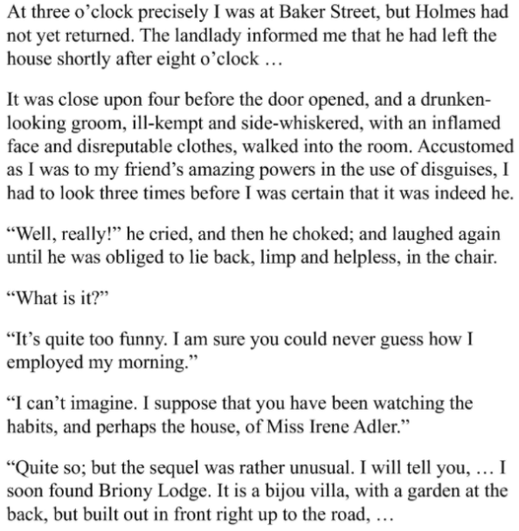
Encoding vs. Decoding
Stimulus
Representation
Encoding
fMRI
Stimulus
Representation
Decoding
fMRI
Haiguang Wen et al, 2017

Slide 83
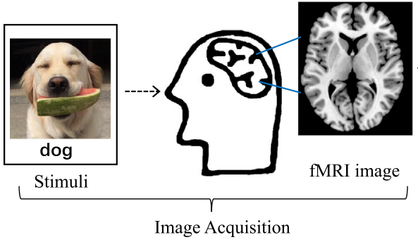
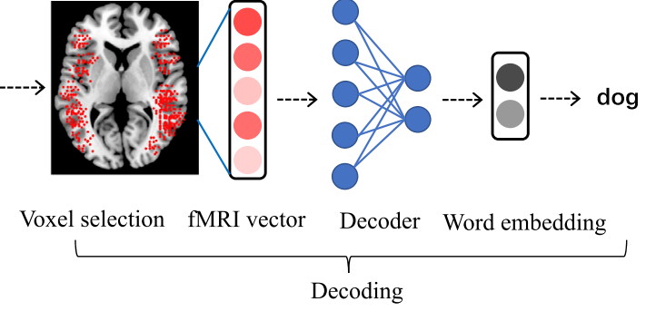
What is Brain Decoding?
Can we reconstruct the stimulus, given the brain response?
Can you read the mind with fMRI?
Or at least tell what the person saw?
Visual Task
Language Task
Smith et al., 2011, Wang et al. 2019

Slide 84
Linguistic Decoding
output
input
Zou et al., 2022

Slide 85
Outline
Introduction to Brain Decoding
Decoding models
Linear Models
Non-Linear Models (including DNNs)
Evaluation Metrics
Language
Periera et al. 2018, Gauthier et al. 2019, Huth et al. 2023, Oota et al. 2022

Slide 86
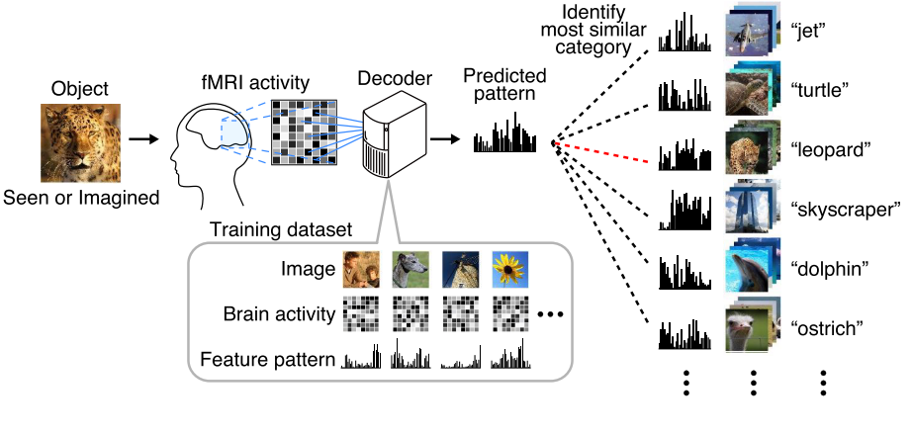
Linear Decoder Models
Stimulus Representation
Ridge / Logistic Regression
Stimulus Classification
Horikawa et al. 2018

Slide 87
Non-Linear Decoder
Deep CNNs
Vu et al. 2018

Slide 88
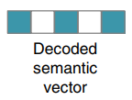
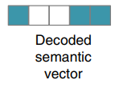
Evaluating Decoding Models: Pairwise Accuracy
i^{th} Concept Word
j^{th} Concept Word
Periera et al. 2018

Slide 89
Evaluating Decoding Models: Rank Accuracy
i^{th} Concept Word
Y₁
Y₂
Correaltion
rank = rsort(corr_scores).index(correlation)
Y_{n}
All the correlation scores in descending order
Periera et al. 2018

Slide 90
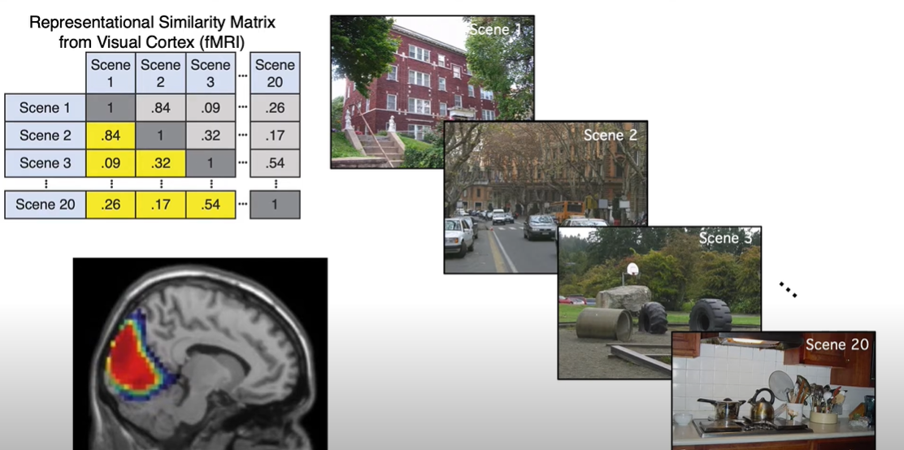
Representational Similarity Matrix (RSM)
corr(Scene1, Scen2)
Moussa et al. 2012

Slide 91
Representational Dissimilarity Matrix (RDM)
Hamed et al. 2014

Slide 92
Representation Similarity Analysis
DSM = RDM
Kriegeskorte et al. 2018

Slide 93
Outline
Introduction to Brain Decoding
Decoding models
Linear Models
Non-Linear Models (including DNNs)
Language
Periera et al. 2018, Gauthier et al. 2019, Huth et al. 2023, Oota et al. 2022

Slide 94
Linguistic Brain Decoding
Toward Word-level Universal Brain Decoder
Does injecting linguistic structure into language models lead to better alignment with brain recordings?
Multi-view and Cross-view Decoding
Periera et al. 2018, Gauthier et al. 2019, Huth et al. 2023, Oota et al. 2022

Slide 95
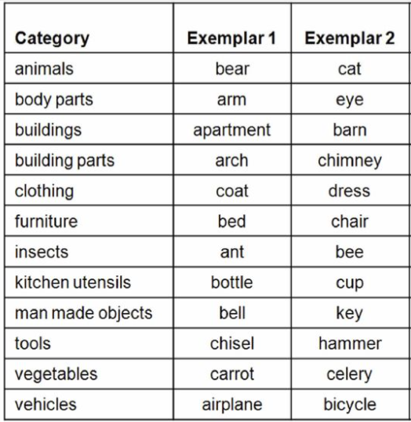
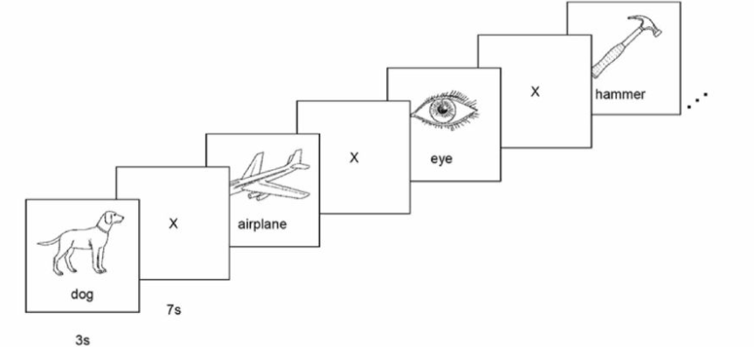
Classical Decoders
Classical decoding solutions extracting linguistic meaning from imaging data have been largely limited to
concrete nouns,
using similar stimuli for training and testing,
small number of semantic categories.
Mitchell et al. 2008

Slide 96
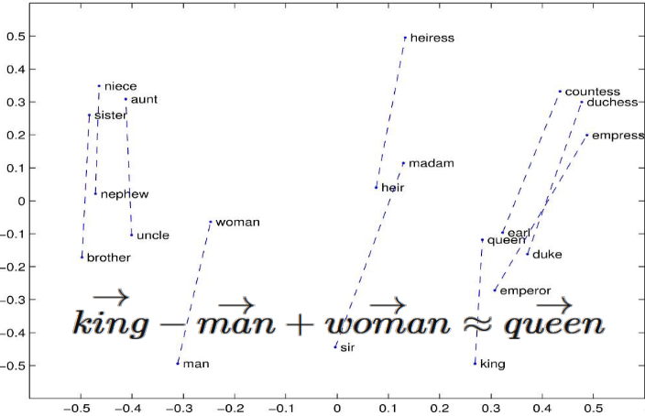
Toward a universal decoder
Presented a new approach for building a brain decoding system:
words and sentences are represented as vectors in a semantic space constructed from massive text corpora.
wide variety of both concrete and abstract topics from two separate datasets.
subject reads naturalistic linguistic stimuli on potentially any topic, including abstract ideas (ex., pleasure, justice, love, etc).
GloVE
Pennington et al. 2014
Pereira et al. 2018

Slide 97
Dataset Details (Experiment-1)
Concept Word
Concept + Sentence View
Concept + Picture View
Concept + Wordcloud View
Periera et al. 2018

Slide 98
Dataset Details (Experiment-1)
180 Concepts
128 nouns
22 verbs
29 adjectives
1 function word
16 subjects
AAL atlas (180 regions)
Gordon atlas (333 regions)
Periera et al. 2018

Slide 99
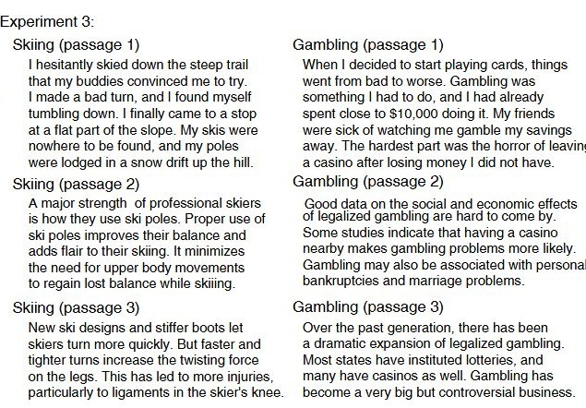
Dataset Details (Experiments 2 and 3)
Topic
Concept
Topic
Periera et al. 2018

Slide 100
Informative Voxel Selection
Correlation across feature dimensions
Stimulus:
Apartment
Stimulus:
Apartment
Pearson Correlation (R) = Corr(Y, W(X))
Present
Present
3D Image
X
W
Y
Input
Ridge Regression
Output
Voxel + 26 neighbors in 3D
V₁ – R₁
V₂ – R₂
….
V_{n} – R₃
GloVE
Select 5000 voxels based on top-5000 correlation scores

Slide 101
Pairwise and Rankwise Results
Decoder built from Expt 1 could distinguish sentences at all levels of granularity
Universal Decoder!
Periera et al. 2018

Slide 102
Distribution of Informative Voxels
5000 informative voxels are roughly evenly distributed among the four networks
Brain activation patterns consistent across 16 Ss
Overall, LN contains a relatively higher proportion of informative voxels, compared to its size!
Periera et al. 2018

Slide 103
Insights
Presented a viable approach for building a universal decoder, capable of extracting a representation of mental content from linguistic materials.
The semantic resolution of brain-based decoding of mental content will continue to improve rapidly
given the progress in the development of distributed semantic representations
Periera et al. 2018

Slide 104
Linguistic Brain Decoding
Toward Word-level Universal Brain Decoder
Linking artificial and human neural representations of language
Multi-view and Cross-view Decoding
Periera et al. 2018, Gauthier et al. 2019, Huth et al. 2023, Oota et al. 2022

Slide 105
Linking artificial and human neural representations of language
Evaluate the link between human brain activity and neural network models as the models are optimized for different tasks.
Ridge Regression
To investigate why these mappings are successful?
Uncovering the parallel representational contents shared between human brains and neural networks
Gauthier et al. 2019

Slide 106
Pretrained vs. Task-specific language models
Devlin et al. 2019

Slide 107
Pretrained vs. Task-specific language models
Natural Language Understaning Tasks
Paraphrase
Question Answering
Sentiment Analysis
Natural Language Inference
Squad-2.0: Question Answering
Devlin et al. 2019, Bowon et al. 2020

Slide 108
Custom Tasks
Scrambled language modeling:
LM-scrambled: deals with sentence inputs where words are shuffled within sentences
LM-scrambled-para, uses inputs where words are shuffled within their containing paragraphs in the corpus.
This is Los Angeles. And it's the height of summer. In a small bungalow off of La Cienega, Clara serves homemade chili and chips in red plastic bowls -- wine in blue plastic.
This is Los Angeles. And the height it's of summer. In a bungalow off small of La Cienega, Clara serves homemade chili and chips in red plastic bowls -- wine in blue plastic.
Fingers are used for grasping, writing, grooming and other activities.
grasping are used for Fingers, grooming, writing and other activities.
Gauthier et al. 2019

Slide 109
Brain decoding performance
Scrambled language models have shown better performance!!
Gauthier et al. 2019

Slide 110
Brain decoding performance trajectories over fine-tuning time
Gauthier et al. 2019

Slide 111
Summary
Set of scrambled language modeling tasks which best match the structure of brain activations among the models tested.
models optimized for LM- scrambled and LM-scrambled-para — the models which improve in brain decoding performance
Gauthier et al. 2019

Slide 112
Linguistic Brain Decoding
Toward Word-level Universal Brain Decoder
Linking artificial and human neural representations of language (contd)
Multi-view and Cross-view Decoding
Periera et al. 2018, Gauthier et al. 2019, Huth et al. 2023, Oota et al. 2022

Slide 113
Continuous Language Decoder
Tang, LaBel, Jain & Huth (2023)

Slide 114
Continuous Language Decoder
Tang, LaBel, Jain & Huth (2023)

Slide 115
Continuous Language Decoder
Tang, LaBel, Jain & Huth (2023)

Slide 116
Summary
Continuous language representations of semantic meaning can be decoded (reconstructed) from non-invasive brain recordings (fMRI),
Given novel brain recordings, decoder generates intelligible word sequences that recover the meaning of perceived speech, imagined speech, and even silent videos, demonstrating that a single language decoder can be applied to a range of semantic tasks.
Exciting possibility enabling future multipurpose brain-computer interfaces!
Tang, LaBel, Jain & Huth (2023)

Slide 117
Linguistic Brain Decoding
Toward Word-level Universal Brain Decoder
Linking artificial and human neural representations of language
Multi-view and Cross-view Decoding
Periera et al. 2018, Gauthier et al. 2019, Huth et al. 2023, Oota et al. 2022

Slide 118
Multi-view and Cross-ViewBrain Decoding
Human brains have the unique capability of language acquisition:
the process of learning the language
understand the meaning of concepts from multiple modalities such as images, text, speech, and videos.
Prior works focus on single-view brain decoding using traditional feature engineering.
However, how the brain captures the meaning of linguistic stimuli across multiple views is still a critical open question in neuroscience.
Consider three different views of the concept bird:
(1) sentence using the target word,
(2) picture presented with the target word label, and
(3) word cloud containing the target word along with other semantically related words.
Earlier works have explored which of these three different views provides richer information to understand the concept.
Oota et al. 2022

Slide 119
Multi-view decoding
Sentence View
Picture View
Wordcloud View
Train
Wordcloud View
Train
Picture View
Train
Sentence View
Oota et al. 2022

Slide 120
Multi-view decoding results
Train
Picture View
Train
Sentence View
Train
WordCloud View
Pictures Best Accuracy
Sentences Best Accuracy
BERT Representaions
Shuffled the Target Concepts
Test
Oota et al. 2022

Slide 121
Distribution of Informative Voxels
Oota et al. 2022

Slide 122
Cross-view Decoding
Train
Picture View
Train
Picture View
Train
Wordcloud View
Train
Sentence View
Test
Caption
Test
Visual words
Test
Sentence
Test
Keywords
Oota et al. 2022

Slide 123
Cross-view Decoding results
BERT Representaions
Shuffled the Target Concepts
Oota et al. 2022

Slide 124
Summary
Cross-view and Multi-view decoding tasks establish that the information contained in the brain response is rich and capable of driving multiple downstream tasks.
Oota et al. 2022

Slide 125
Linguistic Brain Decoding
Toward Word-level Universal Brain Decoder
Linking artificial and human neural representations of language
Multi-view and Cross-view Decoding
Periera et al. 2018, Gauthier et al. 2019, Huth et al. 2023, Oota et al. 2022

Slide 126
Agenda
Introduction to Brain encoding and decoding [30 min]
Stimulus Representations [1 hour]
Coffee break [30 min]
Deep Learning for Brain Decoding [1 hour 30 min]
Lunch break [1 hour 30 min]
Deep Learning for Brain Encoding [1 hour 30 min]
Coffee break [30 min]
Advanced Methods [1 hour 15 min]
Summary and Future Trends [15 min]

Slide 127
References
Pereira, Francisco, et al. "Toward a universal decoder of linguistic meaning from brain activation." Nature communications 9.1 (2018).
Sun, Jingyuan, et al. "Towards sentence-level brain decoding with distributed representations." Proceedings of the AAAI Conference on Artificial Intelligence. Vol. 33. No. 01. 2019.
Affolter, Nicolas, et al. "Brain2word: decoding brain activity for language generation." arXiv preprint arXiv:2009.04765 (2020).
Abdou, Mostafa, et al. "Does injecting linguistic structure into language models lead to better alignment with brain recordings?." arXiv preprint arXiv:2101.12608 (2021).
Sun, Jingyuan, et al. "Neural encoding and decoding with distributed sentence representations." IEEE Transactions on Neural Networks and Learning Systems 32.2 (2020): 589-603.
Oota, Subba Reddy, et al. "Cross-view Brain Decoding." arXiv preprint arXiv:2204.09564 (2022).
Gauthier, Jon, and Roger Levy. "Linking artificial and human neural representations of language." EMNLP/IJCNLP (1). 2019.
Shen, Guohua, et al. "Deep image reconstruction from human brain activity." PLoS computational biology 15.1 (2019): e1006633.
Beliy, Roman, et al. "From voxels to pixels and back: Self-supervision in natural-image reconstruction from fMRI." Advances in Neural Information Processing Systems 32 (2019).
Shen, Guohua, et al. "End-to-end deep image reconstruction from human brain activity." Frontiers in Computational Neuroscience (2019): 21.

Slide 128
References
Nishimoto, Shinji, et al. "Reconstructing visual experiences from brain activity evoked by natural movies." Current biology 21.19 (2011): 1641-1646.
Anumanchipalli, Gopala K., Josh Chartier, and Edward F. Chang. "Speech synthesis from neural decoding of spoken sentences." Nature 568.7753 (2019): 493-498.
Schrimpf, Martin, et al. "The neural architecture of language: Integrative modeling converges on predictive processing." Proceedings of the National Academy of Sciences 118.45 (2021): e2105646118.
Wehbe, Leila, et al. "Simultaneously uncovering the patterns of brain regions involved in different story reading subprocesses." PloS one 9.11 (2014): e112575.

Slide 129
Deep Learning for Brain Encoding and Decoding
Subba Reddy Oota¹, Manish Gupta^{2,3}, Raju S. Bapi², Mariya Toneva⁴
¹Inria Bordeaux, France; ²IIIT Hyderabad, India; ³Microsoft, India; ⁴MPI for Software Systems, Germany
subba-reddy.oota@inria.fr, gmanish@microsoft.com, raju.bapi@iiit.ac.in, mtoneva@mpi-sws.org

Slide 130
Agenda
Introduction to Brain encoding and decoding [30 min]
Stimulus Representations [1 hour 30 min]
Coffee break [30 min]
Deep Learning for Brain Decoding [1 hour 30 min]
Lunch break [1 hour 15 min]
Deep Learning for Brain Encoding [1 hour 30 min]
Coffee break [30 min]
Advanced Methods [1 hour 15 min]
Summary and Future Trends [15 min]

Slide 131
Agenda
Introduction to Brain encoding and decoding [30 min]
Stimulus Representations [1 hour 30 min]
Coffee break [30 min]
Deep Learning for Brain Decoding [1 hour 30 min]
Lunch break [1 hour 15 min]
Deep Learning for Brain Encoding [1 hour 30 min]
Classic findings & common approaches
More recent findings utilizing deep learning
Coffee break [30 min]
Advanced Methods [1 hour 15 min]
Summary and Future Trends [15 min]

Slide 132
Mechanistic understanding of information processing in the brain: 4 big questions
What
When
Where
How

Slide 133
Encoding models have a causal interpretation
Reveal which brain areas are affected by stimulus properties [Weichwald et al. 2015]
y_{train}
Train:
<0,1,...0>
“The problem is when the capsule moves from an elliptical orbit to a parabolic orbit.”
^
Evaluate:
Y_{test}, Y_{test}
corr( )
stimulus properties
Part of Speech: Noun
stim. representation
<0, 1, … 0>
stimulus representation
= hypothesis for
latent brain-relevant
stimulus properties

Slide 134
Classic findings using encoding models
Using representations of stimuli not from deep learning
Language:
Mitchell et al. 2008, Science
Vision:
Kay et al. 2008, Nature
Audio:
Santoro et al. 2014, PLoS Comp Bio

Slide 135
Classic encoding model finding: Language
bear
Stimuli: concrete nouns + line drawings
Stimulus representation: corpus co-occurrence counts with 25 sensory-motor verbs (e.g. see, hear, taste, smell)
Empirical evidence for distributed organization for attributes related to:
audition [Kiefer et al., 2008]
color [Simmons et al., 2007]
shape [Chao et al., 1999]
motion [Damasio et al., 1996]
olfaction and taste [Goldberg, Perfetti, et al., 2006a; Goldberg, Perfetti, et al., 2006b]
figure from Kemmerer, 2014; adapted from Thompson-Schill et al. 2006
[Barsalou, 1999; Barsalou, 2008; Pecher et al., 2005]
Mitchell, Tom M., Svetlana V. Shinkareva, Andrew Carlson, Kai-Min Chang, Vicente L. Malave, Robert A. Mason, and Marcel Adam Just. "Predicting human brain activity associated with the meanings of nouns." science 320, no. 5880 (2008): 1191-1195.

Slide 136
Classic encoding model finding: Language
bear
Stimuli: concrete nouns + line drawings
Stimulus representation: corpus co-occurrence counts with 25 sensory-motor verbs (e.g. see, hear, taste, smell)
Brain recording: fMRI
Correspondences
between a semantic property (“push”) and the function of the cortical regions where the fMRI recordings are well predicted
Accurately predicts fMRI recordings for a novel word
Mitchell, Tom M., Svetlana V. Shinkareva, Andrew Carlson, Kai-Min Chang, Vicente L. Malave, Robert A. Mason, and Marcel Adam Just. "Predicting human brain activity associated with the meanings of nouns." science 320, no. 5880 (2008): 1191-1195.

Slide 137
Classic encoding model finding: Vision
Stimuli: natural images
Stimulus representation: mixtures of Gabor wavelets
Brain recording & modality: fMRI, viewing
Encoding models estimated quantitative receptive fields for V1-V3 voxels
Identified which of a set of candidate natural image was viewed by a participant
Kay, Kendrick N., Thomas Naselaris, Ryan J. Prenger, and Jack L. Gallant. "Identifying natural images from human brain activity." Nature 452, no. 7185 (2008): 352-355.

Slide 138
Classic encoding model finding: Audio
Stimuli: natural sounds (speech, music, nature, tools)
Stimulus representation: spectro-temporal filters that are selective for modulations along space and/or time
Brain recording & modality: fMRI, listening
spatial
temporal
posterior/dorsal auditory: coarse spectral info & high temporal precision
anterior/ventral auditory: fine-grained spectral & low temporal precision
Santoro, Roberta, Michelle Moerel, Federico De Martino, Rainer Goebel, Kamil Ugurbil, Essa Yacoub, and Elia Formisano. "Encoding of natural sounds at multiple spectral and temporal resolutions in the human auditory cortex." PLoS computational biology 10, no. 1 (2014): e1003412.

Slide 139
Deep learning models enable data-driven encoding models for naturalistic stimuli
more naturalistic stimuli
more stimulus properties that affect brain activity
simple stim. representations explain less variance in brain activity
<0,1,...0>
DeepMind’s New AI Taught Itself to Be the World’s Greatest Go Player
Singularity Hub
Meet GPT-3. It Has Learned to Code (and Blog and Argue)
The New York Times

Slide 140
Data-driven encoding models evaluate the relationships between brains and deep learning models
Multimodal naturalistic stimulus
Deep learning system
A priori locations in DL system and brain
Data-driven encoding model
how are they related?
fMRI

Slide 141
Encoding: training and evaluation
function often modeled as linear
[Mitchell et al. 2008, Nishimoto et al., 2011;
Sudre et al., 2012; Wehbe et al., 2014]
Considerations for
Linear vs non-linear
Ivanova, Anna A., Martin Schrimpf, Stefano Anzellotti, Noga Zaslavsky, Evelina Fedorenko, and Leyla Isik. "Is it that simple? Linear mapping models in cognitive neuroscience." bioRxiv (2021).

Slide 142
Encoding: training and evaluation
function often modeled as linear
[Mitchell et al. 2008, Nishimoto et al., 2011;
Sudre et al., 2012; Wehbe et al., 2014]
Training: cross validation (CV), regularization parameter chosen via nested CV
Evaluation: 1) make predictions for heldout data
2) compare predictions with true brain data
3) stringent statistical testing

Slide 143
Encoding: training setup
Learn function
Goal: find a mapping from stimulus representation to brain data that generalizes to new brain data
Test how well predicts unseen brain recordings
Method:
Split dataset into train, validation, and test
Employ cross-validation to select model parameters based on validation dataset
Reduce overfitting by using regularization
Ridge regularization

Slide 144
Encoding: training independent models
Independent model per participant
P1
P2
…
PN
Independent model per voxel / sensor-timepoint
P1, v1
P1, v2
…
P1, vm

Slide 145
Encoding: fMRI specifics
Jain, Shailee, Vy Vo, Shivangi Mahto, Amanda LeBel, Javier S. Turek, and Alexander Huth. "Interpretable multi-timescale models for predicting fMRI responses to continuous natural speech." Advances in Neural Information Processing Systems 33 (2020): 13738-13749.

Slide 146
Encoding: evaluation setup
Predict data heldout from training by applying learned function to corresponding stimulus representations
Compare predictions of brain data to true brain data:
Evaluation metrics
Learn function
Test how well predicts unseen brain recordings

Slide 147
Encoding: evaluation metrics
Pearson correlation
2v2 accuracy
Millet, Juliette, Charlotte Caucheteux, Pierre Orhan, Yves Boubenec, Alexandre Gramfort, Ewan Dunbar, Christophe Pallier, and Jean-Remi King. "Toward a realistic model of speech processing in the brain with self-supervised learning." arXiv preprint arXiv:2206.01685 (2022).
Toneva, Mariya, Otilia Stretcu, Barnabás Póczos, Leila Wehbe, and Tom M. Mitchell. "Modeling task effects on meaning representation in the brain via zero-shot meg prediction." Advances in Neural Information Processing Systems 33 (2020): 5284-5295.

Slide 148
Encoding: statistical significance
Goal: determine whether the estimated similarity between the DL representations and the brain recordings is significant
Simple method that makes no assumptions about underlying data:
Permutation test
Break input-to-output correspondence by permuting output labels
Estimate similarity
Repeat 1000s times to estimate null distribution
P-value = proportion of times the similarity metric from permuted labels >= sim. metric from original labels
Specifically for fMRI:
Permute labels in blocks to preserve the autoregressive structure
Correct for multiple comparisons
FDR, FWER, etc.

Slide 149
Encoding: performance visualization
fMRI
MEG/EEG
Gao, James S., Alexander G. Huth, Mark D. Lescroart, and Jack L. Gallant. "Pycortex: an interactive surface visualizer for fMRI." Frontiers in neuroinformatics (2015): 23.
Gramfort, Alexandre, Martin Luessi, Eric Larson, Denis A. Engemann, Daniel Strohmeier, Christian Brodbeck, Roman Goj et al. "MEG and EEG data analysis with MNE-Python." Frontiers in neuroscience (2013): 267.

Slide 150
Agenda
Introduction to Brain encoding and decoding [30 min]
Stimulus Representations [1 hour 30 min]
Coffee break [30 min]
Deep Learning for Brain Decoding [1 hour 30 min]
Lunch break [1 hour 15 min]
Deep Learning for Brain Encoding [1 hour 30 min]
Classic findings & common approaches
More recent findings utilizing deep learning
Coffee break [30 min]
Advanced Methods [1 hour 15 min]
Summary and Future Trends [15 min]

Slide 151
More recent work utilizing progress in DL for encoding
Using representations of stimuli from deep learning systems
Language:
Wehbe et al. 2014; Jain and Huth, 2018; Toneva and Wehbe, 2019; Caucheteux and King, 2020/2022; Schrimpf et al. 2020/2021; Goldstein et al. 2021/2022
Vision:
Yamins et al. 2014; Cichy et al. 2016; Konkle and Alvarez, 2020/2022; Zhuang et al. 2022
Audio:
Kell et al. 2018; Vaidya, Jain, and Huth 2022; Millet et al. 2022

Slide 152
Language: work utilizing DL progress
Stimuli: one chapter of Harry Potter
Stimulus representation: derived from an NLP system (RNN) trained on Harry Potter fan fiction
Brain recording: MEG, reading
significant word-by-word alignment between MEG & representations of words and context from recurrent NLP systems
Wehbe, Leila, Ashish Vaswani, Kevin Knight, and Tom Mitchell. "Aligning context-based statistical models of language with brain activity during reading." In Proceedings of the 2014 Conference on Empirical Methods in Natural Language Processing (EMNLP), pp. 233-243. 2014.

Slide 153
Audio: work utilizing DL progress
Stimuli: Moth Radio Hour
Stimulus representation: derived from self-supervised text language model trained to predict upcoming word in other radio stories
Brain recording & modality: fMRI, listening
alignment between fMRI & recurrent NLP representations w/ varying context;
best alignment with middle layer
Jain, Shailee, and Alexander Huth. "Incorporating context into language encoding models for fMRI." Advances in neural information processing systems 31 (2018).

Slide 154
Language: work utilizing DL progress
Stimuli: one chapter of Harry Potter
Stimulus representation: derived from pretrained NLP systems
Brain recording & modality: fMRI, reading
across several types of large NLP systems, best alignment with fMRI in middle layers
Toneva, M., & Wehbe, L. (2019). Interpreting and improving natural-language processing (in machines) with natural language-processing (in the brain). Advances in Neural Information Processing Systems, 32.

Slide 155
Language: work utilizing DL progress
best alignment with fMRI & MEG in middle layers
better performance at predicting next word -> better prediction of fMRI & MEg
Stimuli: sentences
Stimulus representation: derived from pretrained NLP systems
Brain recording & modality: MEG & fMRI, reading
Caucheteux, Charlotte, and Jean-Rémi King. "Brains and algorithms partially converge in natural language processing." Communications biology 5, no. 1 (2022): 1-10.

Slide 156
Language: work utilizing DL progress
Stimuli: sentences, passages, short story
Stimulus representation: derived from pretrained NLP systems
Brain recording & modality: fMRI & ECoG, reading & listening
some NLP systems can predict fMRI and ECoG up to 100% of estimated noise ceiling
Schrimpf, Martin, Idan Asher Blank, Greta Tuckute, Carina Kauf, Eghbal A. Hosseini, Nancy Kanwisher, Joshua B. Tenenbaum, and Evelina Fedorenko. "The neural architecture of language: Integrative modeling converges on predictive processing." Proceedings of the National Academy of Sciences 118, no. 45 (2021): e2105646118.

Slide 157
Language: work utilizing DL progress
Stimuli: story
Stimulus representation: derived from pretrained NLP systems
Brain recording & modality: ECoG, listening
NLP word representations predict ECoG recordings for upcoming words
Goldstein, Ariel, Zaid Zada, Eliav Buchnik, Mariano Schain, Amy Price, Bobbi Aubrey, Samuel A. Nastase et al. "Shared computational principles for language processing in humans and deep language models." Nature neuroscience 25, no. 3 (2022): 369-380.

Slide 158
Recent work utilizing progress in DL for encoding
Using representations of stimuli from deep learning systems
Data-driven
Language:
Wehbe et al. 2014; Jain and Huth, 2018; Toneva and Wehbe, 2019; Caucheteux and King, 2020/2022; Schrimpf et al. 2020/2021; Goldstein et al. 2021/2022
Vision:
Yamins et al. 2014; Cichy et al. 2016; Konkle and Alvarez, 2020/2022; Zhuang et al. 2022
Audio:
Kell et al. 2018; Vaidya, Jain, and Huth 2022; Millet et al. 2022

Slide 159
Vision: work utilizing DL progress
Stimuli: images of natural objects
Stimulus representation: layers in pretrained CNNs
Brain recording & modality: multiarray recordings in rhesus macaques, vision
Highest layer in CNN model most predictive of IT; intermediate layers most predictive of V4
Yamins, Daniel LK, Ha Hong, Charles F. Cadieu, Ethan A. Solomon, Darren Seibert, and James J. DiCarlo. "Performance-optimized hierarchical models predict neural responses in higher visual cortex." Proceedings of the national academy of sciences 111, no. 23 (2014): 8619-8624.

Slide 160
Vision: work utilizing DL progress
Stimuli: images of natural objects
Stimulus representation: layers of CNN tuned for object classification
Brain recording: fMRI & MEG, vision
A CNN tuned for object classification captures stages of human visual processing in both space and time
Cichy, Radoslaw Martin, Aditya Khosla, Dimitrios Pantazis, Antonio Torralba, and Aude Oliva. "Comparison of deep neural networks to spatio-temporal cortical dynamics of human visual object recognition reveals hierarchical correspondence." Scientific reports 6, no. 1 (2016): 1-13.

Slide 161
Vision: work utilizing DL progress
Self-supervised deep models achieve parity with category-supervised models in predicting fMRI responses along visual hierarchy
Stimuli: images of objects
Stimulus representation: layers in self-supervised deep model
Brain recording: fMRI, vision
Konkle, Talia, and George A. Alvarez. "A self-supervised domain-general learning framework for human ventral stream representation." Nature communications 13, no. 1 (2022): 1-12.

Slide 162
Vision: work utilizing DL progress
Self-supervised deep models produce brain-like representations even when trained solely with noisy data from child head-mounted cameras
Stimuli: images of objects
Stimulus representation: layers in self-supervised deep model
Brain recording: multiarray recordings in rhesus macaques, vision
Zhuang, Chengxu, Siming Yan, Aran Nayebi, Martin Schrimpf, Michael C. Frank, James J. DiCarlo, and Daniel LK Yamins. "Unsupervised neural network models of the ventral visual stream." Proceedings of the National Academy of Sciences 118, no. 3 (2021): e2014196118.

Slide 163
Recent work utilizing progress in DL for encoding
Using representations of stimuli from deep learning systems
Data-driven
Language:
Wehbe et al. 2014; Jain and Huth, 2018; Toneva and Wehbe, 2019; Caucheteux and King, 2020/2022; Schrimpf et al. 2020/2021; Goldstein et al. 2021/2022
Vision:
Yamins et al. 2014; Cichy et al. 2016; Konkle and Alvarez, 2020/2022; Zhuang et al. 2022
Audio:
Kell et al. 2018; Vaidya, Jain, and Huth 2022; Millet et al. 2022

Slide 164
Audio: work utilizing DL progress
Stimuli: natural sounds
Stimulus representation: deep model optimized for speech and music recognition
Brain recording & modality: fMRI, listening
Primary auditory responses predicted best by intermediate layers of task-optimized model;
non-primary responses predicted best by late layers
Kell, Alexander JE, Daniel LK Yamins, Erica N. Shook, Sam V. Norman-Haignere, and Josh H. McDermott. "A task-optimized neural network replicates human auditory behavior, predicts brain responses, and reveals a cortical processing hierarchy." Neuron 98, no. 3 (2018): 630-644.

Slide 165
Audio: work utilizing DL progress
Stimuli: Moth Radio Hour
Stimulus representation: derived from pretrained self-supervised speech models
Brain recording & modality: fMRI, listening
Middle layers of self-supervised speech models predict auditory cortex the best
Vaidya, Aditya R., Shailee Jain, and Alexander G. Huth. "Self-supervised models of audio effectively explain human cortical responses to speech." ICML (2022).

Slide 166
Audio: work utilizing DL progress
Stimuli: audio books
Stimulus representation: derived from pretrained self-supervised speech model
Brain recording & modality: fMRI, listening in 3 languages (Eng, Fr, Mandarin)
Self-supervised speech models reveal specialization for native sounds in the STS and MTG;
IFG and AG show more general specialization for speech rather than native-language
Millet, Juliette, Charlotte Caucheteux, Pierre Orhan, Yves Boubenec, Alexandre Gramfort, Ewan Dunbar, Christophe Pallier, and Jean-Remi King. "Toward a realistic model of speech processing in the brain with self-supervised learning." arXiv preprint arXiv:2206.01685 (2022).

Slide 167
Agenda
Introduction to Brain encoding and decoding [30 min]
Stimulus Representations [1 hour 30 min]
Coffee break [30 min]
Deep Learning for Brain Decoding [1 hour 30 min]
Lunch break [1 hour 15 min]
Deep Learning for Brain Encoding [1 hour 30 min]
Classic findings & common approaches
More recent findings utilizing deep learning
Coffee break [30 min]
Advanced Methods [1 hour 15 min]
Summary and Future Trends [15 min]

Slide 168
Deep Learning for Brain Encoding and Decoding
Subba Reddy Oota¹, Manish Gupta^{2,3}, Raju S. Bapi², Mariya Toneva⁴
¹Inria Bordeaux, France; ²IIIT Hyderabad, India; ³Microsoft, India; ⁴MPI for Software Systems, Germany
subba-reddy.oota@inria.fr, gmanish@microsoft.com, raju.bapi@iiit.ac.in, mtoneva@mpi-sws.org

Slide 169
Agenda
Introduction to Brain encoding and decoding [30 min]
Stimulus Representations [1 hour 30 min]
Coffee break [30 min]
Deep Learning for Brain Decoding [1 hour 30 min]
Lunch break [1 hour 15 min]
Deep Learning for Brain Encoding [1 hour 30 min]
Coffee break [30 min]
Advanced Methods [1 hour 15 min]
Summary and Future Trends [15 min]

Slide 170
Challenges in using DL for cognitive modeling
Not designed to specifically model brain processing
NLP systems: Designed to predict upcoming words
Harry never thought ???
Harry never thought he ???
Harry never thought he would ???
...

Slide 171
Challenges in using DL for cognitive modeling
Not designed to specifically model brain processing
Training DL models using brain recordings
Task-based modeling

Slide 172
Challenges in using DL for cognitive science
Not designed to specifically model brain processing
Training DL models using brain recordings
Task-based modeling
Can be difficult to interpret due to multiple sources of information
part-of-speech
+
semantic role
?
+
dependence on other words
+
...

Slide 173
Challenges in using DL for cognitive science
Not designed to specifically model brain processing
Training DL models using brain recordings
Task-based modeling
Can be difficult to interpret due to multiple sources of information
Disentangling contributions of different info sources to brain predictions

Slide 174
Challenges in using DL for cognitive science
Not designed to specifically model brain processing
Training DL models using brain recordings
Task-based modeling
Can be difficult to interpret due to multiple sources of information
Disentangling contributions of different info sources to brain predictions

Slide 175
Training DL models using brain recordings
Stimuli: one chapter of Harry Potter
Stimulus representation: brain-optimized NLP model
Brain recording & modality: fMRI & MEG, reading
Chapter of a book
NLP system
A priori locations in NLP system and brain
error propagation
Brain-optimized NLP model predicts unseen fMRI recordings better, especially in canonical language regions
𝑥 alignment
fMRI
Schwartz, Dan, Mariya Toneva, and Leila Wehbe. "Inducing brain-relevant bias in natural language processing models." Advances in neural information processing systems 32 (2019).

Slide 176
Training DL models using brain recordings
Stimuli: movie and TV show clips
Stimulus representation: brain-optimized CNN
Brain recording & modality: fMRI, vision
Brain-optimized vision model trained entirely on fMRI recordings ~= task-optimized networks for predicting brain recordings in early and high-level ROI
Seeliger, Katja, Luca Ambrogioni, Yağmur Güçlütürk, Leonieke M. van den Bulk, Umut Güçlü, and Marcel AJ van Gerven. "End-to-end neural system identification with neural information flow." PLOS Computational Biology 17, no. 2 (2021): e1008558.

Slide 177
Training DL models using brain recordings
Stimuli: images natural scenes
Stimulus representation: brain-optimized CNN
Brain recording & modality: fMRI, vision
Brain-optimized vision model can predict brain signals corresponding to a category of stimuli that it was never trained on
Khosla, Meenakshi, and Leila Wehbe. "High-level visual areas act like domain-general filters with strong selectivity and functional specialization." bioRxiv (2022).

Slide 178
Training DL models using brain recordings
Stimuli: images natural scenes
Stimulus representation: brain-optimized CNN
Brain recording & modality: fMRI, vision
Brain-optimized vision model can learn representations that do not follow a strict hierarchy
St-Yves, Ghislain, Emily J. Allen, Yihan Wu, Kendrick Kay, and Thomas Naselaris. "Brain-optimized neural networks learn non-hierarchical models of representation in human visual cortex." Nature Communications (2023).

Slide 179
Challenges in using DL for cognitive modeling
Not designed to specifically model brain processing
Training DL models using brain recordings
Task-based modeling
Can be difficult to interpret due to multiple sources of information
Disentangling contributions of different info sources to brain predictions

Slide 180
Tasks affect processing
Stimuli: natural movies
Task: visual search for vehicles or humans
Stimulus representation: object and action labels from WordNet
Brain recording & modality: fMRI, vision
Category-based attention during natural vision alters representation of both attended and unattended categories
Çukur, Tolga, Shinji Nishimoto, Alexander G. Huth, and Jack L. Gallant. "Attention during natural vision warps semantic representation across the human brain." Nature neuroscience 16, no. 6 (2013): 763-770.

Slide 181
Tasks affect processing
bear
306 sensors
X
800ms
Can we model as a function of the task AND stimulus?
veg?
Systematic difference due to different question tasks
bear
306 sensors
X
800ms
tool?
Attention emphasizes task-relevant information
Mechanism?
Toneva, Mariya, Otilia Stretcu, Barnabás Póczos, Leila Wehbe, and Tom M. Mitchell. "Modeling task effects on meaning representation in the brain via zero-shot meg prediction." Advances in Neural Information Processing Systems 33 (2020): 5284-5295.

Slide 182
Tasks affect processing
The end of semantic processing of a word is task-dependent
Stimuli: concrete nouns + line drawings
Task: answer Yes/No questions about noun
Stimulus representation: human judgments
Brain recording & modality: MEG, reading
question task effect word effect
significant prediction performance
Toneva, Mariya, Otilia Stretcu, Barnabás Póczos, Leila Wehbe, and Tom M. Mitchell. "Modeling task effects on meaning representation in the brain via zero-shot meg prediction." Advances in Neural Information Processing Systems 33 (2020): 5284-5295.

Slide 183
Tasks affect processing
Stimuli: sentences
Task: searching for specific relations
Stimulus representation: word embeddings
Brain recording & modality: EEG, reading
Possible to predict whether a person is passively reading or performing a task with the text based on EEG recordings
Hollenstein, Nora, Marius Tröndle, Martyna Plomecka, Samuel Kiegeland, Yilmazcan Özyurt, Lena A. Jäger, and Nicolas Langer. "Reading task classification using EEG and eye-tracking data." arXiv preprint arXiv:2112.06310 (2021).

Slide 184
Tasks affect processing
Semantic Low-dim. Geometric 2D 3D
Stimuli: images of natural scenes
Stimulus representation: task-optimized CNNs for a range of tasks
Brain recording & modality: fMRI, vision
Vision tasks with higher transferability make similar predictions for brain responses from different regions
Wang, Aria, Michael Tarr, and Leila Wehbe. "Neural taskonomy: Inferring the similarity of task-derived representations from brain activity." Advances in Neural Information Processing Systems 32 (2019).

Slide 185
Tasks affect processing
Stimuli: passages and narratives
Stimulus representation: task-optimized NLP models for a range of tasks
Brain recording & modality: fMRI, reading & listening of different stimuli
Reading fMRI best explained by coref. resolution, NER, shallow syntax parsing
Listening fMRI best explained by paraphrasing, summarization, NLI
Oota, Subba Reddy, Jashn Arora, Veeral Agarwal, Mounika Marreddy, Manish Gupta, and Bapi Raju Surampudi. "Neural Language Taskonomy: Which NLP Tasks are the most Predictive of fMRI Brain Activity?." arXiv preprint arXiv:2205.01404 (2022).

Slide 186
Tasks affect processing
Training language models to summarize narratives improves brain alignment, especially during important narrative elements (Characters, emotions, etc.)
Stimuli: one chapter of Harry Potter
Stimulus representation: summarization-optimized language models
Brain recording & modality: fMRI, reading
Model trained with language modeling
input
input
Model trained to summarize narratives
book chapter
brain alignment (Pearson correlation)
activations
activations
Aw, K.L., and Mariya Toneva. Training language models to summarize narratives improves brain alignment" ICLR 2023

Slide 187
Challenges in using DL for cognitive modeling
Not designed to specifically model brain processing
Training DL models using brain recordings
Task-based modeling
Can be difficult to interpret due to multiple sources of information
Disentangling contributions of different info sources to brain predictions

Slide 188
Disentangling contributions of different info sources to brain predictions
“Mary finished the apple”
Isolating supra-word meaning is a type of intervention
supra-word meaning may contain concept of:
eating
apple core
…
supra-word
meaning
Toneva, Mariya, Tom M. Mitchell, and Leila Wehbe. "Combining computational controls with natural text reveals aspects of meaning composition." Nature Computational Science (2022)..

Slide 189
Disentangling contributions of different info sources to brain predictions
Stimuli: one chapter of Harry Potter
Stimulus representation: disentangled embeddings from pretrained NLP models
Brain recording & modality: fMRI & MEG, reading
full context
supra-word
Bilateral PTL and ATL process supra-word meaning
Word-level information important for prediction of most language regions
Toneva, Mariya, Tom M. Mitchell, and Leila Wehbe. "Combining computational controls with natural text reveals aspects of meaning composition." Nature Computational Science (2022)..

Slide 190
Disentangling contributions of different info sources to brain predictions
Stimuli: story
Stimulus representation: multi-timescale NLP model
Brain recording & modality: fMRI, listening
Utilizing an NLP model that explicitly represents different timescale of information allows the voxel-wise estimation of the preferred timescales
Figures provided by Shailee Jain
Jain, Shailee, Vy Vo, Shivangi Mahto, Amanda LeBel, Javier S. Turek, and Alexander Huth. "Interpretable multi-timescale models for predicting fMRI responses to continuous natural speech." Advances in Neural Information Processing Systems 33 (2020): 13738-13749.

Slide 191
Disentangling contributions of different info sources to brain predictions
Stimuli: one chapter of Harry Potter
Stimulus representation: syntactic tree representations & pretrained NLP model
Brain recording & modality: fMRI, reading
Syntactic structure-based features explain additional variance in language regions over complexity metrics
Regions predicted by syntactic and semantic are difficult to distinguish
Reddy, Aniketh Janardhan, and Leila Wehbe. "Can fMRI reveal the representation of syntactic structure in the brain?." Advances in Neural Information Processing Systems 34 (2021): 9843-9856.

Slide 192
Disentangling contributions of different info sources to brain predictions
Stimuli: story
Stimulus representation: pretrained NLP models
Brain recording & modality: fMRI, listening
Compositional representations recruit a wider cortical network than word-level representations
Syntax and semantics not associated with separate modules
Caucheteux, Charlotte, Alexandre Gramfort, and Jean-Remi King. "Disentangling syntax and semantics in the brain with deep networks." In International Conference on Machine Learning, pp. 1336-1348. PMLR, 2021.

Slide 193
Disentangling contributions of different info sources to brain predictions
Stimuli: story
Stimulus representation: pretrained NLP model
Brain recording & modality: fMRI, listening
Decomposing NLP embeddings into attention heads reveals correlations between syntactic computations and prediction of fMRI recordings
Kumar, Sreejan, Theodore R. Sumers, Takateru Yamakoshi, Ariel Goldstein, Uri Hasson, Kenneth A. Norman, Thomas L. Griffiths, Robert D. Hawkins, and Samuel A. Nastase. "Reconstructing the cascade of language processing in the brain using the internal computations of a transformer-based language model." bioRxiv (2022).

Slide 194
Disentangling contributions of different info sources to brain predictions
Stimuli: story
Stimulus representation: pretrained NLP model
Brain recording & modality: fMRI, listening
Linguistic property
Residual
Syntactic properties contribute the most to the brain alignment trend across layers of language models
This is Los Angeles. And it's the …
Naturalistic stimulus
Language model
Residual brain alignment
Significant difference ⇒Ling. prop. affects alignment
Original brain alignment
fMRI
Oota, S., Manish Gupta, and Mariya Toneva. "Joint processing of linguistic properties in brains and language models" arXiv (2022).

Slide 195
Complex stimulus representations make it difficult to infer the effect of a stimulus on multiple brain areas
Variance in Brain area 1
Variance in Brain area 2
Variance in the stimulus representation
“The problem is when the capsule moves from an elliptical orbit to a parabolic orbit.”
Variance in the stimulus

Slide 196
Framework to determine whether a complex stimulus affects two brain areas in a similar way
Toneva, Mariya, Jennifer Williams, Anand Bollu, Christoph Dann, and Leila Wehbe. "Same cause; different effects in the brain." Causal Learning and Reasoning (2022).

Slide 197
Framework reveals differences in processing across language network areas
Framework reveals differences in processing across language network areas
Stimuli: movie
Stimulus representation: pretrained NLP model
Brain recording & modality: fMRI, view & listen
Example of each type of effect in movie fMRI data
Encoding model perf. significant in all language areas
Toneva, Mariya, Jennifer Williams, Anand Bollu, Christoph Dann, and Leila Wehbe. "Same cause; different effects in the brain." Causal Learning and Reasoning (2022).

Slide 198
Challenges in using DL for cognitive modeling
Not designed to specifically model brain processing
Training DL models using brain recordings
Task-based modeling
Can be difficult to interpret due to multiple sources of information
Disentangling contributions of different info sources to brain predictions

Slide 199
Deep Neural Networks and Brain Alignment: Brain Encoding and Decoding
Subba Reddy Oota¹, Manish Gupta^{2,3}, Raju S. Bapi², Mariya Toneva⁴
¹Inria Bordeaux, France; ²IIIT Hyderabad, India; ³Microsoft, India; ⁴MPI for Software Systems, Germany
subba-reddy.oota@inria.fr, gmanish@microsoft.com, raju.bapi@iiit.ac.in, mtoneva@mpi-sws.org

Slide 200
Agenda
Introduction to Brain encoding and decoding [30 min]
Stimulus Representations [1 hour]
Coffee break [30 min]
Deep Learning for Brain Decoding [1 hour 30 min]
Lunch break [1 hour 30 min]
Deep Learning for Brain Encoding [1 hour 30 min]
Coffee break [30 min]
Advanced Methods [1 hour 15 min]
Summary and Future Trends [15 min]

Slide 201
Outline
Summary
Future trends

Slide 202
Summary
Exciting times: publicly accessible neuroimaging data of various tasks starting to be avaliable now!
Opportunities:
Data ahead of theory, so it’s an open field for theoretical and methodological innovation!
Encoding models can be interpreted as process models constraining brain-computational theories (Kriegeskorte and Douglas, 2019).
Decoding models serve as a test for the presence of information in neural responses (Karamolegkou et al., 2023)
Decoding is relevant for cognitive neuroscientists interested in how semantic information is represented in the brain.
Computational linguists are interested in the cognitive plausibility of distributional models. (Minnema & Herbelot, ACL 2019)
DL is helpful in uncovering patterns in brain responses and may lead to theories of information organization in the brain.
Challenges:
Hypothesis-driven data collection might be more helpful
Individual variability is the norm in neuroimaging data!
Neuroimaging data is more complex, noisy as compared to classical datasets used by DL researchers

Slide 203
Summary
This Tutorial:
Stimulus representation schemes
Vision: CNN-based
Language: Transformer-based
Datasets available (Reading/Listening/Viewing tasks in EEG, MEG, fMRI)
Decoding
Word-level Universal Brain Decoder; Continuous Lang Decoding; Multi-view and Cross-view Decoding
Encoding
Classical findings; More recent DL-based models
Advance methods
Tuning/Training DL models using brain recordings
Task-based modeling

Slide 204
Outline
Summary
Future trends: DNNs & The Brain

Slide 205
DNNs & The Brain: Multi-modal, Multi-task
Brain response to a stimulus is multi-modal, multi-task related
Cross-view and multi-view decoding (Oota et al 2022a)
Visio-linguistic encoding (fusion of vision and language information) (Oota et al 2022b)
Task-based representations give better brain alignment (Neural Taskonomy: Oota et al 2022c)
Multimodal foundation model (Fei et al 2022)
Fei, Lu, Gao et al (2022). Towards artificial general intelligence via a multimodal foundation model. Nature Communications 13:3094
doi.org/10.1038/s41467-022-30761-2

Slide 206
DNNs & Brain Damage
DL models of encoding and decoding have not yet been put through the brain-damage experiments. Ex. Semantic Dementia
Animal habitat task.
The patient is asked:
Where would you find this?
Do DL Models exhibit such degradation with damage to units?
Rt Ant Temporal Lobe Damage (Patient 8)
Snowden, Harris, Thompson, Kobylecki, Jones, Richardson, Neary (2018). Semantic dementia and the left and right temporal lobes, Cortex, 107(188-203).
https://doi.org/10.1016/j.cortex.2017.08.024.

Slide 207
Multilinguality
How do multilingual participants represent information?
Different language families and typologies (verb-framed vs satellite
Multiple scripts
How do brain activations align to modern LLMs that perform language translation among multiple languages apparently seamlessly?
Bi/Multilingual Advantage and what does it mean for DL models?
studies have shown superior executive function (inhibitory control), memory in multilingual participants
Potential representational differences in simultaneous and sequential multilinguals
Link between Language and Cognition
What can DL models contribute to Bi/Multilingual Literature?

Slide 208
DNNs & Brain: Multi-modal, Multi-task
Brain response to a stimulus is multi-modal, multi-task related
Cross-view and multi-view decoding (Oota et al 2022)
Visio-linguistic encoding (fusion of vision and language information) (Oota et al 2022)
Multimodal foundation model (Fei et al 2022)
Fei, Lu, Gao et al (2022). Towards artificial general intelligence via a multimodal foundation model. Nature Communications 13:3094 doi.org/10.1038/s41467-022-30761-2

Slide 209
A big thank you!
Tutorial, Code and Material:
Material from IJCAI 2023 Tutorial would be uploaded soon!
(Past): Deep Learning for Brain Encoding and Decoding, Cogsci-2022
https://tinyurl.com/DL4Brain
(Past): Language and the Brain: Deep Learning for Brain Encoding and Decoding, IJCNN 2023
https://tinyurl.com/DLBrainIJCNN2023

Slide 210
Thanks!
Questions
subba-reddy.oota@inria.fr
gmanish@microsoft.com
raju.bapi@iiit.ac.in
mtoneva@mpi-sws.org
Connect with us:
https://www.linkedin.com/in/subba-reddy-oota-11a91254/
http://aka.ms/manishgupta, https://sites.google.com/view/manishg/
https://sites.google.com/view/bccl-iiith/home
http://www.mtoneva.com

