Slide 1
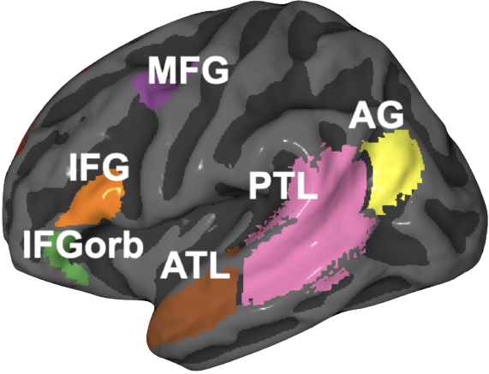
Neuro-Computational Models of Language Comprehension: characterizing similarities and differences between language processing in brains and language models
Subba Reddy Oota¹
¹Inria Bordeaux, France
Artificial
Biological
Mnemosyne (IMN-Team7)

Slide 2
Outline
Introduction to neural basis of language comprehesion
Deep neural networks and brain alignment: brain encoding and decoding
Research questions
Implications to Neuro-AI

Slide 3
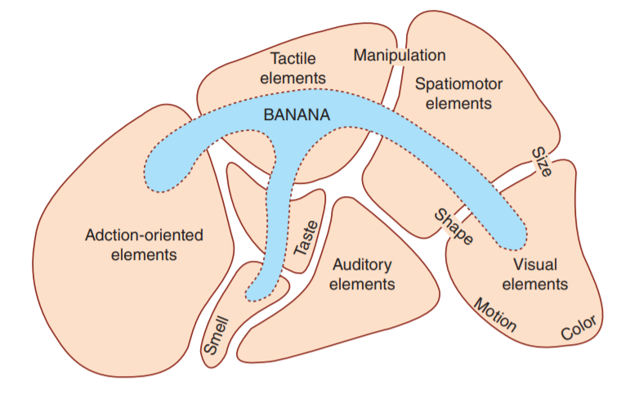
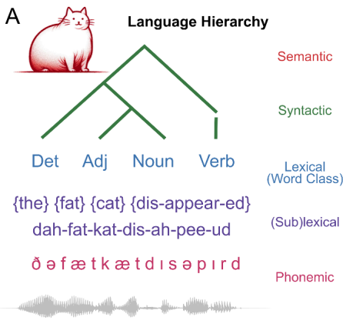
Mechanistic understanding of language processing in the brain: four big questions
What
When
Where
How
Notes:
Fundamental questions about what information is processed where, when, and how in the brain

Slide 4
Typical studies of language processing with controlled experiments
How the human brain computes and encodes syntactic structures?
Syntax: how do words structurally combine to form sentences and meaning?
Controlled experiments
Structured complex sentence
Word lists
I believe that you should accept the proposal of your new associate
thing very tree where of watching copy tensed they states heart plus
Pallier et al. 2011
Notes:
controlled experiments that design artificial stimuli to separate the brain activation
such as comparing structured complex sentences or phrases with word lists
many valuable findings and have identified several brain regions, including the left temporal lobe and the left frontal lobe, that are involved in syntactic structure building
However, as designing artificial stimuli can only separate situations with or without structurebuilding

Slide 5
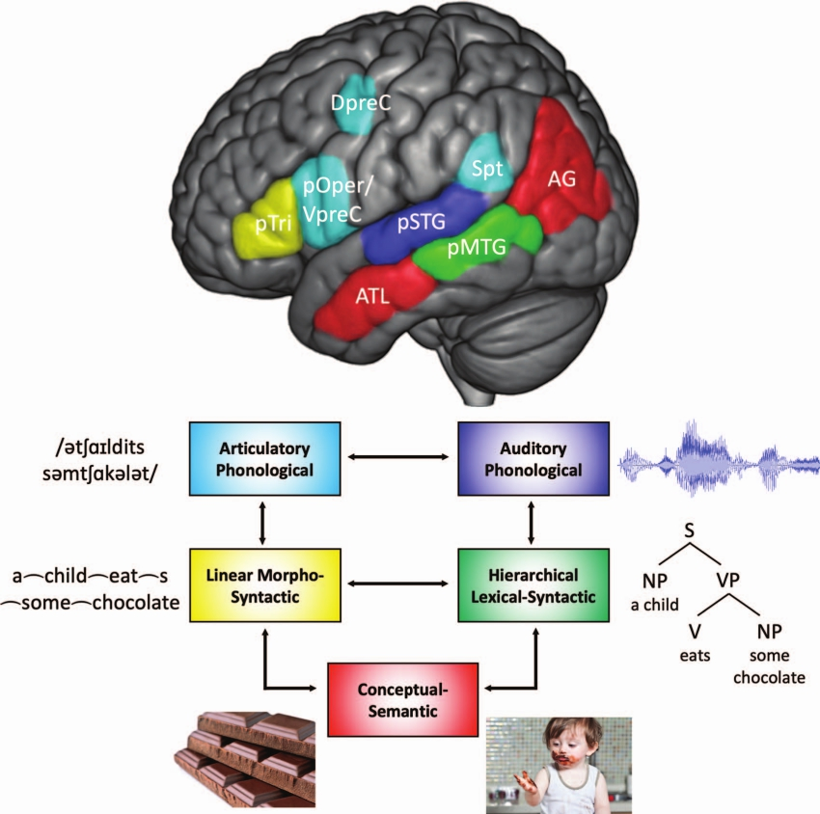
Language organization in the brain
Controlled experiments are task-based and not ecological
Brain process language at different features
Hierarchical syntactic information occurs in the cortical zone situated between auditory-phonological and semantic zones.
Matchin & Hickok et al. 2022

Slide 6
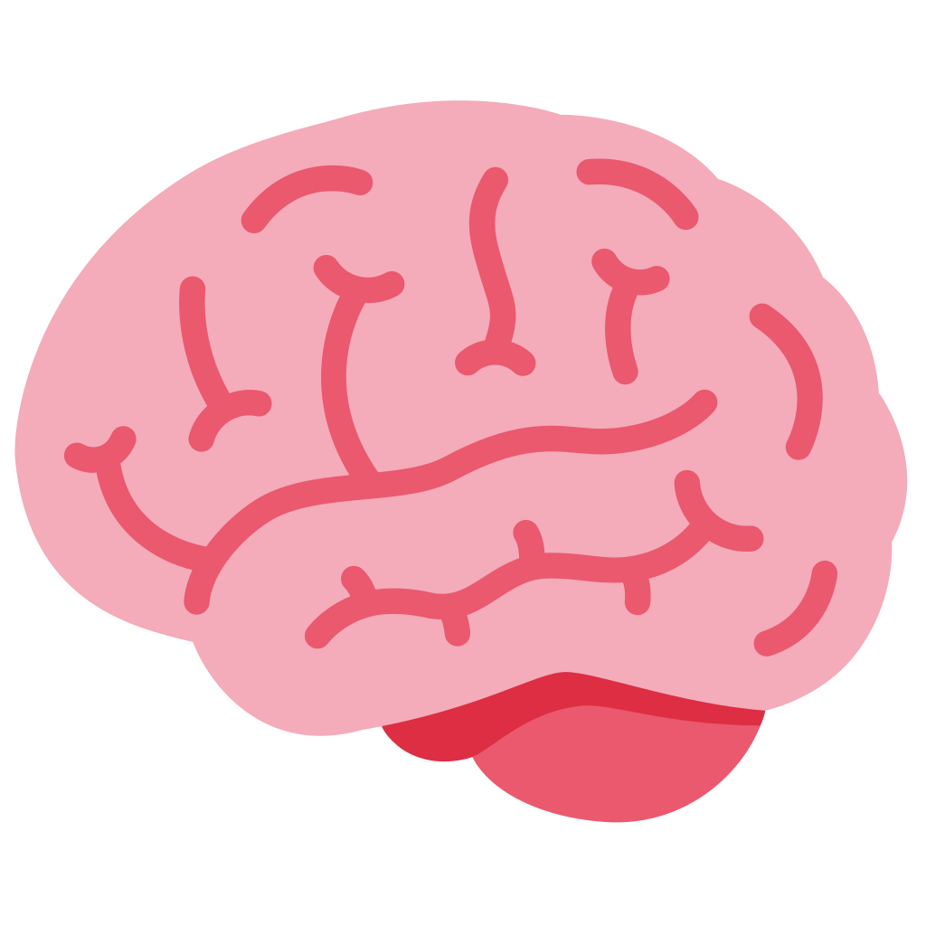
Increasingly available open source ecological stimuli datasets
With advancement of ecological stimuli datasets and open source language models, recent studies looked at interesting open questions?
?
?
Is the “how” of the NLP system the same as “how” of the brain?
How is information aggregated by the brain during language comprehension?
Deniz et al. 2019
Lebel et al. 2022
Nastase et al. 2021
Li et al. 2022
Zhang et al. 2021
Notes:
ecological stimuli -> reading books, listening to stories, watching a movie
The properties of the stimulus that affect brain activity are increasing, so simple representations of the stimuli capture less variance of the brain activity
Meanwhile we have huge progress in deep learning in the last 10 years that gives us AI models that can do many tasks. Of course they are not perfect, and are sometimes flawed, but there is the question of whether we can use their internal representations of the world as rich stimulus representations that perhaps capture some of the properties that are also relevant for the processing in the brain.
Here comes to encoding model

Slide 7
Language models are trained to predict missing words
jumps
Language model
The
quick
brown
fox
[MASK]
Notes:
These language models are trained to [Keep clicking]
predict missing words over millions of text documents.

Slide 8
Transformer: two popular language models (BERT & GPT-2)
Harry never thought he would
Harry never thought he ???
Devlin et al. 2018
Vaswani et al. 2017
Radford et al. 2019

Slide 9
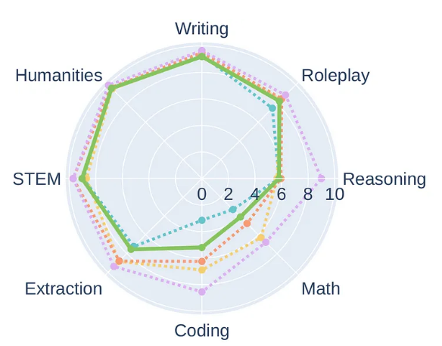
Emerging abilities of language models
Advantages are:
Deals with longer context lengths (e.g. 4096 sequence length in longformer model)
Models are pretrained on different domain specific datasets, and have reasoning capabilities
https://huggingface.co/HuggingFaceH4/zephyr-7b-beta

Slide 10
Extracting representation of a word from LMs
What layer should be considered?
How much context / what context ?
Attention heads, feed forward layers, Weight activations?
Devlin et al. 2018

Slide 11
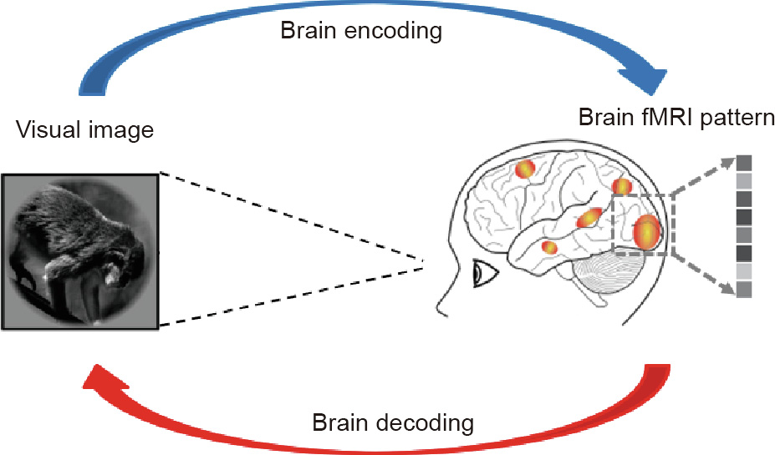
Brain Encoding and Decoding
How is the stimulus represented in the brain?
Reconstruct the stimulus, given the brain response?
Ivanova et al. 2022

Slide 12
Deep neural networks and brain alignment: brain encoding and decoding
Multimodal ecological stimulus
Deep learning system
A priori locations in DL system and brain
Data-driven encoding model
how are they related?
fMRI
Wehbe et al. 2014,
Jain and Huth 2018,
Gauthier and Levy 2019
Toneva and Wehbe 2019,
Caucheteux et al. 2020,
Toneva et al. 2020
Jain et al. 2020,
Schrimpf et al. 2021,
Goldstein et al. 2022
...

Slide 13
General encoding pipeline to evaluate brain-LM alignment
language model (LM)
a priori locations in NLP system and brain
Learn function
𝑥 alignment
~5000 words
fMRI
Test how well predicts unseen brain recordings
Brain alignment of a LM ⇒ how similar its representations are to a human brain’s
Wehbe et al. 2014,
Jain and Huth 2018,
Gauthier and Levy 2019
Toneva and Wehbe 2019,
Caucheteux et al. 2020,
Toneva et al. 2020
Jain et al. 2020,
Schrimpf et al. 2021,
Goldstein et al. 2022
...

Slide 14
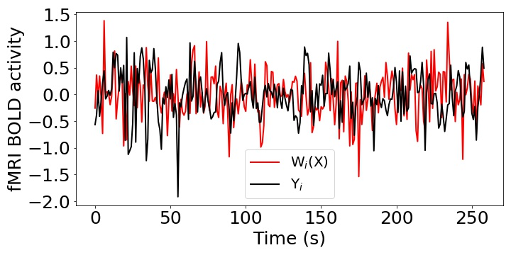
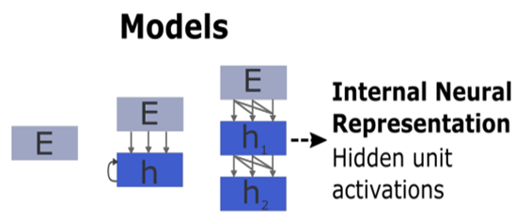
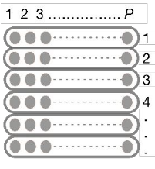
Encoding schema
Pearson Correlation (R) = Corr(Y, W(X))
Stimulus
Stimulus
Input
Present
X
W
Y
Input
Ridge Regression
Output

Slide 15
Encoding: training independent models
Independent model per participant
P1
P2
…
PN
Independent model per voxel / sensor-timepoint
P1, v1
P1, v2
…
P1, vm

Slide 16
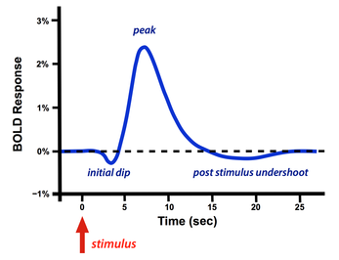
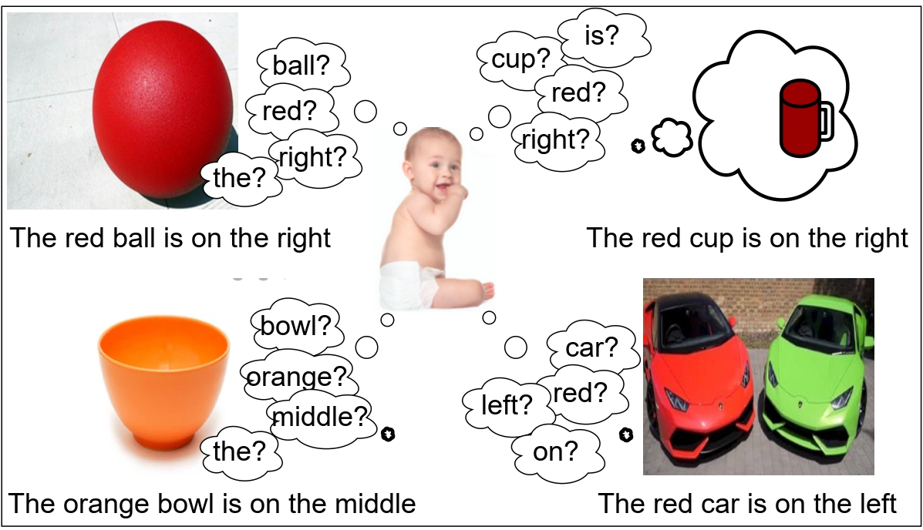
Research questions
?
?
?
Language models predict the next word from nearby words, but semantics are crucial for language comprehension.
Is the how brain utilizes context through time to process words during narrative story listening?
Do language models that process longer sequences align better with human participants during long narratives story listening?
How: ???
Do diverse language regions within the brain is impacted by delays?
Grounded language acquisition: how infants can learn language by observing their environments.
How does the model's ability to learn semantic concepts through cross-situational learning in noisy supervision?
fMRI measures BOLD suffers from delay due to Hemodynamic Response Function

Slide 17
Objectives
What happens during narrative story listening?
Whether a new word representation is combined with previous context?
We use MEG activity to trace
How is context represented in the brain?
How does previous context help for new word meaning?

Slide 18
With MEG we can analyze sub-word time course
MEG recording data at very fast temporal resolution
So, we can look at sub-word process
fMRI recording data at very high-spatial resolution
When
Where

Slide 19
Text: Word Contexts
[Context word]
[Context word]
Current word
Selected embedding
How to extract contextual word representions?
How does previous context help for new word meaning?
Isolating current word meaning is a type of intervention
1-word context
5-word context
Lag-1
Res-1
Past context
Future context

Slide 20
Listening data target: human brain MEG recordings
We use MEG-MASC story listening dataset:
27 subjects (8-subjects used),
4-stories (11,002 words)
Alignment performed between MEG signal and word representations around every word onset
800ms signal window around word onset: 200ms before (baseline correction), 600ms after
Laura Gwilliams, Graham Flick, Alec Marantz, Liina Pylkkanen, David Poeppel, Jean-Remi King. "MEG-MASC: a high-quality magneto-encephalography dataset for evaluating natural speech processing" Arxiv (2022).

Slide 21
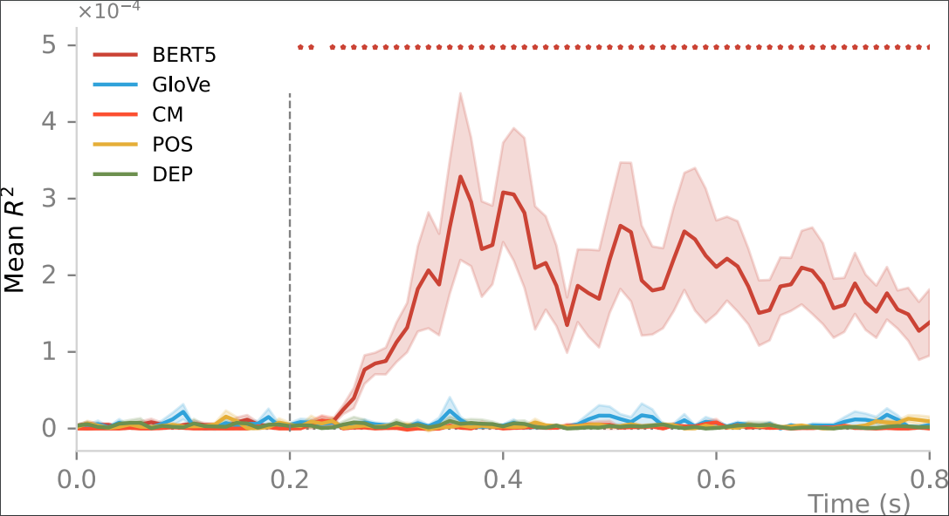
Encoding Performance of Syntactic and Semantic Methods
Simple syntactic features (Complexity Metric, Parts of Speech, Dependency tags)
Non-contextual word representations (GloVe)
BERT contextual representations
Due to limited context information, basic syntactic (CM, POS and DEP), and non-contextual semantic features (GloVe) are, on average, not correlated with the considered window of MEG activity

Slide 22
How is context represented in the brain
effect of direction
Long past contexts enable better encoding than future or short-scale present contexts

Slide 23
Contextual BERT Embeddings:
effect of length
Context length plays a crucial role in predicting MEG (300 to 425 ms).

Slide 24
Contextual BERT Embeddings (Residuals vs. Lag)
MEG is sensitive to mostly the current and previous words
Past word context is crucial in obtaining significant results.
Oota, Subba Reddy et al. 2023. "MEG Encoding using Word Context Semantics in Listening Stories."
Notes:
In this study, we propose novel multi-dimensional features that encode information about the syntactic structure of sentences.
First, we find that our syntactic structure-based features explain additional variance in the brain activity of various parts of the language system, even after controlling for complexity metrics that capture processing load.
At the same time, we see that regions well-predicted by syntactic features are distributed in the language system and are not distinguishable from those processing semantics.

Slide 25
Partial Conclusions
Similar to language models, human brain process words in time through close past words
By varying context lengths, we showed that semantics are crucial for brain language comprehension
Coherent with previous studies:
Gwilliams et al. 2022 showed that the several past phonemes information (with position and order in sequence) are kept in memory

Slide 26
Research questions
?
?
?
Language models predict the next word from nearby words, but semantics are crucial for language comprehension.
Is the how brain utilizes context through time to process words during narrative story listening?
Do language models that process longer sequences align better with human participants during long narratives story listening?
How: ???
Do diverse language regions within the brain is impacted by delays?
Grounded language acquisition: how infants can learn language by observing their environments.
How does the model's ability to learn semantic concepts through cross-situational learning in noisy supervision?
fMRI measures BOLD suffers from delay due to Hemodynamic Response Function

Slide 27
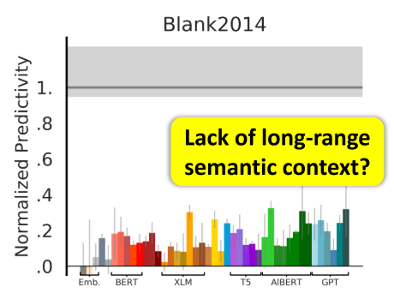
Can current language models deal with long-term dependencies?
Paragraphs
Stimulus
Transformer language models (BERT & GPT-2) are unable to handle the long-term dependencies
sequence length is fixed to 512 words
LSTMs still lacks investigation of the long-term memory cognitive plausibility and its link to fMRI data
Vaswani et al. 2017, Schrimpf et al. 2021

Slide 28
What kind of language models can represent long-term dependencies?
could they also predict higher cognition while subjects are engaged in longer stories ?

Slide 29
The data target: human brain recordings
We use Pieman story listening:
82 subjects,
282 TRs (repetition time)
here it is 1.5 sec.
Example: ''I began my illustrious carrier in journalism…''
Nastase et al. 2021 fMRI

Slide 30
Text: Feature Representaions
Static word
embeddings
Recurrent models
Semantic embeddings
Long Short-Term Memory Networks (LSTM)
Cell state (long memory)
Hidden state (short memory)
ELMo
Longformer
GloVe

Slide 31
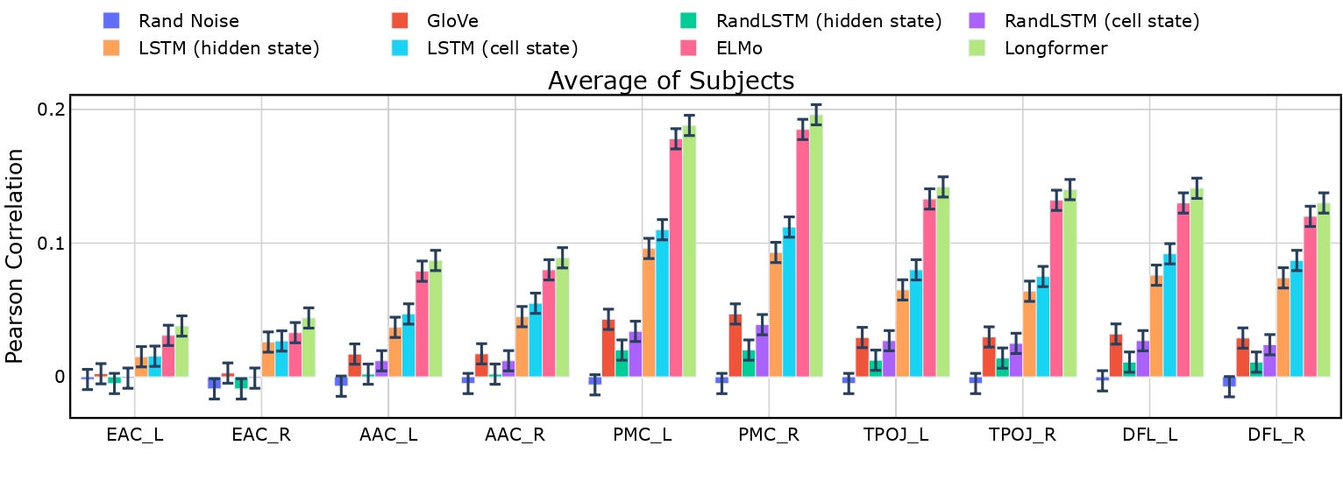
Encoding Performance of language models
Longformer model representations have high Pearson correlation across language rois and sensory regions (early auditory cortex)
LSTM cell state representations display better brain alignment than hidden state representations

Slide 32
Layer-wise encoding performance: Longformer
best alignment with fMRI in middle layers

Slide 33
Effect of context length on longer-context language models
Longformer
brain alignment improves only when we provide longer input contexts (5-100)

Slide 34
Partial Conclusions
Use human brain recordings to evaluate how well representations from language models (static vs. recurrent vs. pretrained) can predict representations of the human brain during language comprehension
Richer representaions learned from language models, designed to integrate longer contexts, have improved alignment with human brain activity
Pretrained language models significantly predict brain language regions that are thought to underlie language comprehension

Slide 35
Research questions
?
?
?
Language models predict the next word from nearby words, but semantics are crucial for language comprehension.
Is the how brain utilizes context through time to process words during narrative story listening?
Do language models that process longer sequences align better with human participants during long narratives story listening?
How: ???
Do diverse language regions within the brain is impacted by delays?
Grounded language acquisition: how infants can learn language by observing their environments.
How does the model's ability to learn semantic concepts through cross-situational learning in noisy supervision?
fMRI measures BOLD suffers from delay due to Hemodynamic Response Function

Slide 36
Hemodynamic Response Function (HRF) delay.
Current brain encoding studies focused on language processing at fixed HRF delay

Slide 37
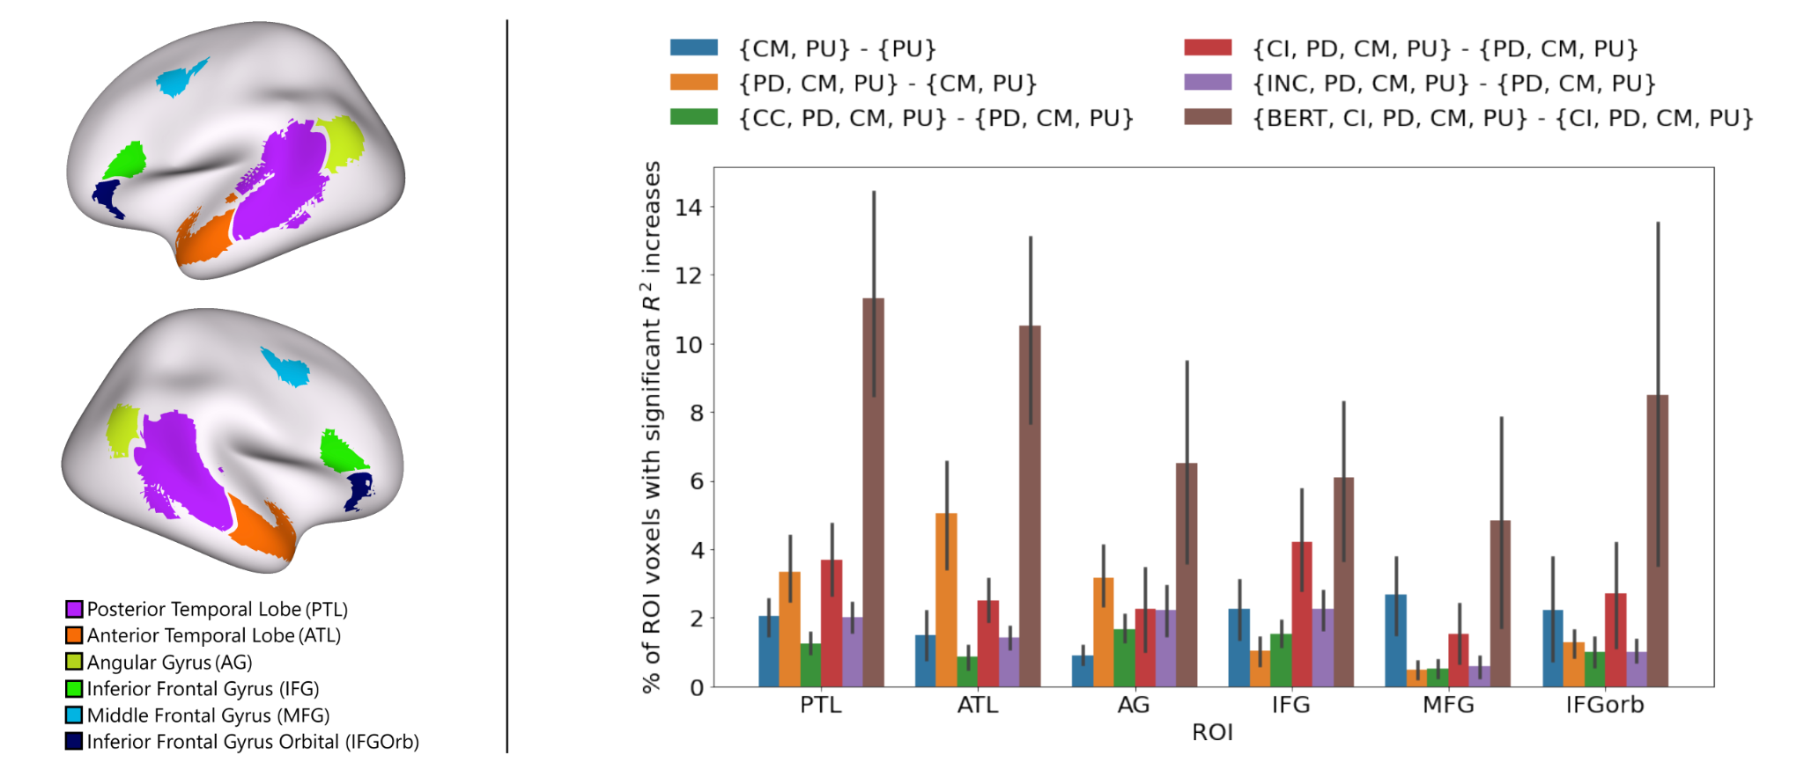
What information is processed across language regions at fixed HRF delay?
Reddy et al. 2021
How language processing within the brain is impacted by delays in the Hemodynamic Response Function (HRF)?
Can we distinguish syntax and semantics by varying delays?
Regions predicted by syntactic and semantic are difficult to distinguish

Slide 38
Text: Feature Representations
Basic word-level syntax
Basic speech features
Syntactic tree parsers
Semantic embeddings
Constituent Complete (CC)
Constituent Incomplete (CI)
Text models: BERT, GPT-2
LLaMa-2
Speech models: Wav2Vec2.0
Part-of-Speech Tags (POS) & Dependency Tags (DEP)
Phonological

Slide 39
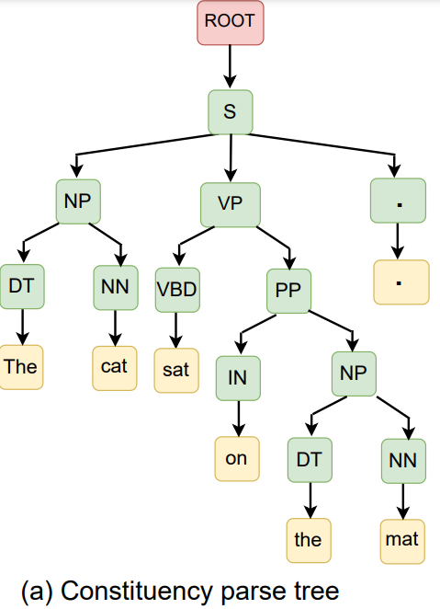
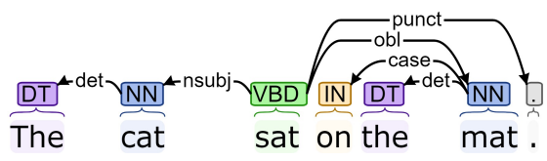
Syntactic Parising
Syntax: how do words structurally combine to form sentences and meaning?
In natural language processing, there are two popular syntactic parsing methods
Constituency parsing
Dependency parsing

Slide 40
Listening data target: human brain recordings
We use Tunneling story:
22 subjects,
1023 TRs (repetition time)
here it is 1.5 sec.
Example: ''I began my illustrious carrier in journalism…''
Language Network
[Fedorenko et al. 2010, 2014]
Nastase et al. 2021
Notes:
we analyze data from 82 subjects listening to the story titled ‘PieMan’ with 259 TRs (repetition time – fMRI recorded every 1.5 sec.).

Slide 41
Normalized Predictivity
Schrimprf et al. 2021

Slide 42
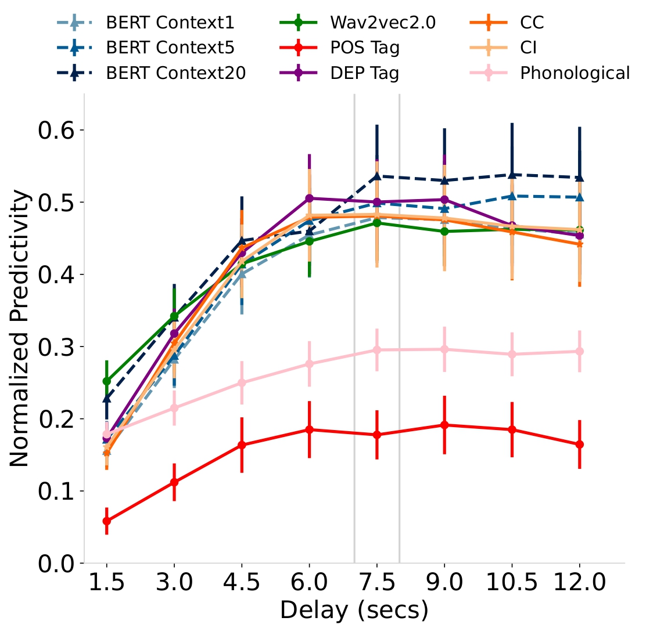
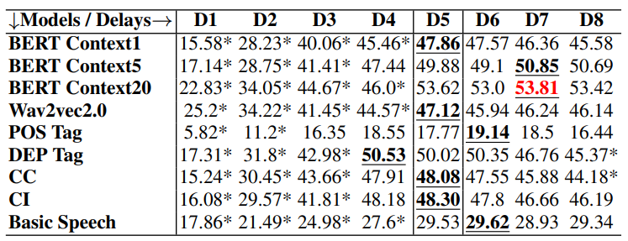
How language processing within the brain is impacted by delays in the Hemodynamic Response Function (HRF)?
Syntactic embeddings, including CC and CI, show higher brain activity in the early delays, particularly D4, with a decrease in activity at later delays (D6-D8).
BERT wth Context 20 performs the best, implying that brain predictivity improves with increasing context length.

Slide 43
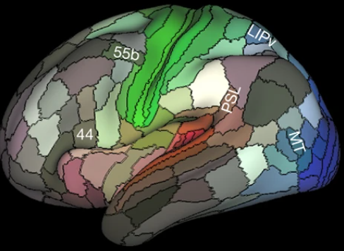
Can we distinguish syntax and semantics by varying delays?
Higher normalized predictivity is observed for syntactic embeddings at D4 for 44 and 45 regions
45
IFJa region process syntax in early delays and semantics in later delays
IFSp region process semantics in later delays (D5-D8)
IFJa
IFSp

Slide 44
Partial Conclusions
In ecological setting, our findings are consistent with Hierarchy of language processing (Matchin & Hickok)
Different optimal HRF delays for processing of syntax (6 secs) and semantics (> 7.5 secs) at early and later delays, respectively
Detailed region and sub-region analysis reveal that longer context may play a significant role in higher HRF delays

Slide 45
Research questions
?
?
?
Language models predict the next word from nearby words, but semantics are crucial for language comprehension.
Is the how brain utilizes context through time to process words during narrative story listening?
Do language models that process longer sequences align better with human participants during long narratives story listening?
How: ???
Do diverse language regions within the brain is impacted by delays?
Grounded language acquisition: how infants can learn language by observing their environments.
How does the model's ability to learn semantic concepts through cross-situational learning in noisy supervision?
fMRI measures BOLD suffers from delay due to Hemodynamic Response Function

Slide 46
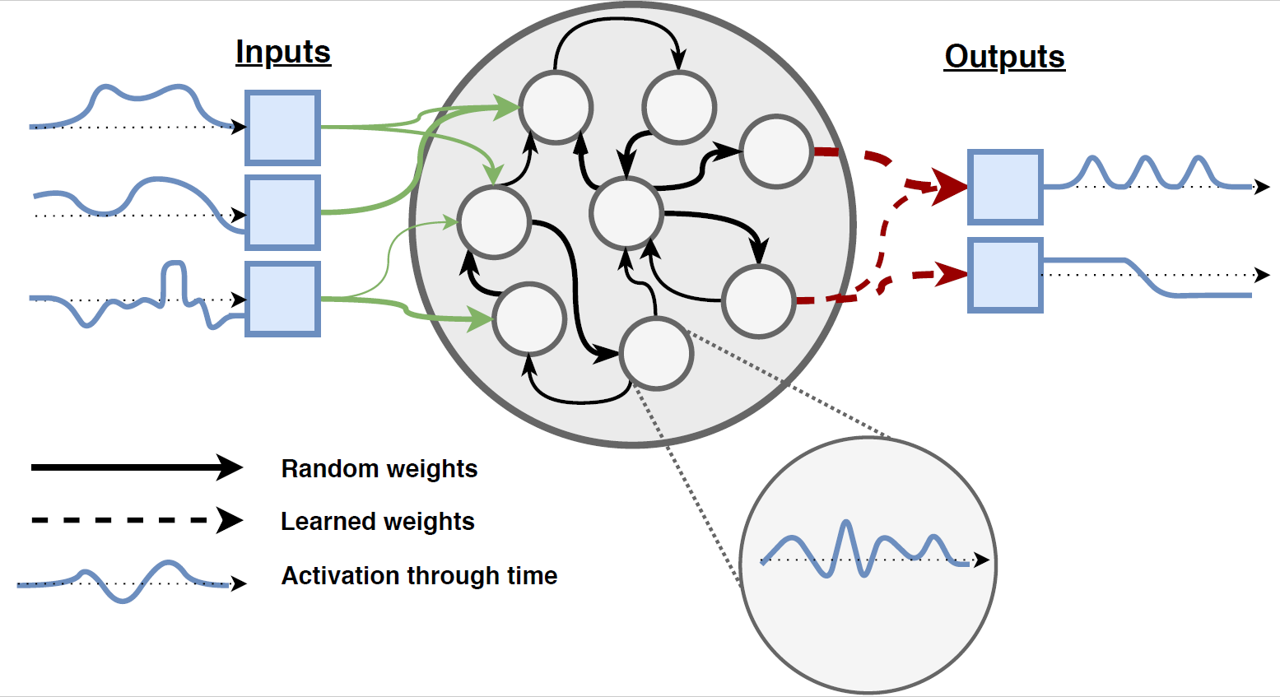
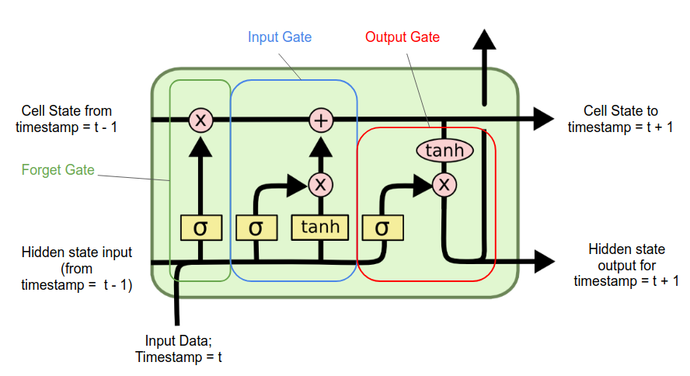
How language models can perform grounded language acquisition?
We employ CSL task using two sequence-based language models:
Echo State Networks (i.e. Reservoir Computing)
Long Short-Term Memory Networks (LSTM)
Notes:
ESNs are able to learn and process word by word
LSTM can process word by word (but not learn word by word)

Slide 47
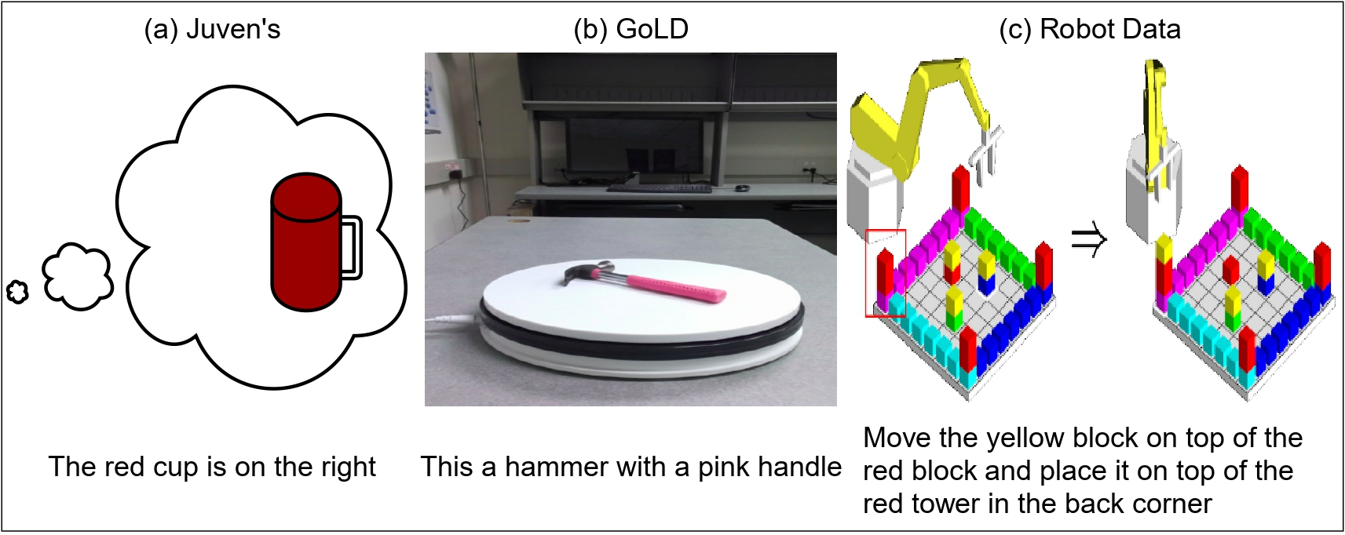
Grounded language datasets
Dataset with simple sentences

Slide 48
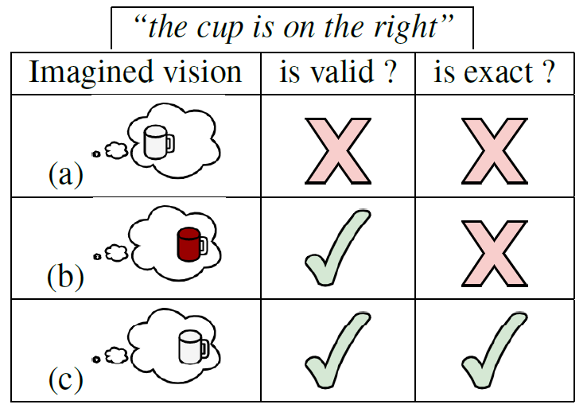
Evaluation metric

Slide 49
CSL Task: Noisy supervision output
The target is a noisy supervision vector that contains additional concepts that are not present in the input sentence

Slide 50
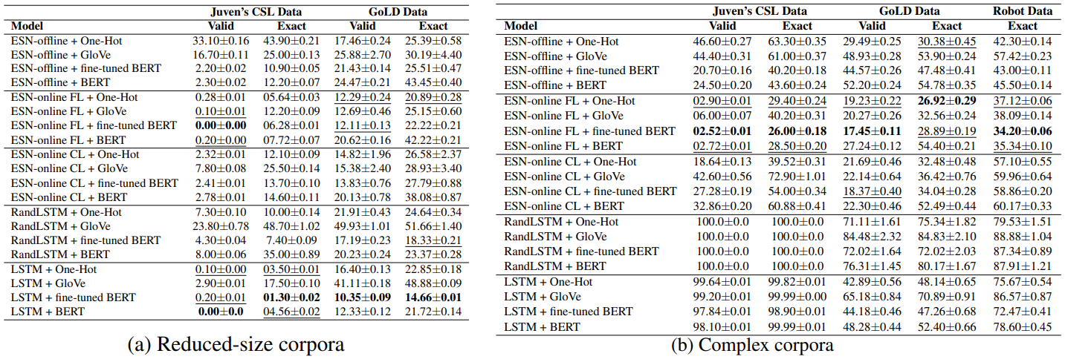
Results
LSTM outperforms the ESN on both Valid and Exact errors on Juven’s and GoLD datasets
ESN-online FL performed significantly better than ESN-online CL and offline methods.
ESN-online FL outperformed all the models
Smaller vocabulary of objects: (4 for Juven’s; 10 for GoLD
Larger vocabulary of objects (50 for Juven’s; 47 for GoLD, 11 for Robot Data)

Slide 51
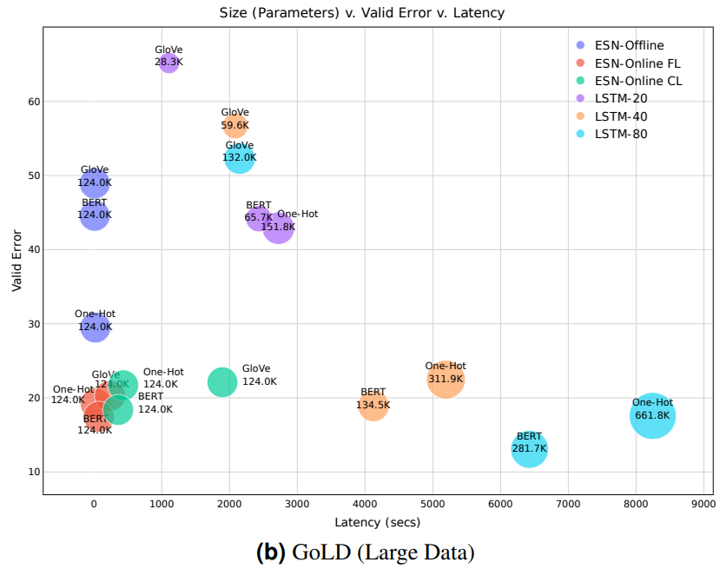
Parameters vs. Valid Error vs. Training Latency
ESN-online FL model showcases lower valid error using 124K parameters with a model training latency of 64 seconds
ESN model has better computational complexity in terms of latency and model size.

Slide 52
Partial Conclusions
Biologically plausible ESNs have a better trade-off on all three grounded language datasets with better prediction error and low latency.
Fine-tuned BERT representations are more efficient at capturing complex relationship between words.
ESNs with online learning models are making better predictions during the processing of a sentence.

Slide 53
Implications to Neuro-AI
NLP -> Neurolingustics
Neurolingustics -> NLP
Disentangling representations allowed us to distinguish syntactic and semantic peaks across language regions at different HRF delays
Need LM with deeper understanding of how humans relate characters, discourse during long narratives
Need LM models to better evaluate meaningful explainable variance for individual participants
Contextual representations allowed us to indicate that alignment with MEG depends on past context.
Need better speech models for end-to-end language comprehension.
Notes:
. suggesting that past events are retained in memory in speakers brain to distinguish future events.
In language regions, the alignment of speech models trails behind text models.

Slide 54
Thank You
Questions?

Slide 55
Outline
Introduction to neural basis of language comprehesion
Language processing with controlled experiments
Ecological stimuli datasets
Deep neural networks and brain alignment: brain encoding and decoding
Pipeline to evaluate language in brain and language in machines
Research questions
Implications

Slide 56
Research questions
How human brain utilizes contextual information through time to process words during narrative story listening?
Do language models that process longer sequences align better with human participants during long narrative story listening?
How the intricate processing of diverse language regions within the brain is impacted by delays in the Hemodynamic Response Function (HRF)?
How model's ability to learn semantic concepts through cross-situational learning in noisy supervision?

Slide 57
Research questions
How human brain utilizes contextual information through time to process words during narrative story listening?
Do language models that process longer sequences align better with human participants during long narrative story listening?
How the intricate processing of diverse language regions within the brain is impacted by delays in the Hemodynamic Response Function (HRF)?
How model's ability to learn semantic concepts through cross-situational learning in noisy supervision?

Slide 58
Research questions
How human brain utilizes contextual information through time to process words during narrative story listening?
Do language models that process longer sequences align better with human participants during long narrative story listening?
How the intricate processing of diverse language regions within the brain is impacted by delays in the Hemodynamic Response Function (HRF)?
How model's ability to learn semantic concepts through cross-situational learning in noisy supervision?

Slide 59
Research questions
How human brain utilizes contextual information through time to process words during narrative story listening?
Do language models that process longer sequences align better with human participants during long narrative story listening?
How the intricate processing of diverse language regions within the brain is impacted by delays in the Hemodynamic Response Function (HRF)?
How model's ability to learn semantic concepts through cross-situational learning in noisy supervision?

Slide 60
Research questions
How human brain utilizes contextual information through time to process words during narrative story listening?
Do language models that process longer sequences align better with human participants during long narrative story listening?
How the intricate processing of diverse language regions within the brain is impacted by delays in the Hemodynamic Response Function (HRF)?
How model's ability to learn semantic concepts through cross-situational learning in noisy supervision?

Slide 61
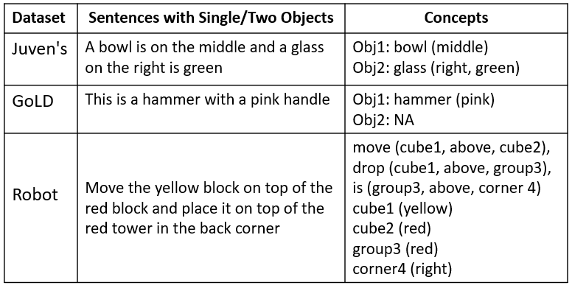
Evaluation metric
Example sentences with concepts

Slide 62
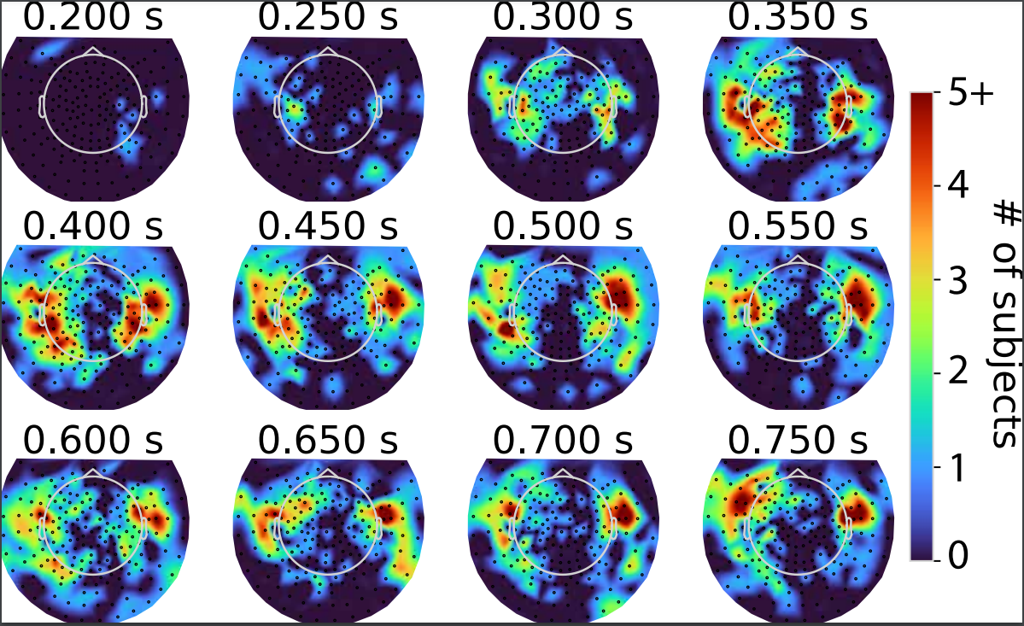
BERT predicted topomaps (significative predictions per subject)
Best brain MEG alignments are in the bilateral temporal and frontal regions between 250ms to 750ms (word onset is at 200ms).

Slide 63
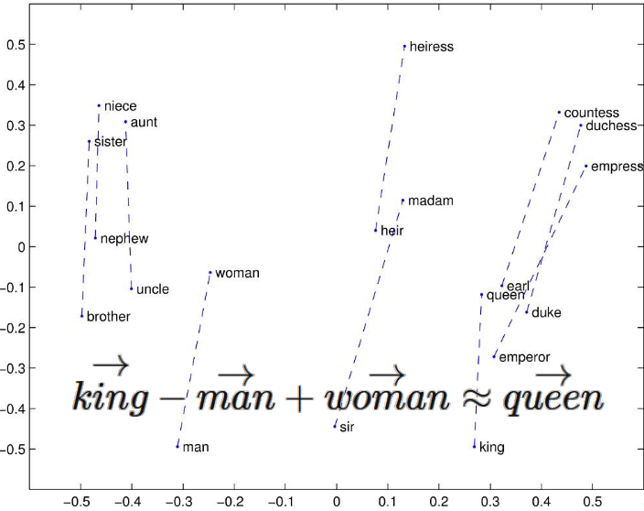
Models considered (n = 5)
Embedding type models: GloVe
GloVe
e.g. Pennington et al. 2014 | Hochreiter et al. 1997 | Peters et al. 2018 | Beltagy et al. 2020

Slide 64
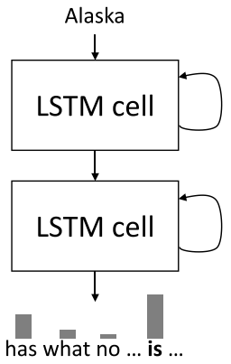
Models considered (n = 5) Contd.
Embedding type models: GloVe
Recurrent type models: LSTM, RandLSTM
Long Memory
Short
Memory
LSTM
e.g. Pennington et al. 2014 | Hochreiter et al. 1997 |Peters et al. 2018 | Beltagy et al. 2020

Slide 65
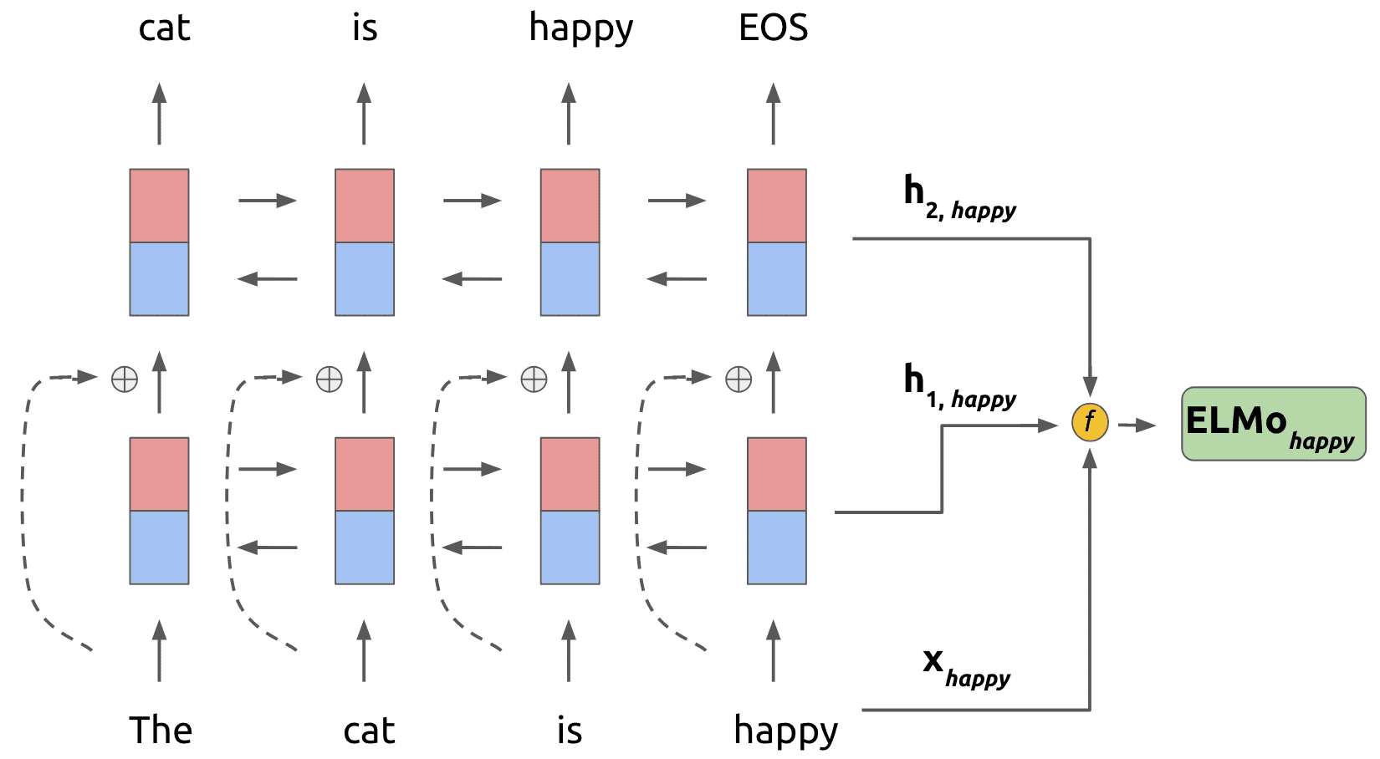
Models considered (n = 5) Contd.
Embedding type models: GloVe
Recurrent type models: LSTM, RandLSTM
Contextualized pretrained models: ELMo, Longformer
Layer-2
Layer-1
ELMo
e.g. Pennington et al. 2014 | Hochreiter et al. 1997 | Peters et al. 2018 | Beltagy et al. 2020

Slide 66
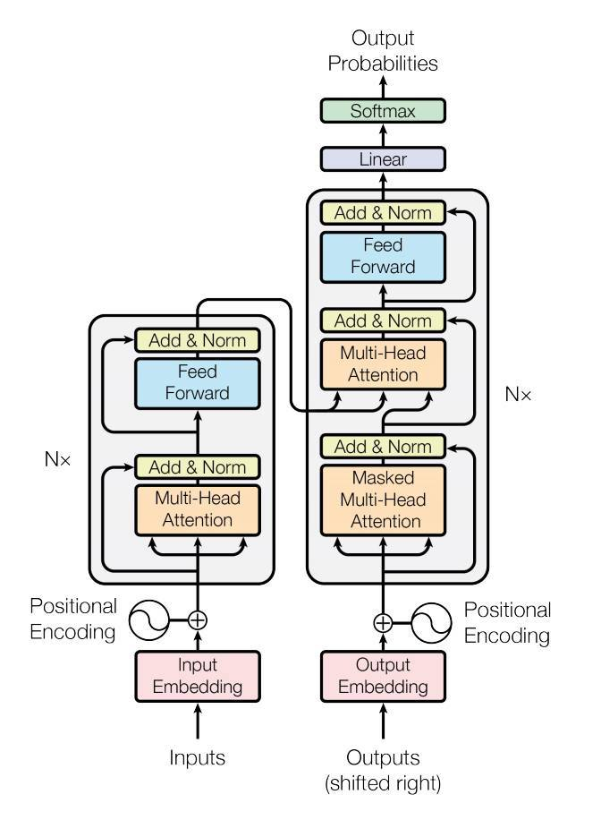
Models considered (n = 5) Contd.
Embedding type models: GloVe
Recurrent type models: LSTM, RandLSTM
Contextualized pretrained models: ELMo, Longformer
Longformer: Transformer with Global + local sliding window
e.g. Pennington et al. 2014 | Hochreiter et al. 1997 | Peters et al. 2018 | Beltagy et al. 2020

Slide 67
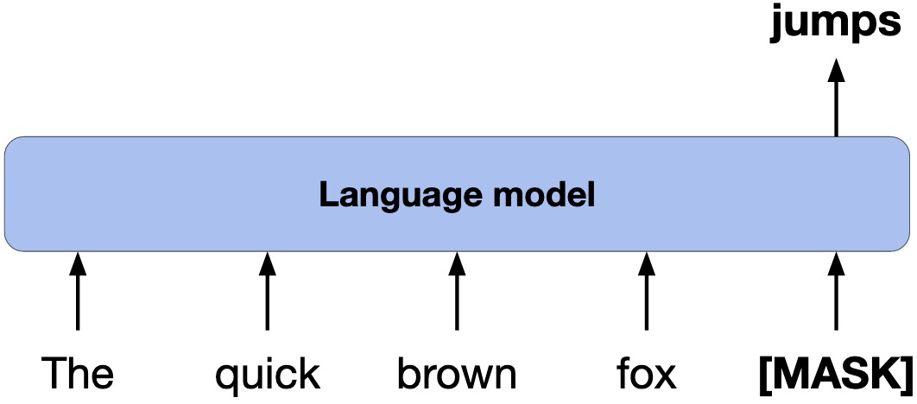
Brain encoding: survey tree
Model trained with language modeling
Use model’s internal layer activations to predict brain activity
input
Notes:
researchers have shown that pretrained language models significantly predict large parts of the brain regions that are thought to underlie language comprehension

Slide 68
Brain encoding: survey tree (Contd.)
Model trained to summarize narratives
Use model’s internal layer activations to predict brain activity
input

Slide 69
Brain encoding: survey tree (Contd.)
Model trained with language modeling
part-of-speech
+
semantic role
input
+
dependence on other words
+
Use syntax/semantic to predict brain activity
...

Slide 70
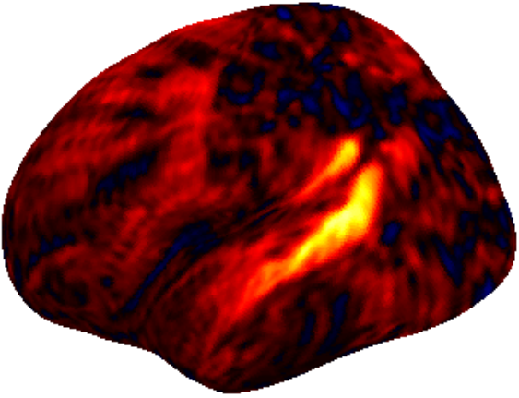
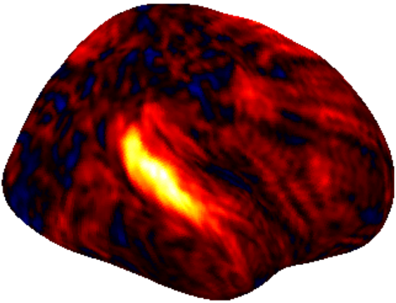
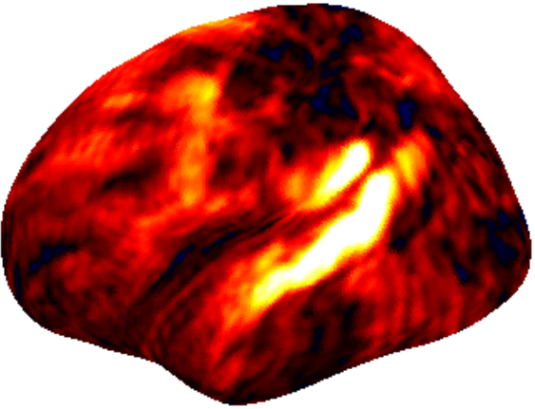
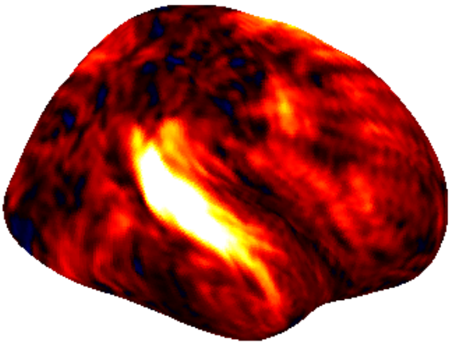
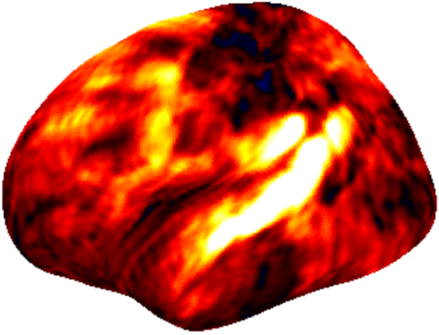
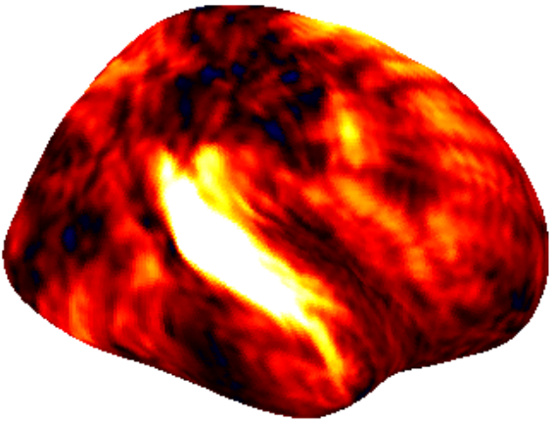
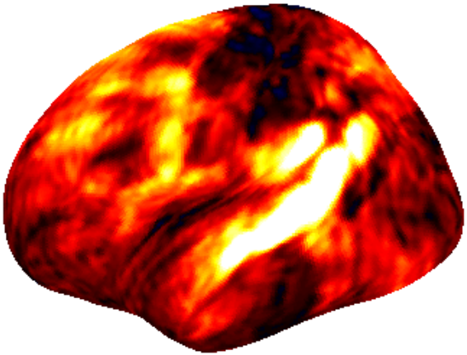
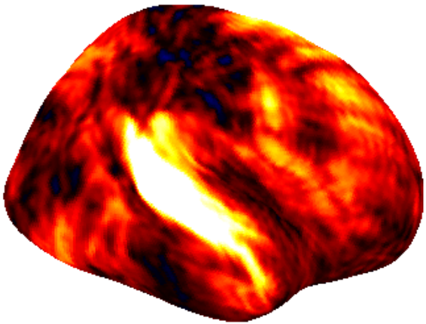
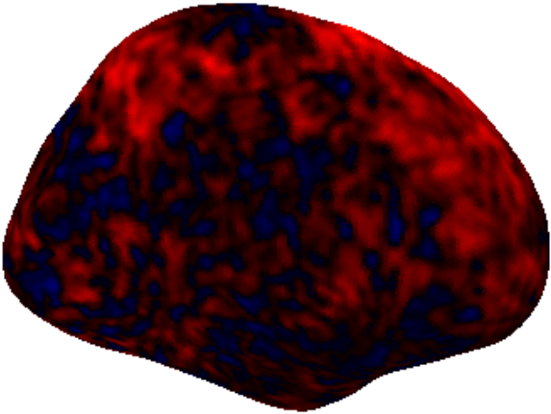
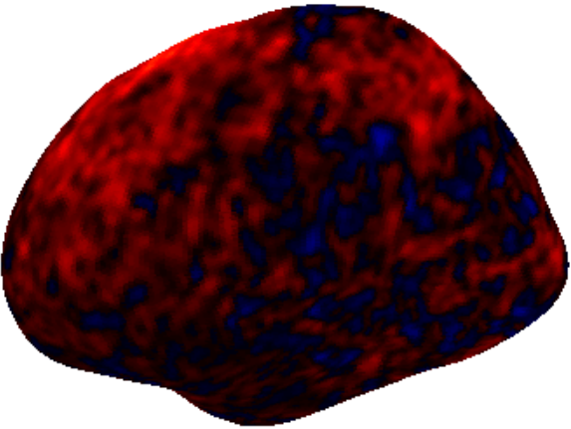
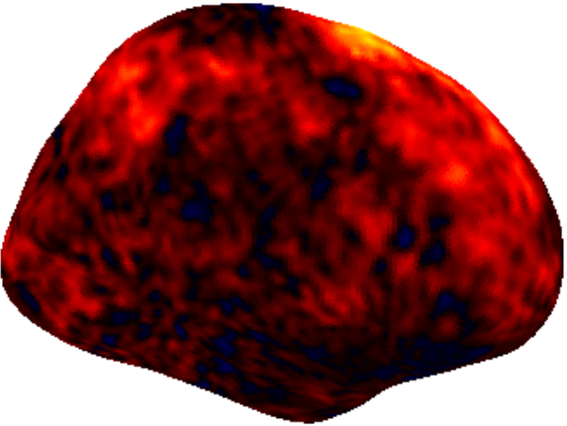
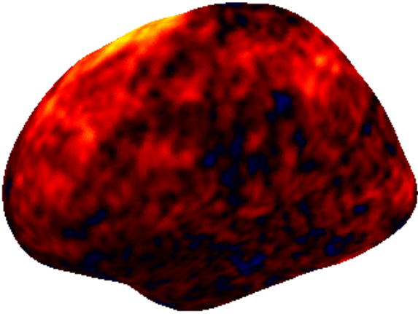
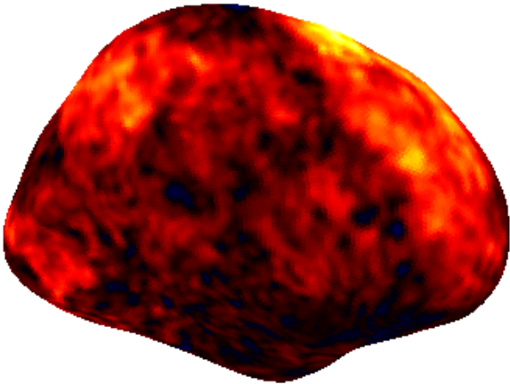
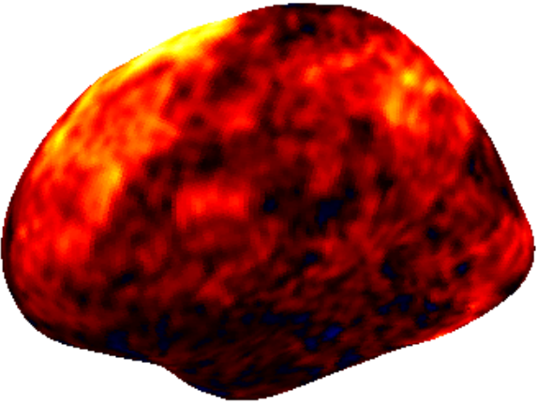
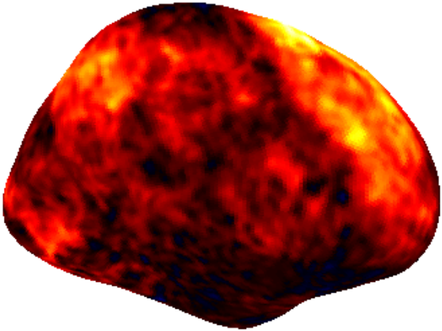
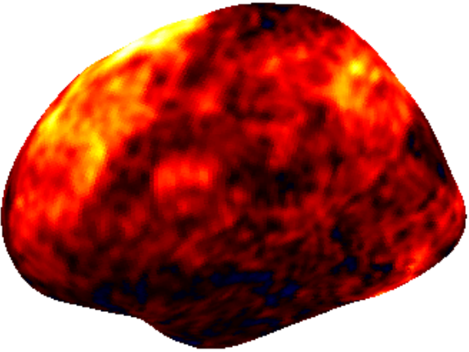
Hierarchical syntax encoded in language ROIs at early delays
Delay1
Delay2
Delay3
Delay4
Delay5
Delay6
Delay7
Delay8

Slide 71
Contextual embeddings BERT encoded in language ROIs at later delays
Delay1
Delay2
Delay3
Delay4
Delay5
Delay6
Delay7
Delay8

Slide 72
Cross-situational learning (CSL)?
Grounded language acquisition: how infants can learn language by observing their environments.

Slide 73
How language models can perform grounded language acquisition?
The Cross-Situational Learning (CSL) task tested with Recurrent Neural Networks (ESNs and LSTMs).

Slide 74
Brain alignment – 4-fold Cross-Validation + Ridge regression
957 words x 768 ⇒ Longformer representations
Downsample from word-level representations to TR-level (taken every 1.5s)
282 fMRI time intervals x 768
Concatenate LM representations for previous 5 TRs ⇒ fMRI response from brain activity peaks about 7.5 seconds after stimulus onset
282 fMRI intervals x 81924 voxels ⇒ fMRI predictions (same dimensions as actual brain activity)
82 participants
(1) Narratives Pieman story
(3) 4-fold Cross-Validation
(2) Brain Alignment: Dataset Curation

Slide 75
Word Contexts: Lag
[Context word]
[Context word]
Current word
Selected embedding
How does previous context help for new word meaning?
Lag-1
Lag-2
Past context
Future context

Slide 76
Word Context: Residuals
Isolating current word meaning is a type of intervention
Res-1
Res-2
Past context
Future context
Notes:
Residuals are opposite no ?

